Slide 1
Zeroing In: Focusing on Teen Needs
Amelia M. Anderson, PhD
Assistant Professor
Old Dominion University
Twitter: @ameliamaclay
Abigail L. Phillips, PhD
Assistant Professor
University of Wisconsin-Milwaukee
Twitter: @abigailleigh
Notes:
A bit of a mish mash of our research
Usually we focus on one study, opportunity to show much more and how research and practice inform one another

Slide 2
Why We Submitted This Proposal
Our research focuses (for the most part) on underserved, neurodivergent, at-risk youth.
Share useful and practical findings
Practitioner-geared research
Social-emotional learning, support, mentorship
Teens will become emerging adults – what are their needs?

Slide 3
Research Informing Practice; Practice Informing Research
Highlights of Research (to date)
Librarian empowering youth with ASD and other neurodivergent youth (programming, services, etc.) (Philips & Anderson, to appear (a))
Programming and tailored services for neurotypical and neurodivergent youth (Anderson & Phillips, to appear (b))
Youth librarians and library staff demonstrating empathy as an everyday practice (Phillips, 2017)
Meeting teens where they are (Anderson & Phillips, 2019)
Learning from the experiences, reflections, and insights from librarians
Notes:
Define neurotypical (not displaying or characterized by autistic or other neurologically atypical patterns of thought or behavior.)
neurodiverse (displaying or characterized by autistic or other neurologically atypical patterns of thought or behavior; not neurotypical.)
From the autism community
Research practice partinerships

Slide 4
LISTENING TO TEENS!
Notes:
Big takeway away, mention danah boyd = INCLUSIVE– ethnography, researching with teens, not ON teens (librarians do something similar)
What do do teens what from librarians?
Educational resource
Traditional support
Advocate
Teachers, parents, and school administration
Empathy
Understanding

Slide 5
Emerging Themes
Collaboration is key.
School libraries supplementing public libraries services; Public libraries supplementing school curriculum
Working with the community
Not a solo effort; partnerships and collaborations
Education - working with diverse youth
What is the librarians’ role? What is their responsibility?
Varying by community? Community needs?
Who are the youth in your community?
Notes:
Community partnerships
Working with schools, police, parents, youth leaders, mental health professionals

Slide 6
Librarianship & the Underserved, Overlooked Teen
Role of empathy in librarianship
Important, but often unacknowledged, role of empathy in the everyday work of school and public librarians
Empathetic services – “Structured activities carried out one-on-one or in groups in which the role of the librarian is to provide empathy during these interactions.” (Phillips, 2017, pp. )
Librarians as a source of support
Librarians often overlooked, relegated to “other adults” classification
Provide social, emotional, and psychological support to patrons
Notes:
Stole from my DIS, seemed to apply

Slide 7
“So thinking about what this role is, as it keeps growing. You know, are librarians' social workers? Are we teachers? I would say there are aspects of social work in teaching, in our jobs, right. But then when it comes to our capacity, so not just our role, and what our role is, do we have support from our management to do or try new things that might not be in the typical scope of what being a librarian is. You know, do we have the capacity to continue on with all of these things, while we’re still doing summer reading. We’re still ordering books. We’re still helping the public. So you’re just balancing. Balancing to make sure we don’t over commit ourselves and we’re really trying to serve our community and align the library with what’s important in our community, and that could be different no matter what our communities are, across the country. “
~Rachel*, Midwestern Public Librarian
*pseudonym

Slide 8
Let’s Talk!
Case studies from your libraries or experiences
Thinking beyond the Teen Space
Failures (learning opportunities)
Approaches to getting to know your teen patrons
Tough/sensitive topics
Community assessment
Plans within your library for engaging with teens in forward focusing programs, services, etc.
Managing the many, many roles
Taking of yourself
Best practices or what’s worked for you and your teens
Where do we go from here?
Notes:
Discussion points for people to get into groups of 2-3-4 depending on audience

Slide 9
In response to how librarians can help: “I think the most organic way is just conversation. You’ve got a kid that comes in on a weekly basis and you develop a relationship with that person. That’s the easiest way to go about being a kind of advocate or support system for that person if they’re dealing something”
~David*, Southeastern Teen, 18
*pseudonym
Notes:
Stole from my DIS, seemed to apply
And it made me cry

Slide 10
Thank you! Contact Us!
Abigail Phillips, PhD
University of Wisconsin-Milwaukee
abileigh@uwm.edu
@abileigh
Amelia Anderson, PhD
Old Dominion University
amanders@odu.edu
@ameliamaclay
Thank you to YALSA!
Funding from Frances Henne Grant, 2018

Slide 11
References (in lovely APA)
Anderson, A., &. Phillips, A. (to appear). “Getting basic information isn't actually as helpful as the nuanced advice we can give each other”: Teens with autism on digital citizenship education. Journal of Research on Libraries and Young Adults.
Anderson, A. & Phillips, A. (2019). Meeting teens where they are: Video ethnography as research approach. Paper presented at iConference 2019: Inform. Include. Inspire. Washington, D.C.
boyd, d. (2014). It's complicated: The social lives of networked teens. New Haven, CT: Yale University Press.
Phillips, A., & Anderson, A. (to appear). Cyberbullying, digital citizenship, and youth with Autism: LIS education as a piece in the puzzle. Library Quarterly.
Phillips, A. (2017). Understanding empathetic services: The role of empathy in everyday library work. Journal of Research on Libraries and Young Adults, 8(1).

Slide 12
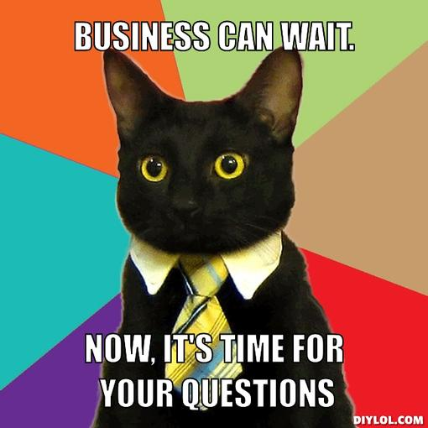
#twogoodfriends

Slide 13
Many school and public libraries are being asked to do more with less. Identifying and honing in on teens’ greatest needs can help prioritize service and mobilize resources. While teen needs often vary from community to community, all teens can benefit from building social and emotional skills that will help them succeed in school, college, and future careers. Libraries can leverage collections, services, programs, community partnerships and more to help teens build skills around self-awareness, self-management, responsible decision-making, relationships, and social awareness. In this session, we will explore how libraries can best support teens’ social and emotional learning to help them effectively navigate a challenging world.

