Slide 1
Y.A.K. About It!
Rachel Pollari & Shanel Slater
Marion Public Library, Iowa
Notes:
https://marionpubliclibrary.org/teens/teen-programs

Slide 2
This Session
We hope: to start a discussion about empathy-driven tools and talking circles that you can adapt for your library and community​
Roadmap:​
Introduction to us and our community’s needs
Talking Circle framework
Y.A.K. at your library
Notes:
This is a presentation about talking circles and their implementation in our public library programming for teens. Our specific program is called Y.A.K., which stands for “Youth Advocating Kindness.”

Slide 3
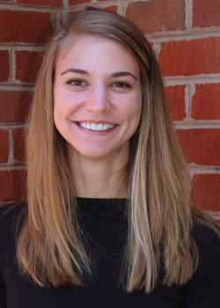
Who Are We?
Not the experts
Limited lived experiences:
White, cisgender, able-bodied
Talking Circle tradition
is not our creation
Rachel Pollari​
Full-Time Teen Services Assistant​
she/her/hers
rpollari@marionpubliclibrary.org
Shanel Slater​
Part-Time Teen Services Specialist​
she/her/hers
sslater@marionpubliclibrary.org​
Notes:
It is necessary to acknowledge our perspectives. We're certainly not the experts, and our perspectives are limited to our life experiences.
This is in contrast to our teens, who come from a variety of backgrounds, genders, abilities, and racial identities. Our Talking Circle program aims to build a space in which teens can be vulnerable, open, and honest. Having an understanding of our own privilege and authority in relation to our teens is SO important to consider in Talking Circles and in all aspects of librarianship. This is a continual process of unlearning biases, owning up to mistakes, seeking further education, and listening to community advocates.
We’d also like to acknowledge that the Circle process that many non-Native people are using today is rooted in the tradition of talking Circles that Indigenous Peoples in North America use and have used for centuries. Different Native Peoples practice different forms of the Circle process. We want to respectfully acknowledge the origin of Circle history and implementation as we share how we interpret it in our community.
We’d also like to respectfully acknowledge the Quapaw and Chikashsha Yaki People, who have stewarded this land throughout the generations.

Slide 4
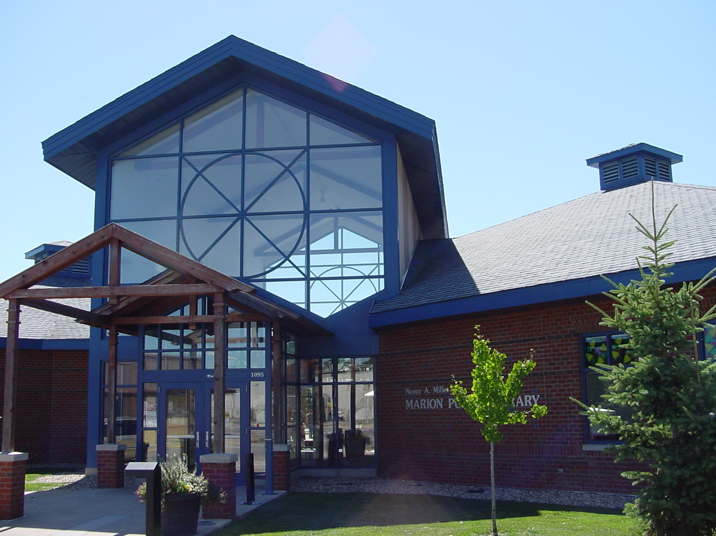
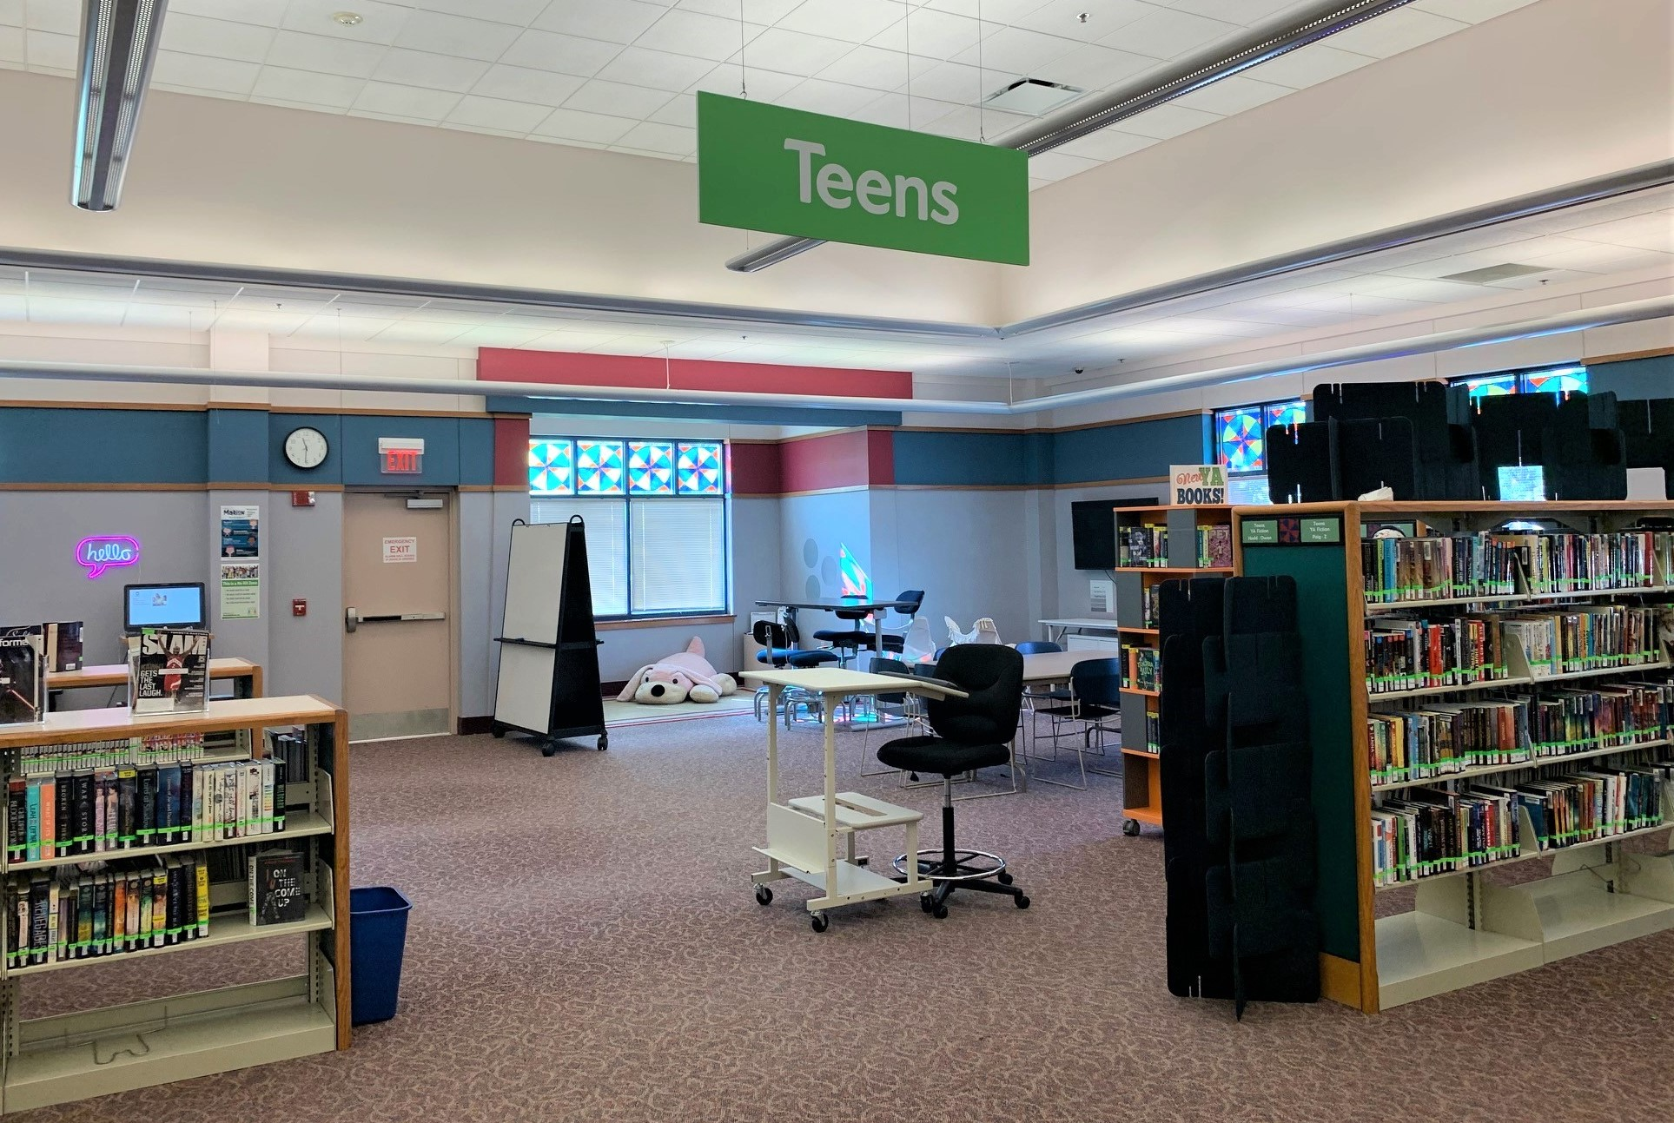
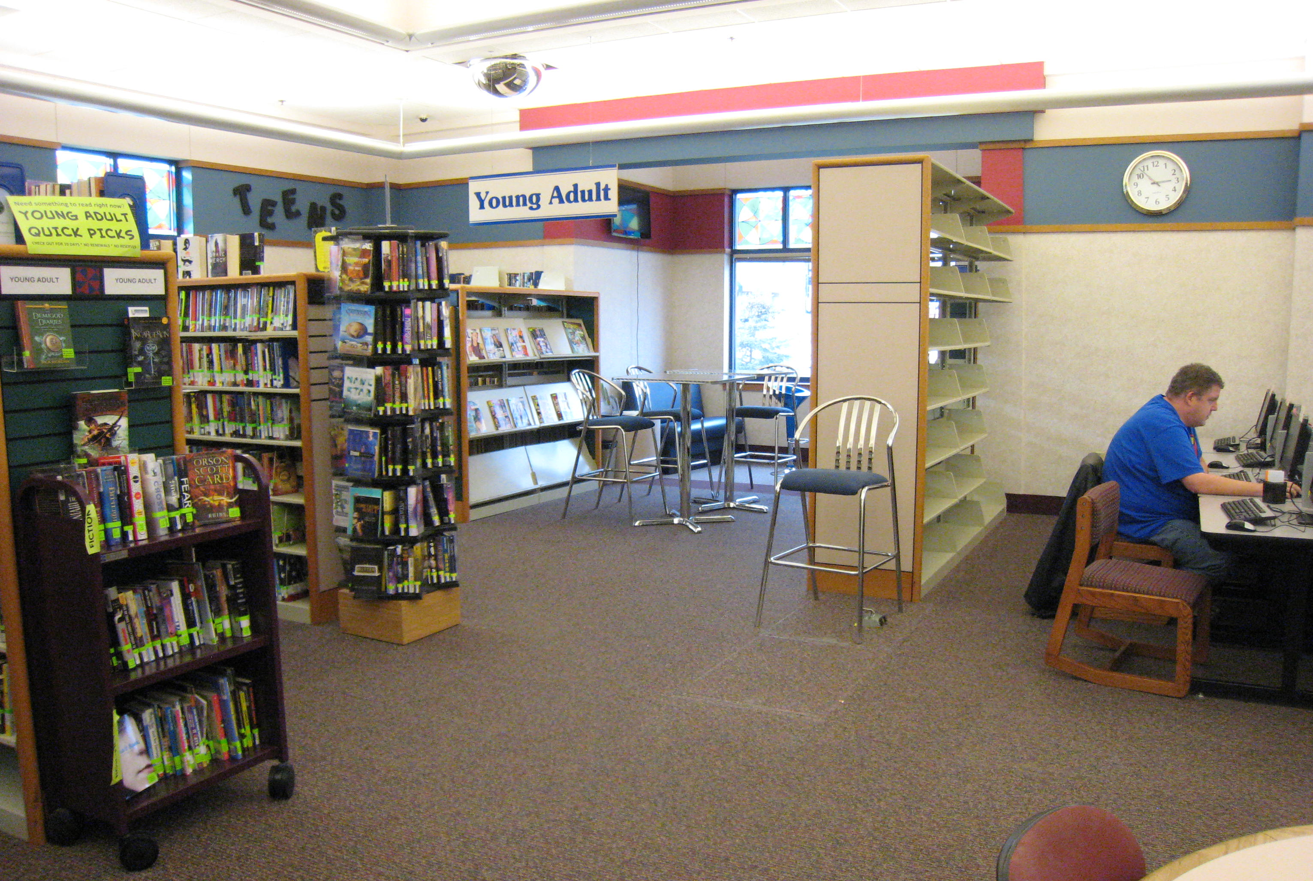
Meet the Marion Public Library
Notes:
Marion Public Library
Marion, IA (service population: 40,000 -- doubled since 2000)
Adjacent to Cedar Rapids, IA and part of the Metro Library Network
About 1,000 patrons of all ages visit daily
Teens @ MPL
"Teens" = middle and high school
Two school districts in Marion
2 blocks from Vernon Middle School
Before: daily, after-school programs
Now:
New Teen Space created May 2019
Average 20-40 teens every day after school

Slide 5
Motivation
PEERS, LIBRARY,
& COMMUNITY
TEENS
Notes:
More teens = more amazingness… and more behavior, both positive and negative. Behavior included more minor offenses, such as being “too loud” or “rambunctious,” but also included physical fighting and racial slurs. Part of this was because there were only two free places in Marion for teens to hang out: the library and the park. What kind of message did this send to teens?
Because of this, we wanted to find a program that would primarily focus on building community and relationships and carve out a space just for teen voices. Historically, there was a neutral to negative relationship between staff and teen patrons, and we wanted to rebuild some of those relationships. Also, as teens got more comfortable with teen staff, they told us about issues within their lives and feelings of isolation. They felt like they were the only ones who felt this way. Each teen's circumstances and experiences are unique, but we wanted a program that would allow teens to come together and meaningfully discuss issues, if they wanted.
So, in all of this, we were asking ourselves: How can we build an empathic community? How can we build and repair relationships at the library and beyond? And we found… TALKING CIRCLES!

Slide 6
How to Y.A.K. Talking Circle Framework
Notes:
At this point, we asked for volunteers to participate in a Talking Circle.

Slide 7
Talking Circle Framework
Pre-Circle: set the environment
Physical calm
Open the circle
Guidelines and agreements
Facilitator role
Check-in
Guided conversation
Personal conversation
Check out
Notes:
This is our program’s framework—not set in stone, but this is what works for us. Take and use or modify as needed.

Slide 8
Pre-Circle: Set the Environment
Space
Privacy & simplicity
Lighting
Communication
Circle
Arrange the circle
Centerpiece
Sightlines
Notes:
Space
Room that is as private as possible with as few distractions as possible
Don’t want other people to be able to see in, especially parents or peers
Create a zone if in large room
Dim lights if possible
Whiteboard, chalkboard
Circle
Form a circle with chairs, pillows, carpet squares, or indicate the space when teens arrive
Centerpiece in the middle
Line of sight for each person

Slide 9
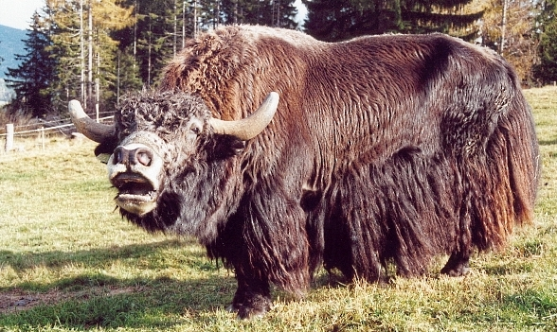
1. Physical Calm
Physicality
Awareness
Energy
Presence
Attention
Exercises
Breathing
Stretching
Sound
Notes:
Check in with yourself prior to starting the circle: it can be hard, but do an internal audit
Bring awareness to your physical presence in the circle and direct energy and attention
Breathing exercises—taking some deep breaths puts a load of serotonin in your gut
Cat/cow and other stretches
Make silly noises! Loosen up!

Slide 10
2. Open the Circle
Set the Tone
Describe the purpose of the circle
Explain the center object
Starting quote
Notes:
Describe the purpose: What’s the purpose of the circle? For YAK, it’s always to build connectedness, community, and kindness advocates through listening to each other and to our own thoughts. There’s a lot we can learn from each other!
Explain the center object: Explain the purpose of the centerpiece if you choose to have one. We have silk flowers to represent the growth we wish to see in our small YAK community and larger Marion community.
Starting quote, short story, or poem that sets the tone for the circle and the theme for the session.

Slide 11
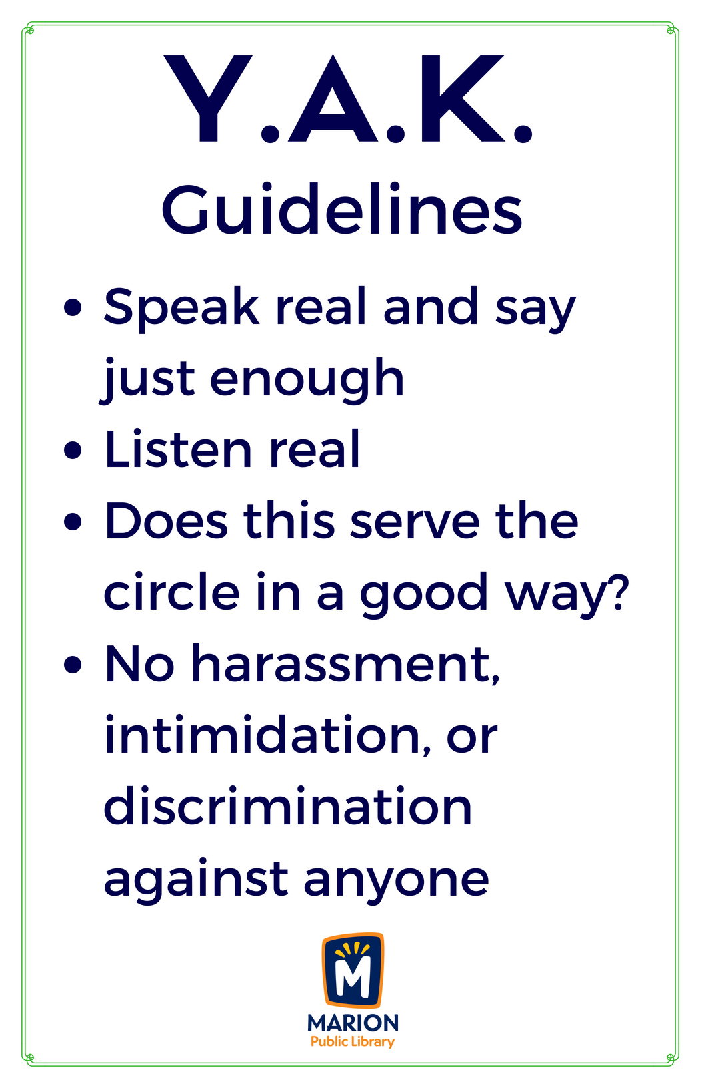
3. Guidelines & Agreements
Notes:
Guidelines
Non-negotiable
Consistent throughout every circle session
Tie-in with library policy
Go over at every meeting
Clearly posted
Agreements: Agreed upon by the group. Must be unanimous in order to be adopted. Reassess at every meeting. Also usually written on a whiteboard. Teen-suggested examples:
What is said here stays here
No technology except during breaks

Slide 12
4. Facilitator Role
Share
Enforcing guidelines and agreements
Mandatory reporter?
Be Aware
Vulnerable
Professional
Boundaries
Notes:
Make your role known clearly
You’re the facilitator, you will help with enforcing guidelines and agreements, but it is the responsibility of everyone in the circle
Are you a mandatory reporter? Know your legal role and, more importantly, let teens know
Be vulnerable, but be professional and know appropriate boundaries

Slide 13
5. Check-In
Self-Reflection
Sort through thoughts
Emotional weather report
Purpose
Comfortable
Low-risk
Notes:
Check-in round
Low-risk questions
"Emotional weather report"
Purpose
Introduces new teens to the structure
Creates a more comfortable environment
A chance for every teen to be heard (if they want to speak!)

Slide 14
6. Guided Conversation
Prompts
Reflect and respond
Open-ended
Relevant
Not trying to prove a point
Notes:
Prompt that fits your purpose, giving each teen the opportunity to respond or reflect:
Open-ended
Relevant/current events
Purpose isn't to prove a point—not "Tell me why bullying is bad“ but possibly “Talk about a time when you witnessed bullying”
Don’t have to be so serious or deep! Our first prompt: “What’s your favorite part about your name or nickname? What’s the story behind it?”

Slide 15
7. Personal Conversation
Notes:
Teens expressed desire to “popcorn” conversation in a more unstructured way, but still protected by guidelines and agreements. In our program, this comprises last half of the session, after a short 5-minute break.
With permission to share in this presentation, some of their "popcorn" conversation has included:
New playground equipment
Coming out to their parents
How the community sees teens
Teens have asked others directly for advice and for the wisdom of the circle

Slide 16
8. Check Out
Concluding
Reflect on experience
Closing quote
“The circle is closed.”
Notes:
Describe your experience here: state 2-3 words describing experience in that session
Quote/story/poem fitting the theme of the guided conversation
Clearly state that the circle is closed, and the guidelines and agreements no longer apply (except library policy)

Slide 17
What just happened?
Notes:
What just happened in our example Talking Circle? COMMUNITY JUST HAPPENED!
We got a chance to reflect on our experience this weekend (or about something else in your life) and were open to sharing that and/or listening to and learning from others. We started to build empathy! We’re already pretty empathetic people, working with teens, but engaging with our professional peers through a Talking Circle increases that empathy in a new and hopefully inspiring way.

Slide 18
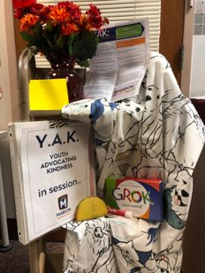
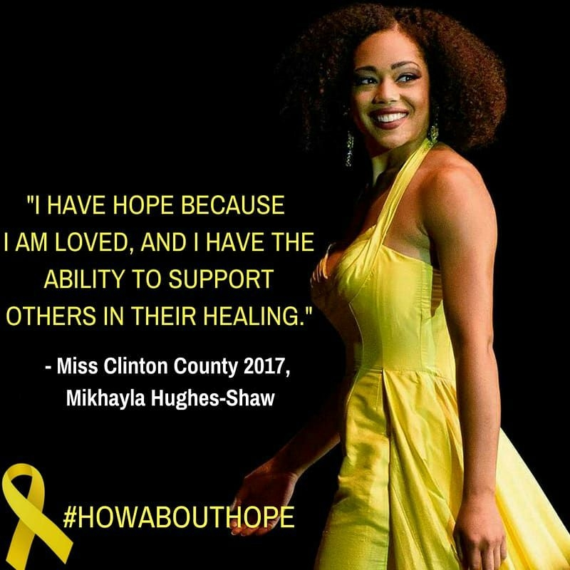
Y.A.K. @ MPL
Notes:
The practical aspects of our program:
Program length: 30 minutes
Doors closed, locked from outside, “YAK in session” sign posted
We weren’t sure how many teens to expect our first year, so we had one long program for middle and high school students combined. We wanted to respect each age group’s unique needs, so we now have 1 session for middle schoolers and 1 session for high schoolers.
Community projects and special guests: Mikayla Hughes-Shaw *Miss Iowa 2018*
Opportunity for teen leadership
Helping state the guidelines
Setting up
Grabbing other teens to join
Suggested circle topics

Slide 19
Common Roadblocks
Notes:
How do I get teens to come?
Food: “I’m just here for the snacks” gives protection for teens who feel pressured to say they want to come to Y.A.K.
Word of mouth: teens inviting friends who may be experiencing hardships and feelings of isolation
Personal invitations given out by librarians
People aren’t talking?
Not necessarily a bad thing: lean into the silence! Check your own impulses!
Split into smaller groups within the larger circle
May need more community building first, or a lighter prompt
What if one person is talking more?
Facilitator: “Thank you for sharing with the circle! Who else wants to add to the circle today?”
Understanding that teen may be going through a rough time
What if the Talking Circle turns into a gossip session?
Refer to your guidelines and agreements
Gentle reminder as facilitator: “Are we speaking about our own experiences and emotions?”
Use pseudonyms to avoid naming people directly
How can I help with emotional literacy?
Purchase GROK Cards or make your own: emotions and needs cards for both youth and adults
So powerful and have really resonated with the teens
What if someone wants to talk about Y.A.K. outside of Y.A.K.?
Ask permission: “Thank you for sharing that with me. Rachel would really know a lot about where to find resources for that. Would you be comfortable if I shared what you just told me with Rachel?"
Keep it centered on your experiences, keep it general: “Hey, I just had this really great conversation and I learned this about myself.”
Teens can use general lessons learned, but they should respect guidelines and agreements because that's why they're there

Slide 20
What will your program look like?
Repair the Harm:
Restorative Approaches to Behavior Management in Libraries by Shauna Anderson
Notes:
Our program does not have to be your program! Figure out what works for you and your community.
Take inspiration and tailor it: Our next step after learning about Talking Circles was reaching out to community partners who were using the Talking Circle model. I went to a faith-based organization and learned about the GROK cards. I learned about classroom talking circles and learned language from a residential facility. Essentially, we borrowed from everyone to make it work for us. So you can borrow from us to make it fit your community and your needs. There are also plenty of online resources, like this webinar we found on the YALSA site! It is free to view if you are a YALSA member. It was SUPER helpful for us because it was a specific example of the Talking Circle model used with teens in libraries.

Slide 21
So what can Talking Circles do?
First…
Build trust
Which then…
Builds community
Builds vulnerability
Prevents & repairs harm
Notes:
To summarize:
First few weeks are about…
Introduction to talking circles
Getting to know each other
Low risk prompts that are fun to answer
Building trust among each other
Which then…
Builds community and a place for vulnerability
Repairs harm if necessary
Does preventative work
Having these relationships, this model of empathy and community, will naturally decrease negative behavior; when issues arise, Talking Circles give a structure and framework to talk about it. To have an open dialog, to speak real and listen real together. These skills impact teens not only in the library, but also beyond.

Slide 22
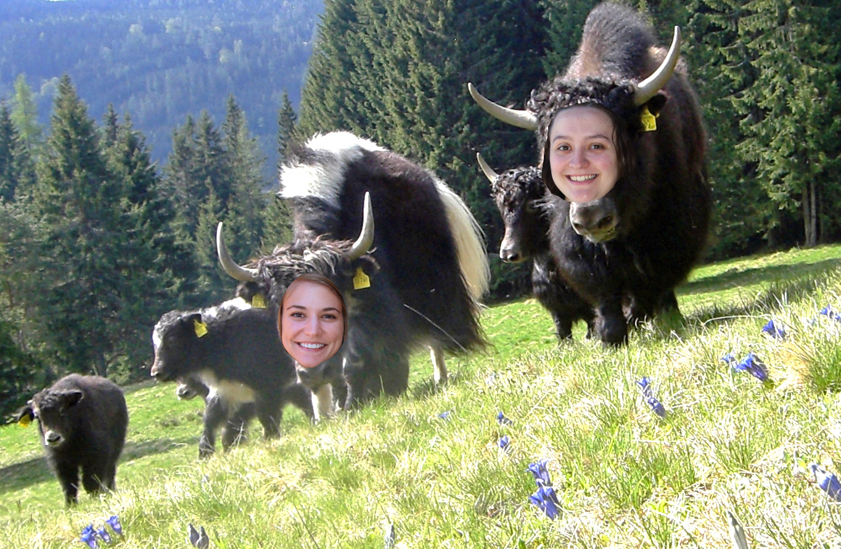
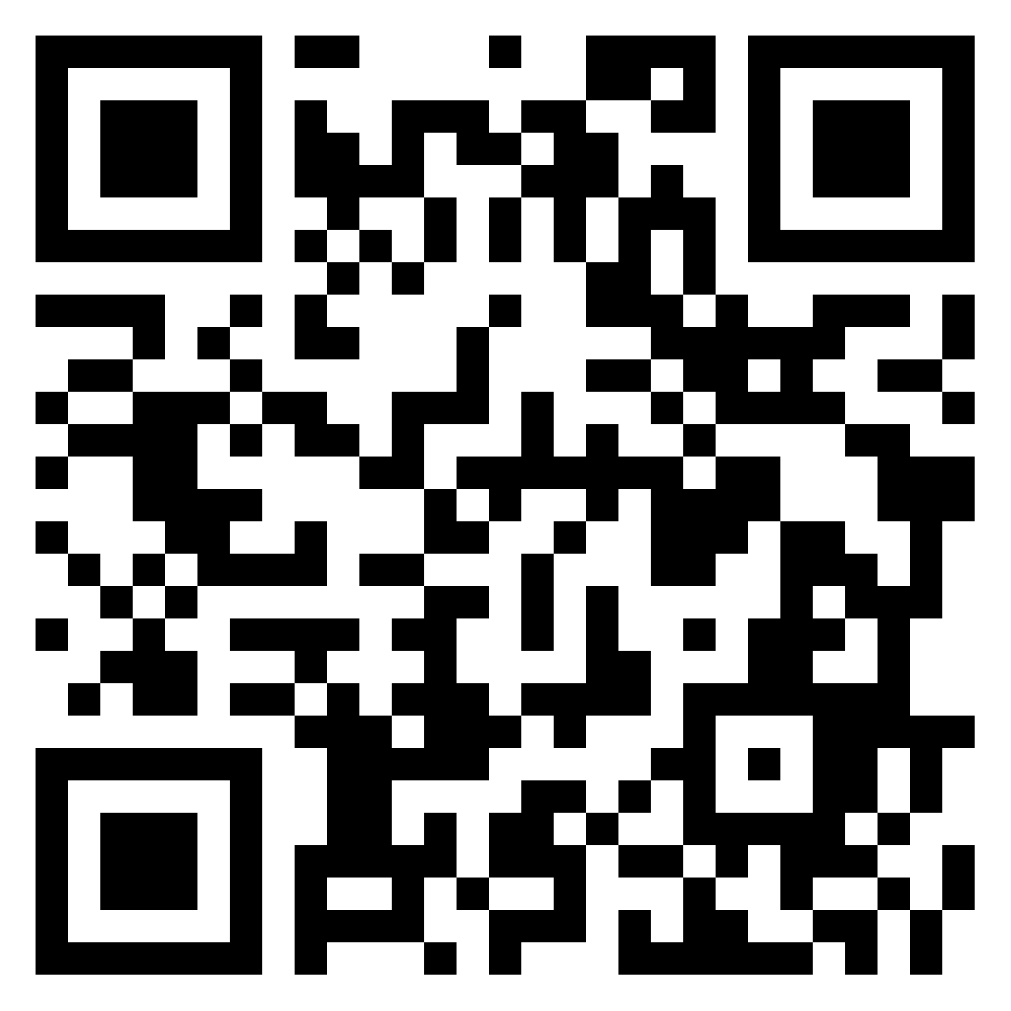
Thank you! Questions?
Rachel Pollari​
rpollari@marionpubliclibrary.org
Shanel Slater
sslater@marionpubliclibrary.org
Notes:
Please reach out with any questions or comments. Thank you!

