Slide 1
Fostering Community Through Picture Books
How one public/school library collaboration is working to develop teen leaders in our community.

Slide 2
Presentation Agenda
Meet Erin and Megan (5 minutes)
General Housekeeping information (5 minutes)
Presentation Goals and Outcomes (5 minutes)
Fostering Community Through Picture Books (20 minutes)
Group Breakout (20 minutes)
Conclusion (5 minutes)

Slide 3
Join the Conversation
www.menti.com 32 06 42 (5 minutes)

Slide 4
Your Presenters
Erin Phemester
Megan Koppitch
Public Librarian for 13 years focused on youth and teens
Currently Director of Youth Services and Programming for the Public Library of Youngstown and Mahoning County in Ohio
Currently Reading
Worked with children and teens for over ten years in both school and public libraries.
Currently the Media Specialist and Yearbook Sponsor for the P.K. Yonge Developmental Research School
Currently Reading:

Slide 5
Presentation Goals and Outcomes
Everyone will leave with a program/lesson plan for teens to critically analyze picture books, present the picture book in a new setting, and facilitate a discussion through the lens of cultural awareness.
Everyone will find one new idea to use in their library to foster deeper community connections between libraries, teachers, teens, or communities.

Slide 6
Fostering Community: Laying the Groundwork
Introducing teens to the lesson (School)
Introducing teens to picture Books (Public)
Training teens to share picture books (Public)
Training teens to host conversations with kids (School)
How do you foster a community where teens feel safe to have open dialogue about issues?
Connecting school/public libraries
Finding partners within the school
Working with teens
How do you make successful connections with your community?

Slide 7
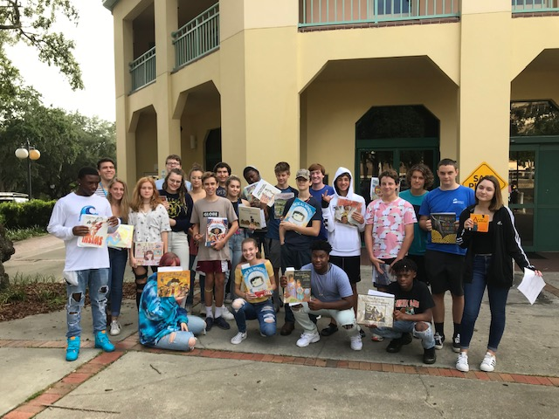
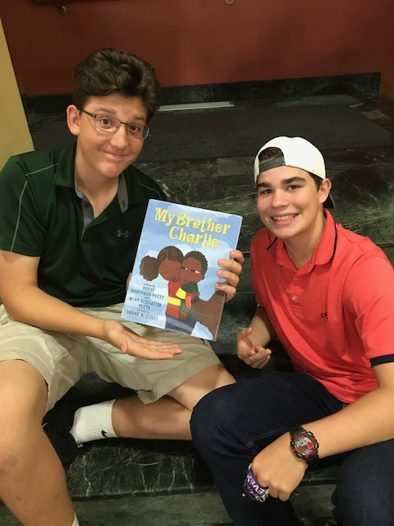
The Project
9th graders selected picture books on under-represented populations to read to K-2nd graders.

Slide 8
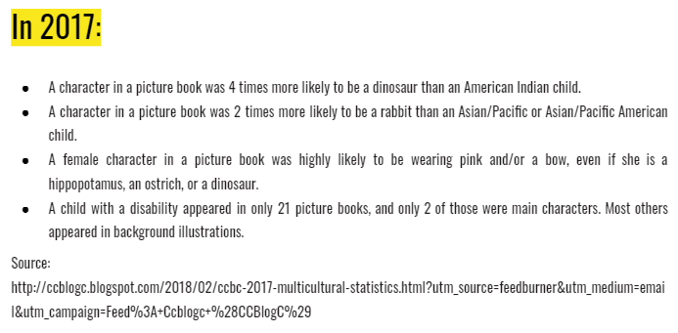
Introducing Concepts
9th graders were introduced to the concept of “windows and mirrors” from Rudine Sims Bishop to discuss cultural diversity in books.
The class discussed the findings from the Cooperative Children’s Book Center at the University of Wisconsin-Madison.

Slide 9
Introducing Concepts
They learned why these results matter:
Those not represented get the message they are unseen and unimportant in society.
Those who are represented exclusively are being told they are the only ones that matter.
Kids who feel excluded from the books they read, struggle with reading.
They then used a Teaching Tolerance worksheet on evaluating books through a cultural lens.

Slide 10
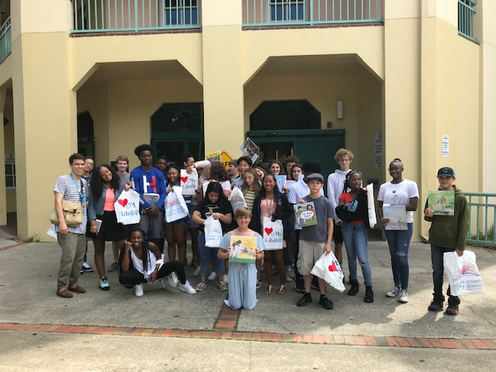
Choosing Their Representations
Students went to the public library as a class to select the books on the populations they chose to represent.
Sometimes they had to change their direction when there were not enough books available on their choice.
Learned how to read out loud to younger students.

Slide 11
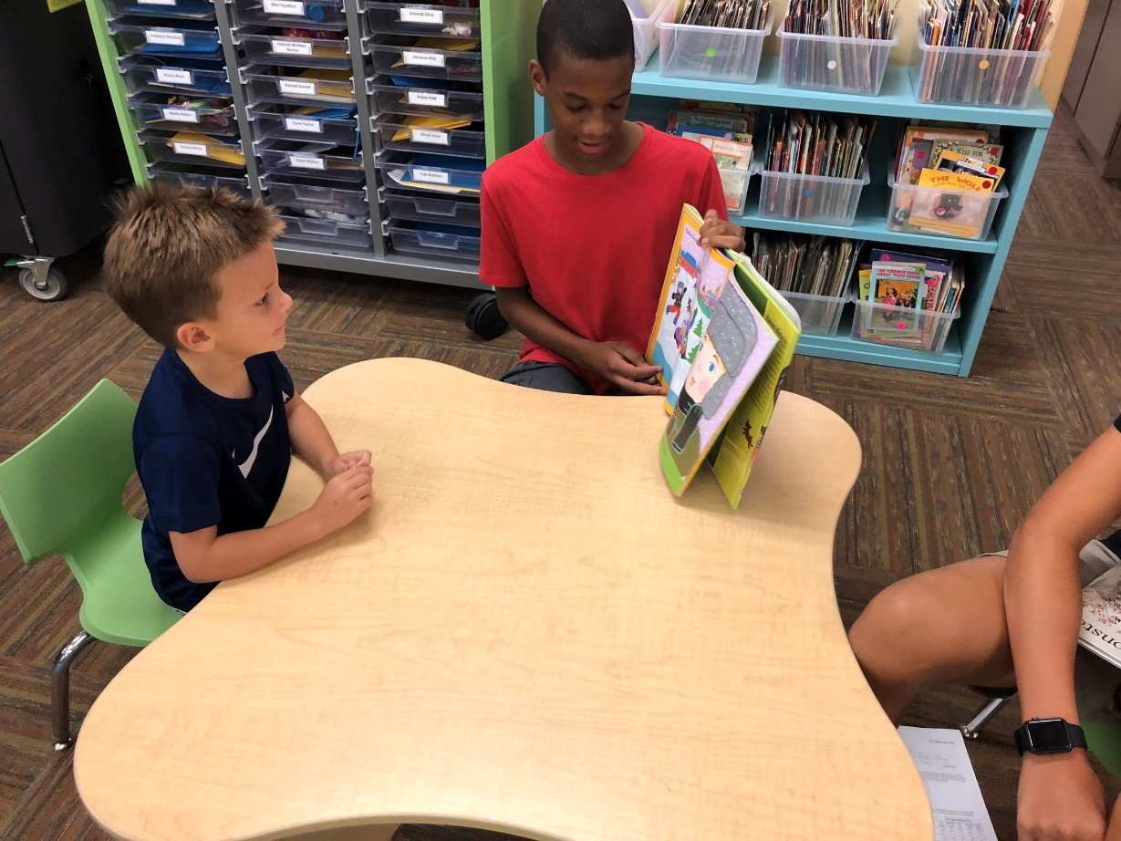
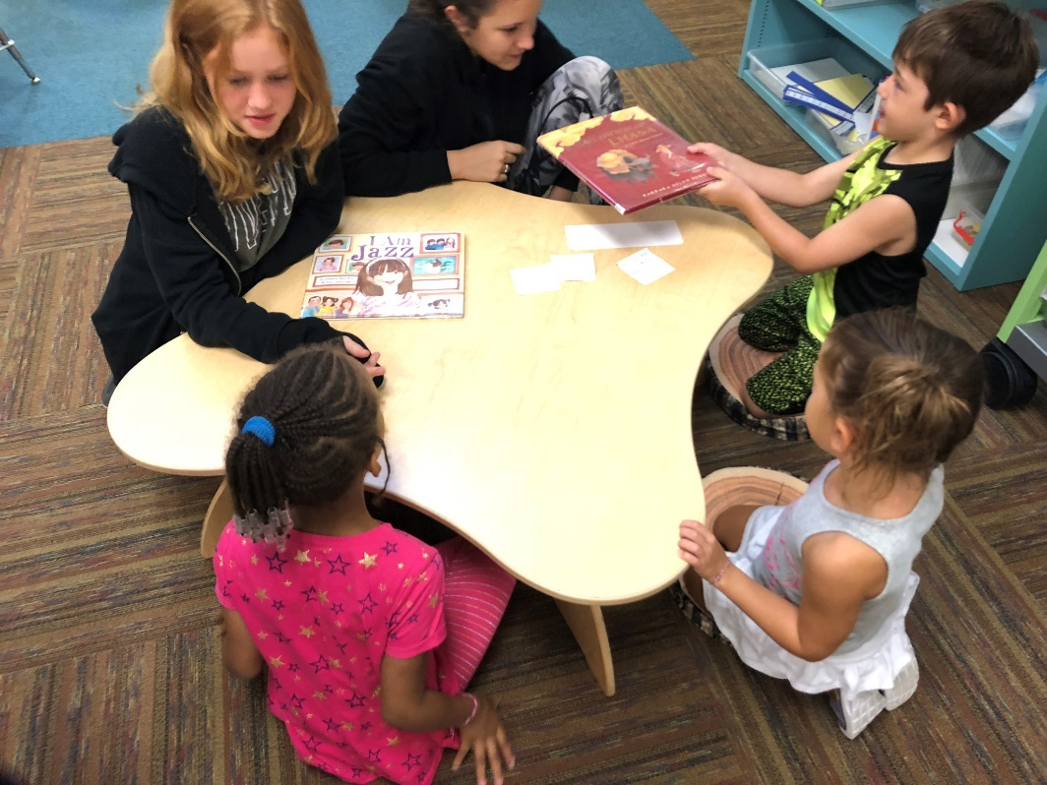
Teens Sharing Stories
List of Titles Teens Selected
Read to small groups of K-2nd grade students.

Slide 12
Continuing the results
Books were suggested and purchased for the school library
The project will be continued as other teachers expressed interest in participating
The discussion of culturally diverse texts carried over into other classrooms
Highlighted books
I am Jazz
Yo Soy Muslim: A Father’s Letter to His Daughter
Bowwow Powwow
Mommy’s Khimar
Red: A Crayon’s Story
We Are Family
Separate is Never Equal: Sylvia Mendez & Her Family’s Fight For Desegregation

Slide 13
Your Turn
Please work by yourself or with a group of people to select a picture book from our stacks.
Complete the worksheet
Share with the group

Slide 14
Conclusions
Giving students a voice in their work can lead to increased interest.
Collaborating with local partners expands your resource bank.
Young adults should be given more opportunities to serve as information sources and leaders to the younger grades at their schools.

Slide 15
References
Bishop, R. S. (1990). Mirrors, windows, and sliding glass doors. Perspectives, 6(3), ix-xi.
Oltmann, S. (2017). Creating space at the table: Intellectual freedom can bolster diverse voices. Library Quarterly: Information, Community, Policy, 87(4), 410-418. Retrieved from
https://www.journals.uchicago.edu/doi/pdfplus/10.1086/693494
Reading Diversity. (n.d.). Retrieved from https://www.tolerance.org/magazine/publications/reading-diversity
Tyner, M. (1970, January 1). CCBC 2017 Multicultural Statistics. Retrieved from http://ccblogc.blogspot.com/2018/02/ccbc-2017-multicultural-statistics.html?utm_source=feedburner&utm_medium=email&utm_campaign=Feed:+Ccblogc+(CCBlogC).

Slide 16
Thank You
Feel free to contact us with questions or thoughts. We hope to continually improve this program through engaging with this community of librarians and our learning communities at home.
Erin Phemester – ephemester@libraryvisit.org
Megan Koppitch – mkoppitch@pky.ufl.edu
Twitter: @megankxena
Instagram: pkyhiddenlibrary

