Slide 1
Increasing Teen Resilience through Trauma Sensitive Approaches
Presented by Mid-Continent Public Library

Slide 2
outline
Recognizing Trauma–15
Principles of Trauma Sensitivity—30
Community Resources—10

Slide 3
Objectives
Define trauma, understand the prevalence of trauma, explain the impact of trauma on behavior and development
Understand the principles of trauma sensitivity and describe ways we are already trauma-sensitive
Notes:
By the end of this training:

Slide 4
Recognizing Trauma
Definitions, Prevalence, and Impact
Notes:
Define trauma, understand the prevalence of trauma, explain the impact of trauma on behavior and development
***ASK: What are some examples of trauma?
Trauma refers to intense and overwhelming experiences that involve serious loss, threat or harm to a person’s physical and/or emotional well being.
These experiences may occur at any time in a person’s life. They may involve a single traumatic event or may be repeated over many years.
Any trauma experiences that overwhelm the person's coping resources, can often lead the person to find a way of coping that may work in the short run, but may cause serious harm in the long run.
Also, historical and generational trauma can powerfully shape people, even when they themselves have not directly experienced that trauma.

Slide 5
SAMHSA Definition
Event: Actual experience, threat, or lack of, withholding, or lack of control over resources (external to person experiencing event)
Experience: How someone assigns meaning to the event—depends on perception of individual
Effects: results of the person’s experience of the event—can include neurological, physical, emotional, and cognitive effects
Notes:
"an event, series of events, or set of circumstances that is experienced by an individual as physically or emotionally harmful or life threatening and that has lasting adverse effects on the individual’s functioning and mental, physical, social, emotional, or spiritual well-being.“ SAMHSA 5/22/19
Internal resources reside within the individual--hope, self-worth, critical thinking, problem solving skills, faith,
optimism, strong imagination, etc.
External resources exist in the environment--food, shelter, money, family, mentor, education, relationships that foster internal resources (faith community, school, work, etc.), therapist, pets, etc.
External Resources often foster internal resources and the lack of external resources often break down the internal resources. For example, the lack of a safe home environment diminishes an individual’s overall sense of safety.
Discuss the impact of the individual’s perception of these resources. (Ex. Boarding school: one person sees this as an escape from a traumatic home life and another sees it as abandonment.) An experience that is traumatizing to one person could be perceived as being a beautiful opportunity by another and just inconsequential to another. Everyone has a unique life experience and perception of that experience.

Slide 6


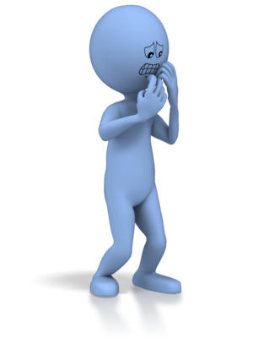
Human Stress Response Behaviors
Fight
Escalate defense or offense
Confront the threat
Flight
Avoid the threat
Run or escape
Freeze
Paralyzed by shock or fear
Retreat within, collapse, or dissociate
Notes:
*****Add list of what this looks like in teens to notes (from next slide), ask a discussion question*****
What is missing from this picture so far? What might we see in teens? How do we differentiate between normal teen brain development and toxic stress?
Our role is in building relationships. We aren't first responders. Sometimes we are not even mandatory reporters. It's about understanding balance.
Sympathetic nervous system response (versus parasympathetic “Rest & Digest” nervous system response)
You can experience stress with work, family, personal life, environment, etc.
It’s not just the stress in the moment; stress can also have a cumulative effect which can impact our ability to bounce back.
Flight can take the form of running in to fix/rescue/be the peacemaker
Indications of dissociation (Freeze):
Staring vacantly into the distance
Spacing out or being uninvolved in the present
Being unable to focus, concentrate or respond to instructions
Being unable to speak
Long silences
Unable to pay attention or understand instructions
What does this look like in teens?
Symptoms:
Poor emotional control, often not appropriate to the situation; Confrontational (fight); Overly protective of space/belongings (freeze/ hunkering down)
Difficulty with transitions (e.g. MS>HS); Alcohol and drug abuse; Overeating; Lack of hygiene (freeze, in part); Anger and irritability(fight)
Anxiety/worry about safety; Depression and withdrawl; Increased risk taking; Decreased focus and attention

Slide 7
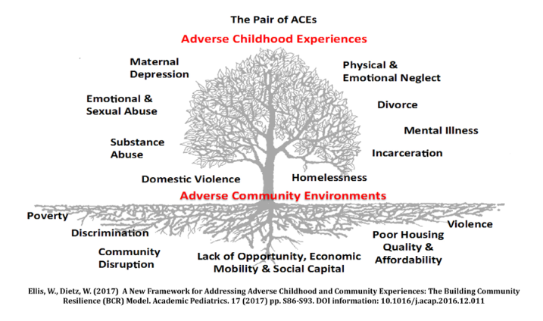
Pair of Aces
Notes:
Kaiser Permenete Study – San Diego, CA 1995-1997
Philadelphia Urban ACE Survey – 2012-2013
Pair of Aces – Adverse Childhood Experiences – from the incarceration of a caregiver to emotional and sexual abuse, etc.
Adverse Community Environments – from poverty to violence to poor housing
When you use both measures the numbers of people experiencing at least one ace increases. In a recent resilience study in Kansas City, the average of seeing 64% of people experiencing at least one ACE, increased to 87%

Slide 8
Prevalence & Impact
Most people have at least 1 ACE (Adverse Childhood Experience), and can be higher in occupations serving the public.
Trauma impacts neuro-physiological development
Trauma affects physical, social, and emotional health and wellbeing
Trauma shapes core beliefs
Trauma creates symptoms that are really adaptations—what we see as “the problem” has been the person’s solution
Notes:
Most people have had at least 1 ACE, over 2/3 in most studies;
Historical and generational trauma are also impactful
What does this look like in teens?
Symptoms:
Poor emotional control, often not appropriate to the situation; Confrontational (fight); Overly protective of space/belongings (freeze/ hunkering down)
Difficulty with transitions (e.g. MS>HS); Alcohol and drug abuse; Overeating; Lack of hygiene (freeze, in part); Anger and irritability(fight)
Anxiety/worry about safety; Depression and withdrawl; Increased risk taking; Decreased focus and attention
“The impact of trauma to the community can be seen in high rates of absenteeism, under-performing at work and school, and high healthcare costs, etc. The research has been validated now across the country.” –Behavioral Health Action Report, Greater Kansas City Chamber of Commerce
"attention seeking" may be more properly understood as "connection seeking"

Slide 9
Principles of Trauma Sensitivity
Notes:
Awareness and response—what is the library’s role in being trauma informed?

Slide 10
Trauma-Informed Culture
Realize
The prevalence of trauma and ACEs
Recognize
Trauma can affect ability to cope
Interferes with our beliefs
Responds
Infusing knowledge about trauma and recovery into policies, procedures, and practices
Resists
Humility to respond to traumatization
SAMHSA, 2014
Notes:
*****Make this more graphic to match slide prior, steal some notes*****
Realizing the prevalence of trauma
Refer to ACEs—which you will learn about in the Resilience DVD
Recognizing how trauma affects individuals
Research shows trauma disrupts the central nervous system and overwhelms a person's ability to cope. It often results in feeling vulnerable, helpless, and afraid. It interferes with relationships and fundamental beliefs about oneself, others, and one's place in the world.
Michael has already helped us with Realizing and Recognizing. I'll be dealing with Responding.
Responding by putting this knowledge into practice
Trauma-informed care is a principle-based culture change process for an entire organization. It provides a new perspective where those providing the support shift from asking "What is wrong with you?" to "What has happened to you?" This change reduces the blame and shame that some people experience when being labeled. It also builds an understanding of how the past impacts the present, which effectively makes the connections that progress toward healing and recovery.
Trauma-informed care takes a collaborative approach, where healing is led by the consumer and supported by the service provider. Together, in a true partnership, people learn from each other. There's greater respect, progress towards healing, and greater efficacy in services.
Resisting re-traumatization
Acknowledging that sometimes we will fail, we will do everything within our power to reduce possible triggers and provide safe, nonjudgmental, collaborative, relational care.

Slide 11
Trauma Sensitive Principles
Safety
Trustworthiness
Choice
Collaboration
Empowerment
Resilience
Notes:
Introduce Crosswalk – While we talk about each of these principles, we want you to answer, “What you are already doing in your school, agency, facility, group, or library that aligns with the principles of trauma sensitivity?” We wanted to show you that many of these things aren’t coming from out of the blue, they are things you are already doing, or that are built into your cultures. We will provide examples for each and facilitate a discussion at the end.
Safety and Resilience are really the bread that holds together the ingredients in our TIC sandwich. When those are robust, it is much easier and more natural to develop the other principles.

Slide 12
Safety
Physical
Moral
Psychological
Social
Notes:
Safety: Ensure physical and emotional safety, recognizing and responding to how racial, ethnic, religious, gender or sexual identity may impact safety across the lifespan.
Domains of Safety
Physical: free from injury to the body; environment that evokes ease
In the following domains, safety is fostered through the experience of connection and belonging.
Social: free from bullying and peer isolation; connected to people/ belonging
Moral: free from persecution for belief; diversity is celebrated
Psychological: free from emotional distress, fear, anxiety, shame; compassion is a practice and mindfulness is promoted
ADA- Free Choice and Physically Safe Places

Slide 13
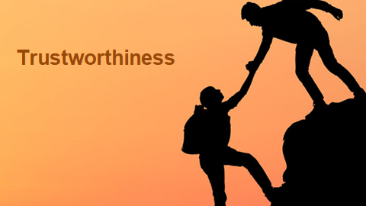
Trustworthiness
Notes:
Trustworthiness: Foster genuine relationships and practices that build trust, making tasks clear, maintaining appropriate boundaries and creating norms for interaction that promote reconciliation and healing. Understand and respond to ways in which explicit and implicit power can affect the development of trusting relationships. This includes acknowledging and mitigating internal biases and recognizing the historic power of majority populations.
Establishing trustworthiness through transparency.
We won't share your address

Slide 14

Choice
Notes:
Choice: Maximize choice, addressing how privilege, power, and historic relationships impact both perceptions about and ability to act upon choice.
Trauma by its very nature robs us of our choices and our sense of personal power. Returning these to individuals who have experienced trauma has a profound effect on their healing, their confidence, and their belief that they can move through the world as capable people.
Free choice of what you can research, watch, read, etc. - Satanism
Programming – Provide Choices
Teen Advisory Group

Slide 15


Collaboration
Notes:
Collaboration: Honor transparency and self-determination, and seek to minimize the impact of the inherent power differential while maximizing collaboration and sharing responsibility for making meaningful decisions.
Traumatic experiences by their very nature impose the will of another or an outside force upon an individual.
These principles provide further support for healing by honoring the experiences and the wisdom of the person and acknowledging that “you are the expert on you.” “No decision about me without me.”
Behavior Agreements

Slide 16

Empowerment
Notes:
Empowerment: Encouraging self-efficacy, identifying strengths and building skills which leads to individual pathways for healing while recognizing and responding to the impact of historical trauma and oppression.
YALSA 21st Century Skills – we are supposed to be empowering teens

Slide 17
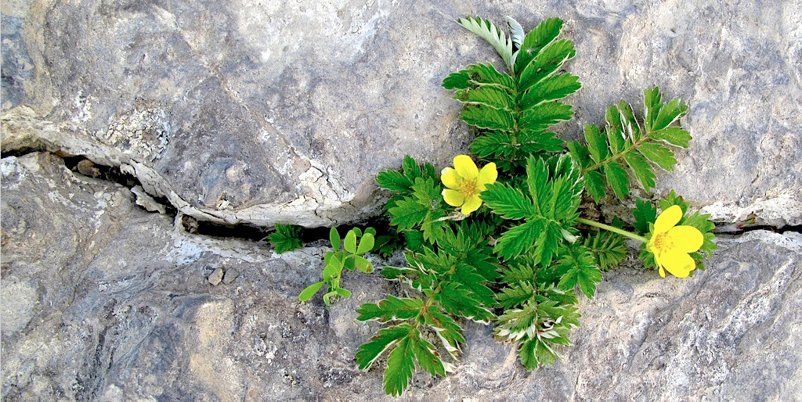
Resilience
Notes:
This is such an important principle that, along with safety, we recommend it as a good jumping off point for organizations.
Resilience: The ability to absorb high levels of disruptive changes while displaying minimal non-productive behaviors.
Relationship Building

Slide 18
Resilience continued
What practical things can we do to foster connections among teens?
How do we help teens nurture a positive view of themselves?
How do we help teens keep things in perspective?
How do we encourage teens to practice self-care?
Notes:
Recognize your own personal need for self care, which we aren't going to go into, but have provided resources for
How do we view change as part of living and encourage teens to see change as natural, not a crisis? (There’s an answer but we can look together for solutions)
How do we help teens define their goals in life? (career/college readiness)
How do we help teens take decisive actions (vs. detachment)?
How do we guide teens to opportunities for self-discovery? (readers’ advisory, programming)
How do we help teens nurture a positive view of themselves?
How do we help teens keep things in perspective?
How do we encourage teens to practice self-care? (not just like…treat yo’ self)

Slide 19
Resources

Slide 20
National Resources
ACEs Connection
NNLM (National Network of Libraries of Medicine)
NAMI (National Alliance on Mental Illness)
SAMHSA (Substance Abuse and Mental Health Services Administration)
Notes:
National Child Traumatic Stress Network, administered by SAMHSA (nctsn.org has many resources)
Traumainformedcareproject.org (Wisc. Dept. of Public Instruction)

Slide 21
Local Resources
Local Groups
Statewide Orgs & Coalitions

Slide 22
Other Librarians
Who might be able to relate to your experiences with trauma & resiliency? How can you share ideas/support?
What are the supports you have in your community? In your library?
How can we be resources to each other?
Notes:
*****Change to ask questions about resilience/self-care/mindfulness*****
What is your relationship with trauma & resilience? Who might be able to relate to this experience? How can you share ideas/support?

Slide 23
Your presenters (hey it’s us)
Scott Rader
  srader@mymcpl.org
Michael Willis
  mwillis@mymcpl.org

Slide 24
Material Resources
  The Deepest Well by Nadine Burke Harris
  Building Resilience in Children and Teens: Giving Kids Roots and Wings by Kenneth R. Ginsburg
  Resilience DVD
  Paper Tigers DVD
  Kaiser Permanente ACE Study
  Philadelphia ACE Study

