Slide 1
[Self]customer Service
SELF CARE FOR BETTER SERVICE
Notes:
Yvette

Slide 2
Welcome & Introductions
Yvette Garcia, YOUmedia Manager, Chicago Public Library yleigh@chipublib.org
Alice Son, Teen Services Supervisor, Arlington Heights Memorial Library ason@ahml.info @alicehson
Martha Sullivan, Young Adult Librarian, Geneva Public Library District msullivan@gpld.org @magicalmartha
Notes:
Disclaimer: We are not mental health professionals!

Slide 3
4/7/8 Breathing
Notes:
Martha
The 4-7-8 breathing technique, also known as "relaxing breath," involves breathing in for 4 seconds, holding the breath for 7 seconds, and exhaling for 8 seconds. Repeat for 4 cycles.
Play the singing bowl!

Slide 4
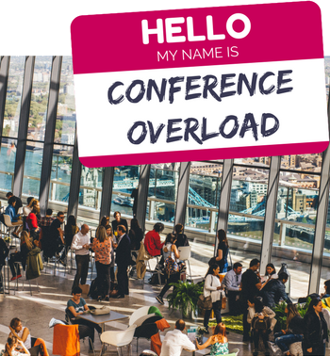
Conference & Networking Overload
It’s OK to NOT be okay and not be “ON”...
Plan for breaks, plan to eat
Check in with yourself. If you’re not operating at 100% you’re not benefiting yourself OR your org!
Now that Symposium is nearly over, take some time to breathe
Notes:
Alice
“ON”: There’s a lot of pressure in our work to be “on” and provide good customer service. Honestly, we want to provide that and represent our organizations well. We’re only human, and it’s important to remember that it’s not natural to be “on” all the time.
PLAN FOR BREAKS: Conference buddies to help ease the awkwardness of conversation, have someone to eat with. Remember librarians are nice!
100%: That’s quite a threshold. The point is to check in with yourself and determine if you’re good.

Slide 5
What we found helpful during conference…
Yvette:
Play tourist.
Enjoy a slow meal
Non-work related chill/chats
Alice:
Hiding Chilling in my hotel room
Reminding myself that Symposium doesn’t have to be a 24/7 networking event
Martha:
Taking non-work time for myself every day
Staying hydrated (and fed)!
Researching food options beforehand

Slide 6
Advice from the Social Media Sphere
“Don’t try to do too much... Take a minute, decide the can’t miss stuff vs the could be cool stuff & be okay with missing some stuff.”
Amanda Margis, @akmargie
“Take some time to look out of the conference center windows for goodness sake. Or to do something that has NOTHING to do with libraries before you head home.”
Regina Townsend, Young Adult Services Forum group on Facebook
“Eat what makes you feel good, go outside between sessions, stay hydrated.”
Heather Booth, Young Adult Services Forum group on Facebook
Notes:
Martha

Slide 7
More Advice
“I have started packing gym clothes and taking advantage of the hotel fitness center to destress before going to bed. And I like to buy some breakfast treats to keep in my room or order room service so I can eat in my jammies before going out in public.”
Donna Block, Young Adult Services Forum group on Facebook
“Talk to people! Sessions are great, but I've learned so much from the professional friendships I've made at conferences.
I know this isn't easy advice for everyone to take, so respect your own limits. Wear comfortable shoes and bring a sweater or jacket. Pack or purchase snacks so you can keep a little something in your bag.”
Andrea Johnson, Young Adult Services Forum group on Facebook
Notes:
Martha

Slide 8
Professional Stress(ors)?
Balance
Boundaries
Managing Stress vs. Eliminating Stress
My Expectations
Others
The Unexpected
Notes:
Yvette

Slide 9
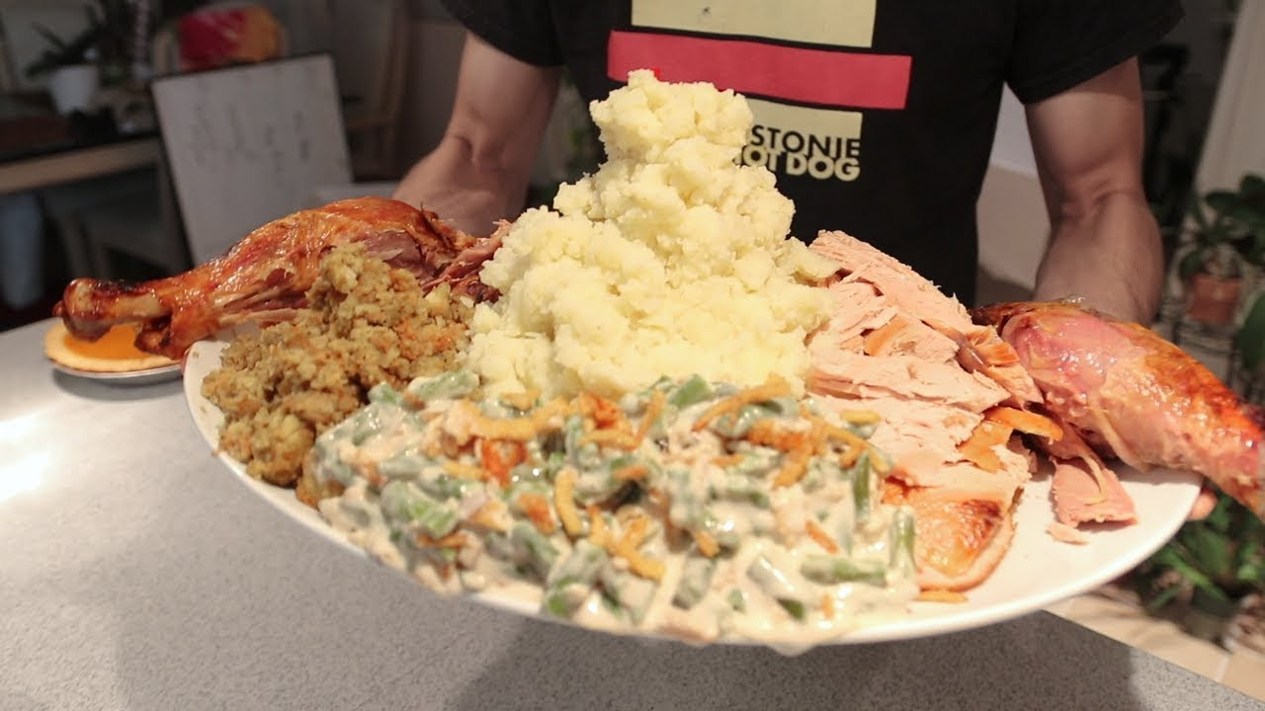
Realistic Expectations
What’s on your plate?
How much can I accomplish on the clock?
What can be delegated or shared?
Notes:
Yvette

Slide 10
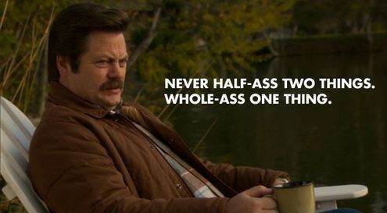
Think of the children!
Notes:
Alice
Grumpy Cat v Ron Swanson
Ron Swanson quote is something I often think about. The point of this quote being that if you half-ass 2 things, they are just not as good. My issue at times is that I want to whole-ass all the things, and that is an unrealistic expectation I put on myself. If I am able to put 100% effort into everything I do, but overbook myself, my mental and physical well-being is often the thing that suffers. And that leaves me running on empty for the teens I serve and my staff who serve teens.
If your work suffers, who is it hurting?

Slide 11
Having convos about workload...
Advocating for Yourself
Point to the numbers
Suggest others to work on projects with you
Suggest eliminating certain stressors
Your time, your schedule
Advocating for Your Staff
Ask staff if they’re able to accomplish everything that’s on their plate
Making sure the same staff members aren’t always “tapped” for different projects
Notes:
Alice
These conversations can be difficult, and you don’t want your supervisor to think you can’t handle your job. But at the same time, your supervisor may not realize how much you realistically have going on in a given week or month. If you feel like you’re drowning in your work, it may help to have these conversations to determine possible solutions.
Point to the Numbers: number of programs, number of outreach visits, number of desk shifts, number of committees, number of projects. Number of hours in a day. BE HONEST! What fits into a month? Is there anything that can be eliminated or managed differently?
Your time, Your schedule: Consider what your work week looks like. Can you do everything that’s on your plate within that time? Will you potentially have to work over your allotted hours to complete these things? If you’re a salaried exempt employee, make sure to take time off for the overtime you have to pull some weeks.

Slide 12
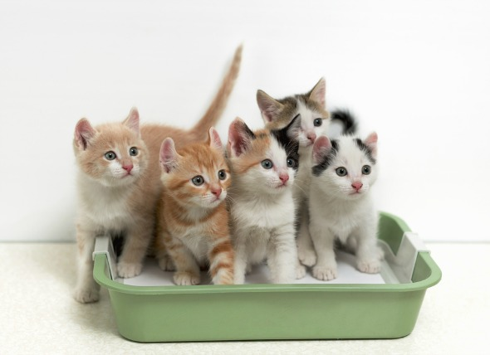
Boundaries…
“If I don’t control my life someone else will and I won’t like it” -Paul White, LCSW
Social Media
Personal/Professional
Leaving work @ work
Setting boundaries with patrons
Setting boundaries with coworkers
Notes:
Martha

Slide 13
How we maintain boundaries:
Keep work at work
Know when you can say “No” (and then do it!)
Knowing what is and isn’t your job - your “sphere of influence”
Notes:
Martha

Slide 14
How we maintain professional boundaries:
Yvette: Don’t accept “friend requests” from teens on personal accounts. Professional vs. Personal social media accounts.
Alice: Put group chats and texts on “mute.” Not every work conversation needs to happen right NOW.
Martha:
Leaving the building for lunch breaks
Ensure that project roles are clearly defined
I’m Extremely Online but I don’t try to represent the profession or my job

Slide 15
Advice from the Social Media Sphere
“Don't let any PTO time go to waste...make sure you're resting when you’re ill and taking mental health days to recharge however you see fit.”
Donna Block, Young Adult Services Forum group on Facebook
“If you're upset (say from a negative patron interaction) step away. Go to the back, get a drink, take a breath, calm yourself, then go back out. Don't stay at the desk and stew while passing the negativity on to other people.”
Allison Kearly, Teen Librarians group on Facebook
Notes:
Martha

Slide 16
More Advice
“Build some fun into your work. I color at my desk when I can, I keep a chocolate snack around, and I make time for music in my day... When the day is overwhelming, take a minute and a breath and remind yourself of all the things you GET to do, rather than the things you HAVE to do.”
Regina Townsend, Young Adult Services Forum group on Facebook
Notes:
Martha

Slide 17
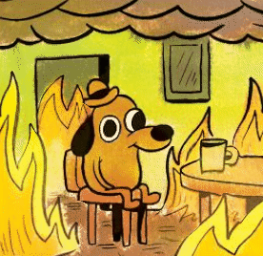
Programming Burn-Out
It’s all about the #numbers.
Lack of an audience
Ideas
Too Many
Too Few
Too Old
Taking it personally
Notes:
Alice
Programming burn-out is real! Here are some causes of programming burn-out.
Everything is not fine… don’t go down with the fire of your burn-out and hate programming forever. Find solutions… (next page)

Slide 18
How we manage program burnout…
Yvette: Variety & programming breaks.
Alice: Collaborating with other staff or TAB to present a program to bring something new to it and to have some programming buddies.
Martha:
Planning programs that I’m enthusiastic about, not just the popular thing
Recruit teens to run them for me

Slide 19
Resources…
Apps:
Todoist To-do list
Remente Mindfulness and goal setting
Calm Meditation and relaxation aid
Apple Watch Breathe app
Notes:
Martha

Slide 20
Questions?
Advice?
Suggestions?

Slide 22
Contact Us
Yvette Garcia, YOUmedia Manager, Chicago Public Library yleigh@chipublib.org
Alice Son, Teen Services Supervisor, Arlington Heights Memorial Library ason@ahml.info @alicehson
Martha Sullivan, Young Adult Librarian, Geneva Public Library District msullivan@gpld.org @magicalmartha
Notes:
Disclaimer: We are not mental health professionals!

