Slide 1
Out-of-the-Box Outreach
Kristin Kern, Elizabeth Lippoldt, and Mindy Schmidt
St. Charles City-County Library

Slide 2
What is Out-of-the-Box Outreach?
What it is:
Building connections with community social resources, supporting at-risk and high needs communities.
Taking library programs on the road, customized to the needs and location of the outreach partner.
What it is NOT:
Visiting schools
Talking about library resources
Signing up new library cards

Slide 3
YALSA on Outreach
“Our vision is that all teens, from a variety of backgrounds including, but not limited to ability, class, gender-identity, sexual orientation, race, religion and power-differentiated groups, will have access to quality library programs and services ‒ no matter where they occur ‒ that are tailored to the community and that create new opportunities for all teens’ to promote personal growth, academic success, and career development, while linking teens and staff to resources, connected learning opportunities, coaching, and mentoring.”
Notes:
Outreach to teens is very important. Not only is it getting library materials, information, and programming out to those who normally would be unable to walk through the doors. But it is also making the first step, meeting the teens where they are comfortable, initiating that relationship, and building that trust. Since we all know how difficult it can be to get those teens in the library to overcome that challenge.

Slide 4
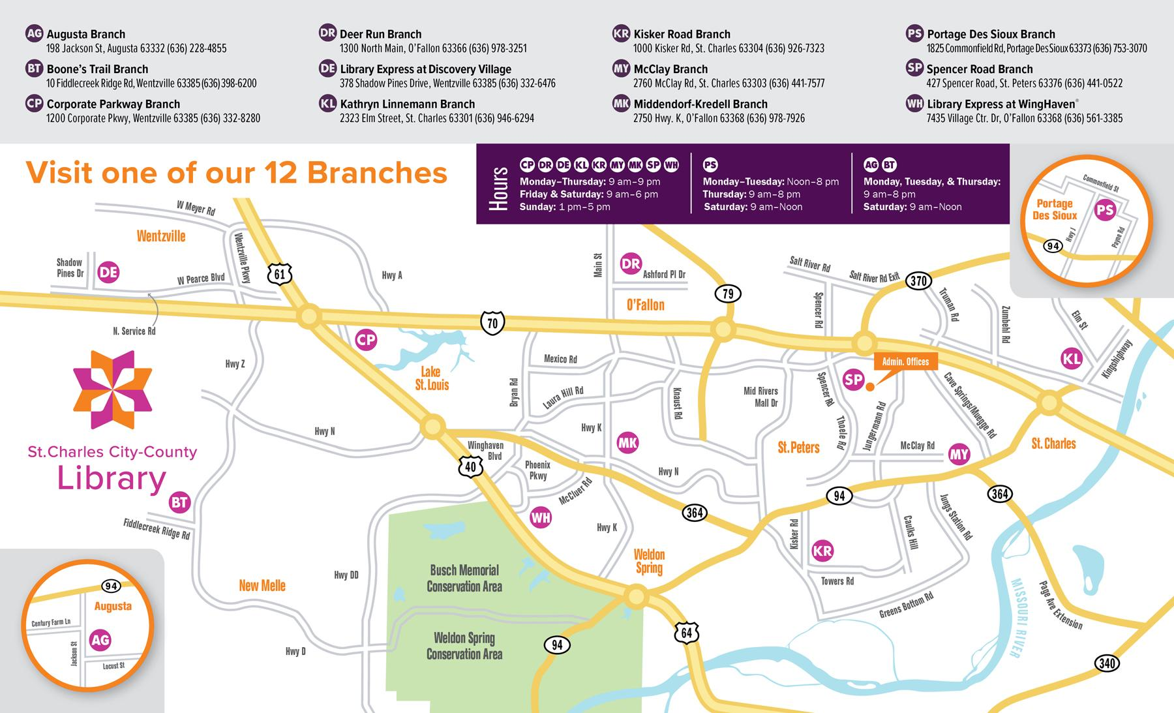
Notes:
A city-county merger in the suburb of St. Louis, more urban and at-risk towards the city, with a mix of gentrified and at-risk rural community members the further you move away from the city. We have 3 large branches that oversee subsections the rest of our district for a total of 12 branches.
Structurally, there are 3 Teen Services Librarians located at the 3 large branches and the other branches have teen paraprofessionals. Teen Services is included in the Youth Department but we function with a lot of independence.
We do have an Outreach Department, which is located in our administration building in the middle of the county. It is unfortunately separate from library staff and the community and we are still trying to find a balance between what our Outreach Department does versus what they would like our in-branch staff to do.

Slide 5
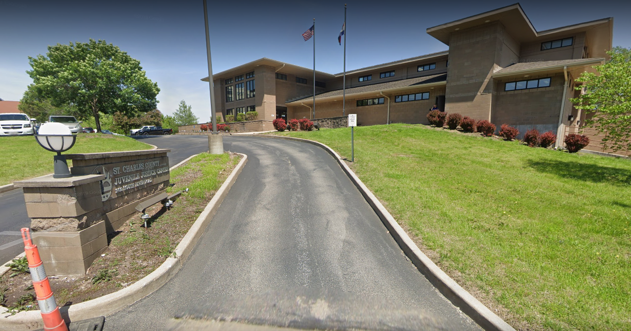
Juvenile Justice Center
Notes:
We began our journey with a partnership with our Juvenile Justice Center. The Center in our county serves youth under the age of 18, holding youth who are either processing for law violations, truancy, and runaway and family abuse situations. When we go, it’s a mix of genders, though mostly male, and is a mix of age ranges, though mostly high school. The facilities can hold at-max about 20 kids, but we work with anywhere from 1 to 8 teens when we go.
Our connection with JJC started at a monthly Young Adult staffing meeting, where our Youth Director brought up that the wish to work with JJC had been long running but we had not had the staff to initiate the project. As the first teen librarian, new and looking for projects, I volunteered to make the connection. My branch was the closest but I also asked Mindy, the teen paraprofessional at the other closest branch, if she wanted to partner with me on the project. I contacted the Superintendent of Detention via email, told him we were interested in offering outreach to the center, and asked to meet with him and tour the facility. He promptly responded and we set up a time to talk.

Slide 6
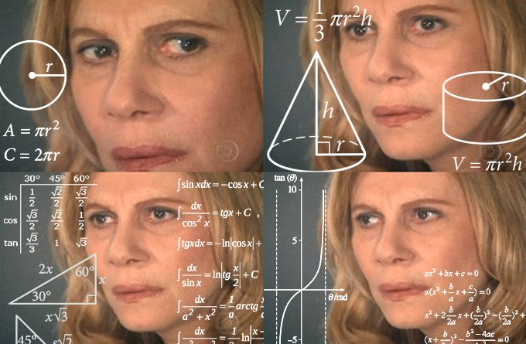
How We Started
Going once a month together in the morning.
Writing lesson plans for every activity or sticking to inflexible 3-4 programs.
How much can we connect with the teens?
What are our mission and personal abilities?
What’s our budget? How does this work with our Outreach Department?
Notes:
This was our first out-of-the-box outreach, so Mindy and I started going once a month together for moral support. Our visits were incredibly rigid, structured on lesson plans that the superintendent required us to fill out, justifying how our programs were educational and meeting his own goals. Writing these lesson plans took a lot of staff time and had the implication of zero flexibility. We aren’t teachers and felt very out of our depth and this led to a lot of insecurity about how well we were doing. Because of the formality, we were not sure how much we could connect with the teens, feeling like there was a boundary between us connecting with them. We had a lot of anxiety and insecurity -- we weren’t sure on what our goals were besides working with these teens and doing outreach with a partner our administration wanted. We also didn’t know how this would work with our developing Outreach Department and branch budgets since it was a project we were sharing.

Slide 7
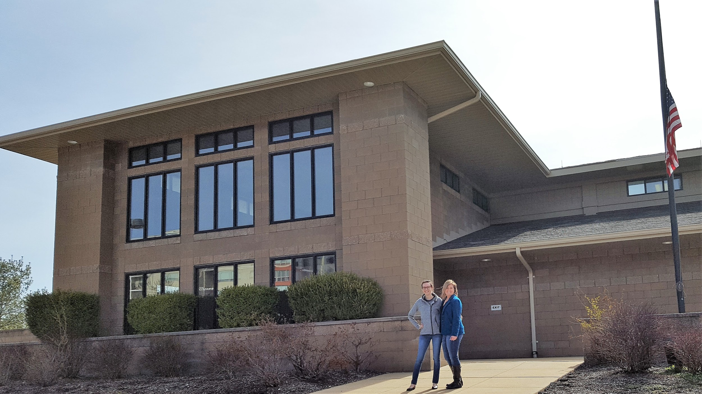
The Moment Everything Changed
Notes:
It wasn’t until about 6 months into outreach that we were invited to their annual Volunteer Appreciation Dinner when everything seemed to click and a lot of our insecurities were resolved. The kids provided all volunteers dinner, presented their various school projects, and gave us handcrafted thank-you gifts. Talking to the other volunteers on what they offer, we discovered that they were not being held to the lesson plan design that we were -- a college social work group was simply playing board games with the teens -- we grew much more confident in what we could do. It was rewarding to hear speeches from the teens and staff on how much they appreciated us, affirming our efforts we were unsure about. And, as funny as it may seem, the teens taught us to play a card game called Trash which completely opened up our hesitant boundaries connecting with them. We realized these teens were no different from the ones we work with in the library, and so our perspective and boundaries changed. Outreach now is just the same as doing a program at our branch -- just with some materials restrictions.

Slide 8
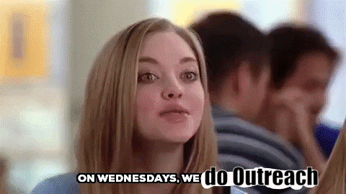
How We Currently Operate
Once a week on afternoons when there is no school.
No more lesson plans!
Assertive and improved communication.
Collaboration with other librarians.
Week-long activity.
Know what our goals are.
Notes:
After the appreciation dinner, we began to run our outreach just like we would a program at the library and ignored lesson plan writing. I had a conversation with the Superintendent, asserting how we would like our outreach to function, and he informed us that the lesson plan paperwork was only to report to his board in the semi-regular newsletter. After getting bounced around from time slot to time slot, we also asserted what we felt was the best time within our personal capabilities to offer outreach. We improved communication with staff, getting updates from security on the mental health status of the teens each time as well as a headcount the day of from the teacher. In a conversation with our Youth Director, we were able to administrative buy-in for more staff support in order to go weekly. We also worked with our administration for permission to leave our programming kits, which we request and use in-house for library programs, at JJC for the week for the teacher to use when we are not there -- these include things like Snap Circuits or LEGOs. We also learned what our goals were -- to provide at-risk teens who need community support resources and skill building (whether they are educational, social, or artistic.)

Slide 9
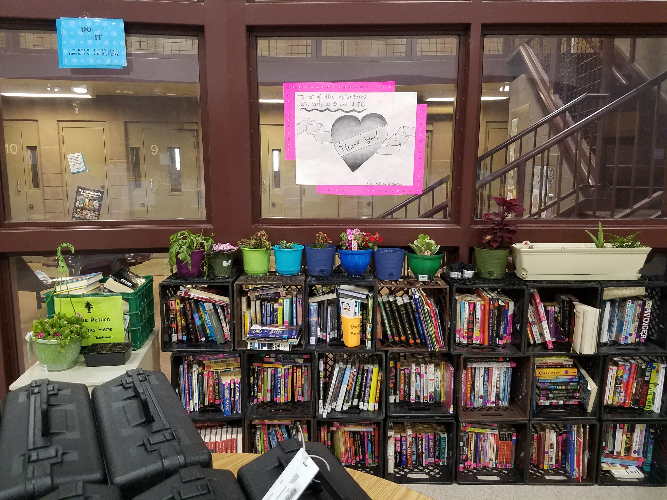
What Do You Do?
LEGO Challenges
Osmos
Snap Circuits
Slime
World Building
Mad City Money
Roleplaying
Sculpting
Gardening

Slide 10
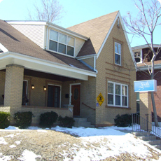
Youth in Need
12-bed temporary shelter
Youth in crisis ages 10-18
Safe haven from:
Abuse
Family stress
Homelessness
Notes:
Our next outreach endeavor was Youth In Need, after working with the kids at the JJC, we found the interactions rewarding and we really liked making connections with teens that weren’t coming into our libraries. As we started looking for ways to expand our at-risk outreach, we chose to contact Youth In Need, who serve youth of varying ages at multiple locations throughout St. Charles County. Since we already have a partnership with Youth In Need relating to younger children and their parents, this seemed like a logical place to start making connections since we had not yet reached out to their teen population.
The Youth In Need's Emergency Shelter, shown above, houses up to 12 kids ages 10 through 18. They provide a safe haven from abuse, a 'family timeout' to use as a cooling off period and they provide shelter for homeless children and teens. While kids stay there, they offer individual, family and group counseling, crisis intervention, case management services and daily educational groups.

Slide 11
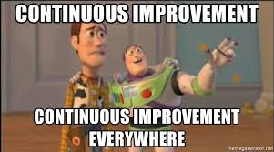
How We Started
Impact more at-risk youth
Pitched our outreach ideas
Blood work and background checks
Going once a month
How We Currently Operate
Increased Visits
Consistency
Improved communication
Improved relationships
Notes:
We initiated a meeting with the Youth In Need’s program coordinator and discussed the activities that we would like to offer. Youth In Need has various services for teens including, Transitional Living, Street Outreach, the Emergency Shelter as well as Teen Parent groups. It was decided that the Emergency Shelter would be a good fit for us. We had to complete background checks and blood work before we could start our outreach at their shelter.
In the beginning, Elizabeth and I started by going to the emergency shelter together once a month, since we were nervous of what to expect, we thought it would be better to have two of us there to interact and run the activities. We were unsure of how the shelter operated and how much the counselors and house staff would interact with the programs.
However, since we were only going one time per month, It felt like we were not making a connection, it was like starting from scratch every time. The kids seemed surprised and confused when we arrived as to why and what the library was doing there.
Like with the Juvenile Justice Center, Elizabeth felt like we would make more of an impact if we could figure out a way to go two or more times a month. The kids would become more familiar with us and become more comfortable. We separated our visits so that we each went once a month, so we were able to increase our visits to YIN to two times a month. Seeing the positive reactions to the increased visits, we collaborated with two other teen outreach staff, and we are now able to visit YIN once a week, along with the JJC. It makes for a full, but rewarding day.
During our visits, we work with about 3-8 high schoolers, a mix of different races and genders. We have more freedom in the activities and little to no restrictions with what we bring to YIN, that makes program planning easier. Working with teens at YIN is very similar to working with teens in our branches, they are funny, inquisitive, and have lively teen conversations. We see lots of familiar faces, some of which come into our individual branches. The kids get excited when they recognize you and that reinforces the library connections. sometimes we plan a separate activity to take there.

Slide 12
Youth In Need - Outreach Evolution
In the beginning:
Nervous
Excited
Conflicted
Disengaged
No Connection
Now:
Confident
Engaged
Excited
Connections
Fun!!
Notes:
We went from visiting once a month together, to twice a month separately, and now we are able to go every week. We have seen a huge difference that this regular interaction makes. The kids look forward to us coming, they are excited and interactive when we are there. I feel we have grown tremendously as an outreach team and we are more connected, engaged, as well as confident. We are making an impact in our teen community, reaching teens that had never considered the library as a place that could play an important role in their lives.

Slide 13
Family Forward Fail
Then:
Lack of Knowledge
Communication Error
Out of our depth
Awkward
Hesitant
Now:
Research
Detailed Questions
Backup Plan
Experience
Graceful Exit
Notes:
After having success with both the Juvenile Justice Center and Youth In Need, we continued to look for ways to expand our teen outreach, searching to find places that would benefit from having the library visit.
We found Family Forward, a facility providing long term, 24-hour care for children with significant medical needs. We reached out to them via email sharing a teen outreach brochure that Elizabeth had drafted. We were then able to set up a conference call and discuss our program ideas. We arranged a visit to the facility before our outreach programs with them began. On touring the property, I was able to meet the residents and interact with them, it was then I realized that they would not be able to do most of our proposed activities. The programs would have to be geared more towards a storytime flannel board program, which Elizabeth and I were not familiar with . However, being a newbie to outreach, I was not sure how to extract us from this commitment without causing ill will. We did proceed with the outreach for several months, going together and performing storytimes with flannel boards. It was an awkward fit and very uncomfortable. We spoke to our Youth Services Director and Outreach Manager who agreed that while we wanted to keep the partnership it needed to be turned over to children’s outreach department who were trained for younger programming. It was a huge learning experience.
In hindsight, I should have asked more pointed questions and LOTS of questions, a tour is always a good thing to do BEFORE you commit to anything, do not be hesitant to admit that you misjudged the situation and pass it on to someone who is more comfortable. Have a backup plan in case things are not what you thought. Do not over commit!!! You can always add to outreach but it is hard to decrease.

Slide 15
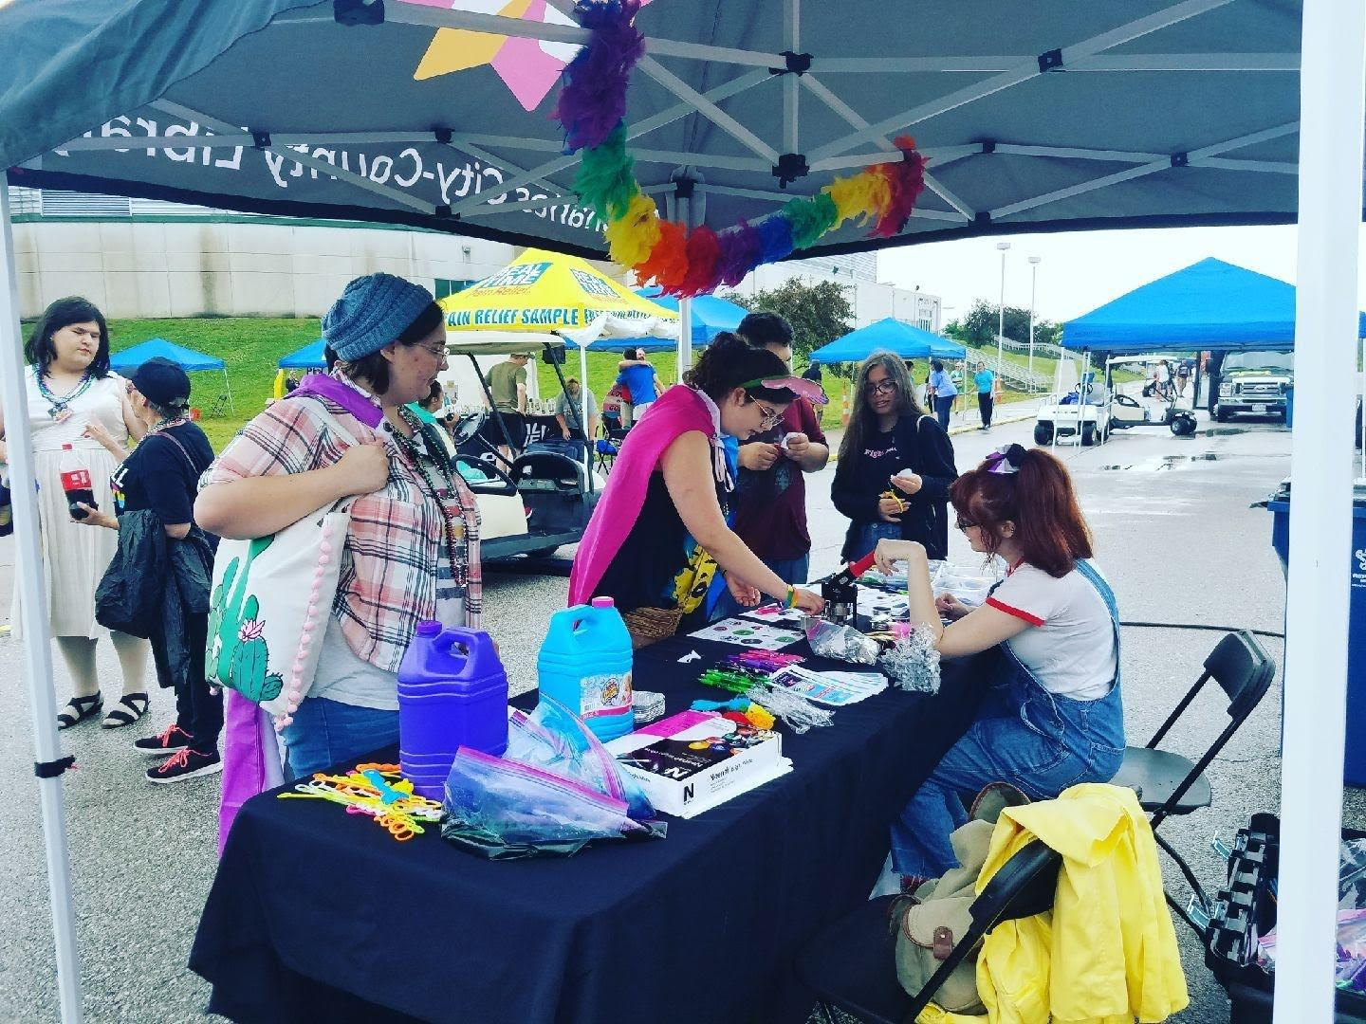
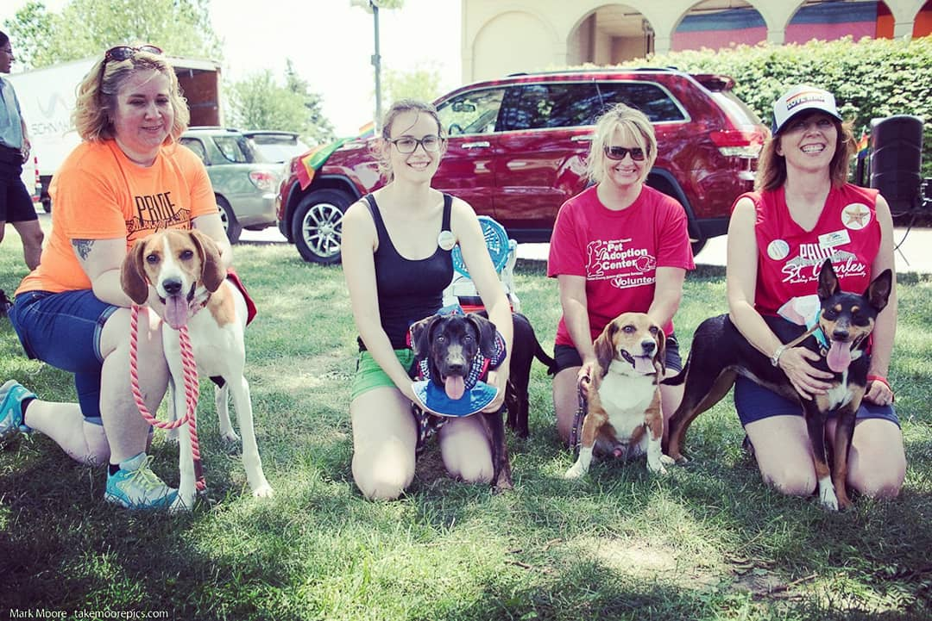
St. Charles Pride
Notes:
Another out of the box outreach community partnership was St. Charles Pride. It was a natural fit, we really wanted to create a teen LGBT group and they were looking to create their own teen group! We started out a little small, such as volunteering to craft the costumes for the Doggy Drag Show Adoption, to having our own booth at this year’s Pride Fest. We got about 312 people to visit, and we were one of the only booths that provided an activity for both young kids and teens/adults. The outreach department was also there to sign up for library cards but we wanted to make more of an interactive impact on the community. This has lead to collaborating on other events, such as teens joining both groups, helping to collect donated clothing for our teen community, to planning a larger event that could be recurring… still thinking of ideas on that one… the teens tend to have great ideas, that are not always the most practical. But with this collaboration, we gained a great friendship! It is so great to have even more connections and opportunities for our queer teens in the library.

Slide 16
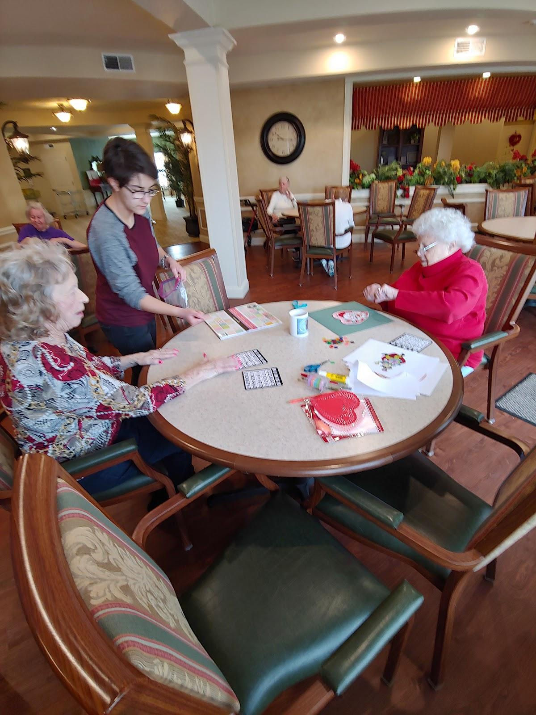
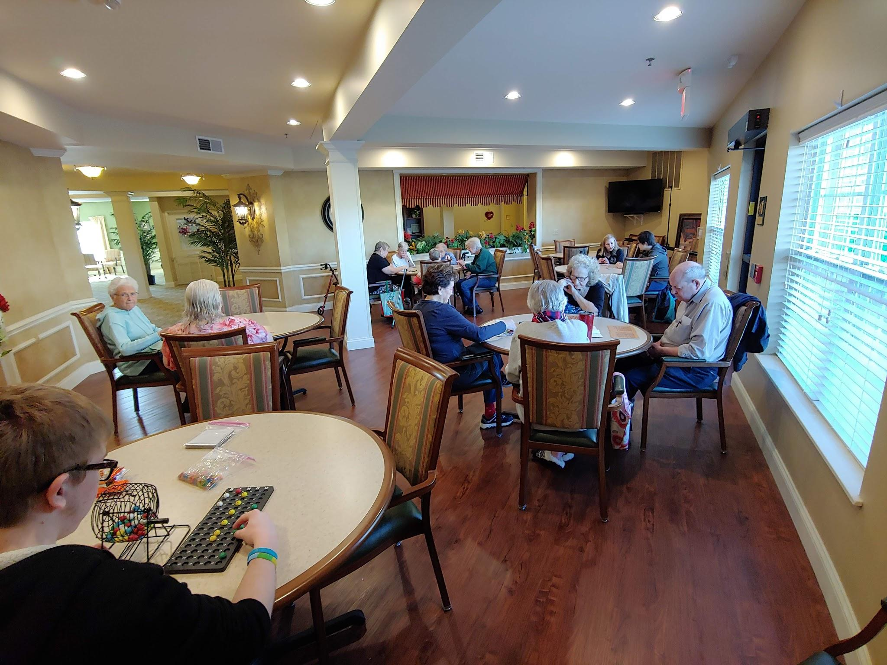
Teen Community Service
Notes:
When I took over the TAB at my library I immediately thought that we could be doing so much more with these teens! I asked them if they were interested in earning more volunteer hours and wanted to get out in the community and try to make a difference? They were immediately suggesting ideas, and things that we could do! I was pumped but my emails to organizations were going unanswered, I thought going in to this, that organizations would be begging for our help! This was not the case, often times it is more work for them to make time for us to volunteer. For example at this retirement home, the activity coordinator comes in specifically for us, on a Saturday afternoon. At these visits we offered tech help, reading aloud to a partner, gardening, cornhole, and the ever popular bingo!
A plan is very important, one afternoon a teen asked what the woman he was talking to was interested in doing that day, and she said that she wanted to learn to read. My teen was very unnerved and obviously ill prepared for assisting an adult to read.
Now we come with a plan A, plan B, and even a Plan C. So we know what we are doing through the whole visit.
Since my TAB has volunteered more and more often another teen librarian at a different branch has also started up a bi-monthly service group where they give back to the community as well. It has gone very well!

Slide 17
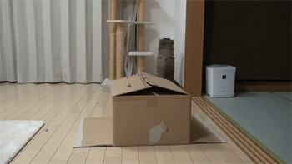
Other Partnership Ideas
Alternative high schools
Boys & Girls Club
Youth Long-Term Shelter
Food Banks
ESL classrooms
School organizations
Parks Department
Community Council
Notes:
Trying to see if you can get a table set up for all local events like this is one of the best ways to get the word out! Organizations to partner/collaborate with are fantastic when you both can get something out of it. The parks department has been great about collaborating and we hope to see if we can get our teens out monthly to clean up local parks, play on branch wiffle ball teams, offering fishing classes, and so much more. This provides a great service and is wonderful publicity for both us.

Slide 18
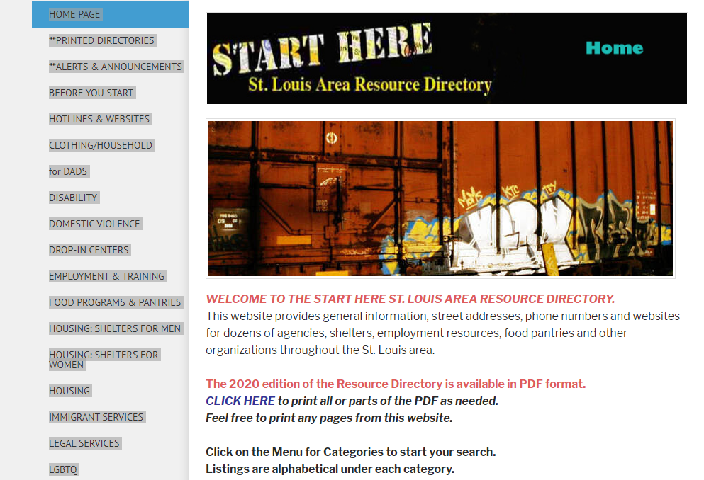
Asset Mapping
Online resources, check out what is in your area.
Start making calls and gain some connections!
Notes:
If you are struggling to find resources in your community: google asset mapping and your city’s name, or by checking youth.org for a list of organizations in your area that serve teens in need.

Slide 19
Questions to Ask
What are your vision and mission with the teens? How can the library support this? Do you have ideas envisioning what the outreach will offer?
What requirements do you have of volunteers? Background checks, bloodwork?
How many teens do you host on a weekly basis? Monthly?
What are the gender and age demographics?
What organizations do you currently work with? What sort of programs do they offer?
What kind of facilities do you have? Access to outside? A space for physical activity?
How would I access the wifi, are there any restrictions? Do you have computers available for the youth to use?
What materials am I not allowed to bring? What about food?
What expectations do you have for me?
How do I enter the facility? What if I have carts of materials or large items? Do I sign in?
Can I rely on any staff to help me facilitate the program?
Notes:
Some of these we asked in our meeting and some we really wished we had and had to figure the answers out as we progressed in our outreach.

Slide 20
I Don’t Have Your Resources!
Consistency!
Communicate
Reuse and recycle outreach & library programs
Don’t overextend
Leave activities behind
Be assertive & honest with partners & management
Partner with other libraries or organizations
Notes:
We recognize that we are pretty privileged with the amount of staff and money our district has -- so what can libraries who serve smaller populations do with limited resources? Here are a couple things we recommend: Consistency is really important. Keep going on the same day (with the same staff, if possible.) It shows your dedication to the partnership but also builds trust and familiarity with the teens and staff. Communicate! Over communication, if you have to, because there can never be enough. The biggest stumbling block has been not communicating enough with our partners.
Reuse and recycle both your outreach and library programs. Depending on your partnership, the teens you see each month or even each week will likely not be the same because they rotating in and out pretty quickly. It’s okay to reuse a program you did at your last outreach event. And maybe you did a program at your library that not a lot of teens turned up to and you have supplies left over? Outreach is a great way to reuse the program or recycle those materials. Don’t overextend yourself. You don’t have to be doing all the outreach. Determine what is an amount that you can handle without being stressed or stressing your coworkers. One outreach visit is better than none -- at-risk teens need any form of support you can provide. If you can’t spend the staff time as frequently as you would like there, leave behind your activity for the staff to run with the teens after you are gone. You can reach the teens you don’t see and it may alleviate any guilt you feel about not going as often. Be assertive and honest your your partners. Being a pushover may lead to signing on to more outreach than you can handle or outreach you feel does not meet your goals. Also be assertive and honest with your management. Prepare reasoning for your partnership for your managers who may not understand why you are dedicating outreach time outside of school visits. (Some of which might be: the teens aren’t coming into the library, so let’s meet them where they are; libraries are strong supporters of underserved, lost communities and at-risk or minority teens are especially vulnerable; it’s a great way to reuse low-attendance programs and won’t take up a large amount of off-desk planning time; YALSA has established this as an important goal; and my favorite -- other libraries are doing it.) See if you can partner with other libraries or organizations for the outreach. Maybe your juvenile justice center serves multiple counties or townships -- reach out to librarians at other libraries within that region to see if you can organize something together and share resources.

Slide 21
Questions & Audience Input
What out-of-the-box-outreach do you do? What challenges have you faced? What successes are you proud of?

Slide 22
Thank you!
Kristin Kern
Corporate Parkway Branch
kkern@stchlibrary.org
Elizabeth Lippoldt
Kathryn Linnemann Branch
elippoldt@stchlibrary.org
Mindy Schmidt
McClay Branch
mschmidt@stchlibrary.org

Slide 23
a kaleidoscope of discovery

