Slide 1
Libraries Transforming Communities: National Issues Forums Workshop for Academic Libraries
American Library Association
Midwinter Meeting
Friday, February 9, 2018

Slide 2
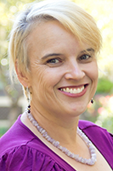
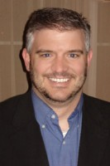
TODAY’S PRESENTERS
Ellen M. Knutson
Research Associate
Charles F. Kettering Foundation
Martín Carcasson
Founder and Director
Center for Public Deliberation
Colorado State University

Slide 3
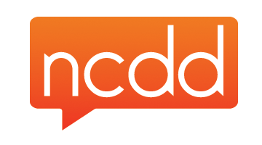
THANK YOU TO OUR PARTNERS
This project was made possible in part by the Institute of Museum and Library Services grant RE-40-16-0137-16.

Slide 4
WEBSITES TO REMEMBER
Libraries Transforming Communities
ALA.org/LTC
National Issues Forums
NIFI.org
National Coalition for Dialogue & Deliberation
NCDD.org

Slide 5
Community Engagement Sessions at Midwinter
The Harwood Institute and Libraries Transforming Communities
Date: Saturday, February 10, 2018
Time: 1:00 pm – 2:30 pm
Location: Colorado Convention Center, Rm 503/504
Join Rich Harwood, President and Founder of The Harwood Institute, and librarians experienced in Turning Outward to learn how libraries are leveraging these tools for impact, and how Turning Outward is spreading through the field.
Libraries Foster Community Engagement Member Initiative Group Meeting
Date: Sunday, February 11, 2018
Time: 8:30 am – 10:00 am
Location: Colorado Convention Center, Rm 708
Hear about community engagement activities in school, academic, public and other libraries and library-related organizations around the country.

Slide 6
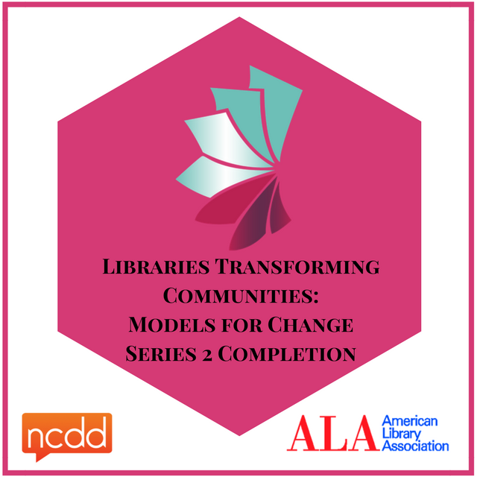
CLAIM YOUR BADGE
INSTRUCTIONS
Visit www.credly.com
2. Create an account or login
3. Click on “Claim Credit”
4. Enter “LTCAcademic5” to claim badge

Slide 7
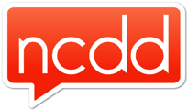
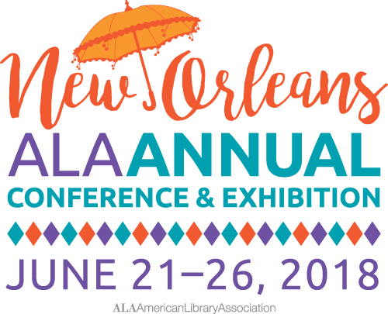
ONLINE LEARNING
SERIES 3:
LEARNING SCHEDULE
Introduction to
Dialogue & Deliberation for Public Libraries Serving Small, Mid-sized and/or Rural Communities
February 28, 2018
REGISTER NOW!
IN-PERSON TRAINING WORKSHOP
Libraries Transforming Communities:
Dialogue & Deliberation for Small, Mid-sized, and/or Rural Libraries
June 22, 2018
apply.ala.org/LTC2018/
Future Search
April 25, 2018
Conversation Café
May 23, 2018

Slide 8
Questions?

Slide 9
THANK YOU!
ALA’s Public Programs Office
publicprograms@ala.org
Ellen Knutson
ellen.knutson@gmail.com
Martín Carcasson
Martin.Carcasson@colostate.edu

