Slide 1

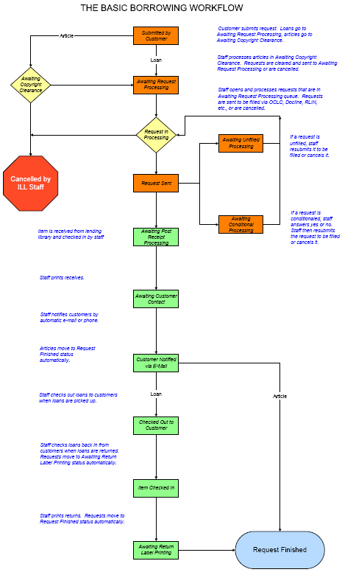
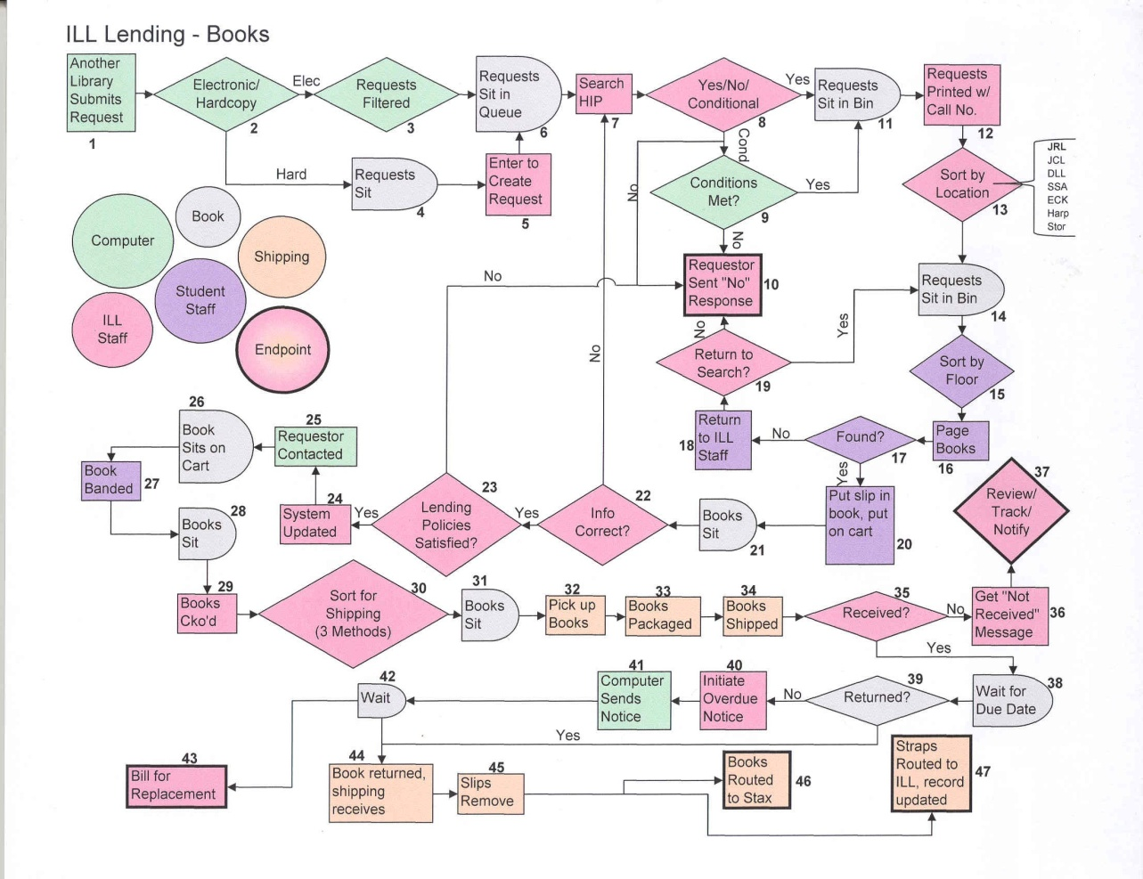
Borrowing
Everything you always wanted to know in 45 minutes…
Getting It System
Cyril Oberlander, SUNY Geneseo
ALA RUSA/STARS
January 23, 2009
cyril@geneseo.edu
Notes:
While no flowchart adequately reflects the resource sharing reality today, the nature of much of what we are talking about is built on the ideas of process, decision making, and relationships.
The most important reality is that people; users and networks of people are what we are talking about today, add to that, an attempt to talk about practices that evolved rapidly and with a lot of variation. How many people remember 3,2,2,1? That was one of the common ways to search in OCLC for ILL about 10 years ago. CLICK, first I want to mention I don’t like the term borrowing because it increasingly doesn’t apply with the range of services and providers we are working with.
Images:
http://www.atlas-sys.com/documentation/illiad/content/OCLCILLiadBorrowingWorkflow.pdf
http://www.mls.lib.il.us/ennounce/2007/01_05/ucprocess1.jpg
Idsproject.org

Slide 2
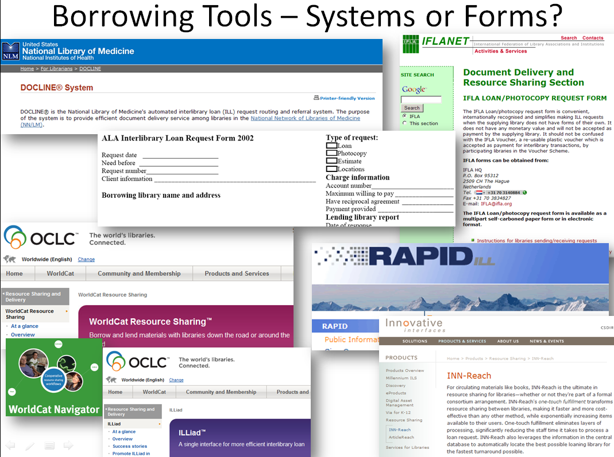

Borrowing Tools
?
Notes:
Which ever the system, CLIO, ILLiad, ALA forms, consortia borrowing systems, they all have a cost-benefit worth annual evaluation, but I want to add that to help these change with your needs, I encourage everyone to share your workflow goals with vendors openly – the more products and service that catch up to our needs – which are tuned to the growing expectations of our users, the better.
I also want to mention that both ARL and IFLA’s Best Practices encourage handling all requests in one electronic system as preferable. Docline is focused on medical materials, it’s a free system, although most of the transactions have lending charges there are some LVIS like FREESHARE libraries; some systems have subscription fees, while others, like the simple ALA or IFLA forms, used well with email templates are adequate for handling small operations efficiently.
http://www.nlm.nih.gov/docline/
http://www.oclc.org/resourcesharing/default.htm
http://www.oclc.org/services/brochures/213665usb_worldcat_navigator.pdf
http://www.ala.org/ala/mgrps/divs/rusa/archive/protools/referenceguide/illformprint.pdf

Slide 3
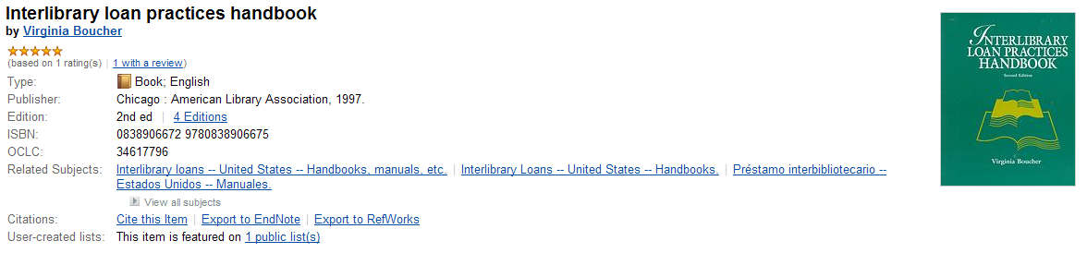
Basic Borrowing
Borrowing in a nutshell…
User asks for something using an ILL Request Form
Searching Requests – Locating Bibliographic Records & Potential Suppliers (Evaluate terms of borrowing; cost, due date, delivery systems, etc.)
Verification & Requesting (remember you are responsible @ point of shipped)
Process Conditional, Unfilled, Special Messages
Receiving & Processing Materials – Preparing for Use and Delivery
User Delivery or Material Pickup: Ariel, Email, Odyssey, Skype, Web Delivery | UPS, USPS, etc.
Returning Material
Extras: Copyright, Renewal, Damaged, Resend Requests, Lost, Wrong Material Sent, Rules of the Road (responsibility, standards, etc).
Adapted from Hilyer, Lee Andrew, “Interlibrary Loan Operations,” Journal of Interlibrary Loan, Document Delivery & Electronic Reserve, vol. 16 (1/2), 2006.
Notes:
Besides Virginia Boucher’s seminal work, I want to point to another source of interest. In 2006, Lee Andrew Hilyer authored a series of articles in Journal of Interlibrary Loan, Document Delivery & Electronic Reserve which attempted to explain the various operations of Interlibrary Loan, the chart is an adaptation of that.
OK, you really want me to cover all this in 35 minutes…

Slide 4
Borrowing Strategies & Tips
Abbreviations:
  PubMed: http://www.ncbi.nlm.nih.gov/sites/entrez?db=journals,
  CASSI,
  UIUC guide: http://www.library.uiuc.edu/biotech/j-abbrev.html
Copyright – Rule of 5 – Cindy will cover that later…
Cost: that is a tough one…
Real Cost
ILL Systems: Annual fees, Use, Maintenance, etc.
Delivery Systems: Ariel, Courier, UPS, USPS, etc.
Copyright Royalty Fees
Lending Charges
More?
Other Cost
User Time
Staff Time
More?
Notes:
Real cost discussions will follow when I move from traditional ILL to alternatives, however, I suspect we all are paying increasing attention to the real costs of borrowing.
How many know the average cost of borrowing an item?
How many charge back to the user some of the cost of borrowing? Charge back has one of the strongest correlations to limiting borrowing services, but may be an increasingly important factor in maintaining resource sharing; unfortunately, adding billing makes resource sharing less efficient.
On important factor in lowering cost of borrowing in OCLC is utilizing strategic custom holdings…
Outsource example: http://www.wnylrc.org/documentView.asp?docid=399

Slide 5
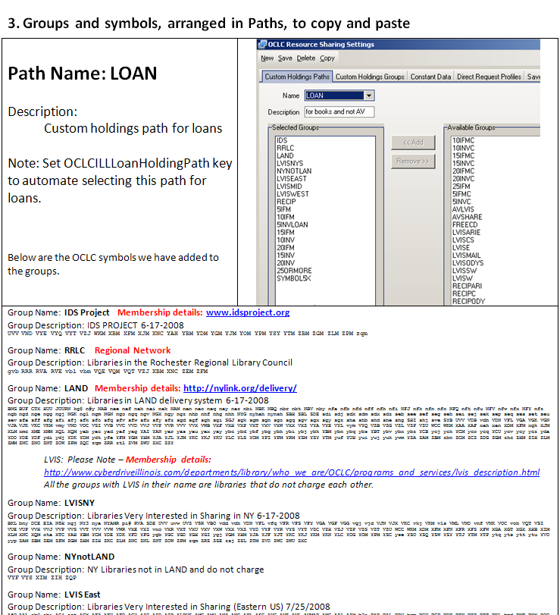
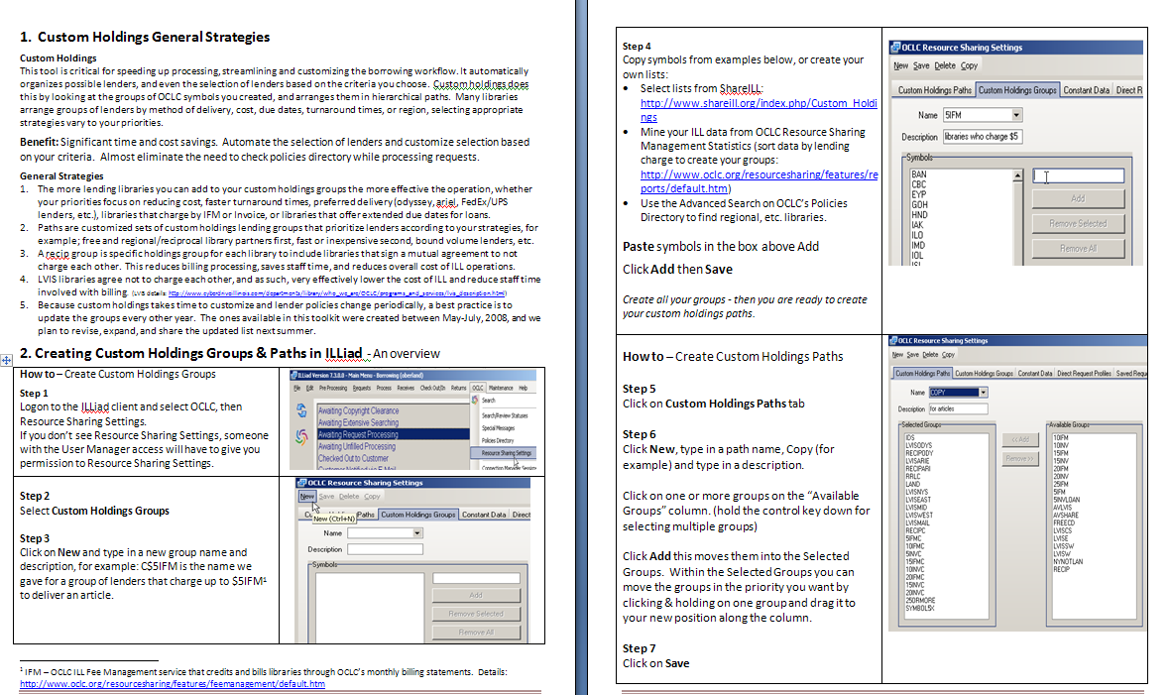
Workflow Toolkit Chapter 3 – Custom Holdings & Direct Request
http://www.idsproject.org/Toolkit.aspx
related info:
Taming the Torrent: http://www.atlas-sys.com/training/handouts/communitycontributedmaterials/tamingthetorrentfull.pdf
Notes:
How – briefly explain…
Sharing best practices is essential – brief explanation of the Workflow Toolkit was created by the IDS Project to share tools and best practices among primarily ILLiad libraries, it has 5 chapters designed to help libraries easily implement or adapt best practices. However, chapter 3 on custom holdings applies to any OCLC Worldcat Resource Sharing borrowers as well.
This example on Custom Holdings is chapter 3 in the toolkit, it provides description for general strategies, but provides example Groups and Path – click - examples that you can copy, adapt, and easily implement. We are working with Atlas to add interactive elements and provide support to their training program – because the more everyone improves their workflow, the overall effectiveness of resource sharing is improved.
This chapter also explains how we customized the path for Direct Request, for example, if no lender can supply for under $15, we want to consider purchasing before borrowing.

Slide 6
Borrowing Strategies & Tips
Abbreviations:
  PubMed: http://www.ncbi.nlm.nih.gov/sites/entrez?db=journals,
  CASSI,
  UIUC guide: http://www.library.uiuc.edu/biotech/j-abbrev.html
Copyright – Rule of 5 – Cindy will cover that later…
Cost: that is a tough one…
Outsourcing: Referral Centers, Libraries centralizing operations or hosting service for others.
Purchase on Demand (POD): Different pilots – but how transformational?
Unfilled Processing: Verification, POD, Renting, Limit the extent of searching?
Un-mediate Processing: searching, selecting, requesting, processing - odyssey trusted sender, etc. What next? Auto-Renewals, lending of e-journals, etc.?
Verification Tools: http://www.shareill.org/index.php/Verification_tools
Notes:
Explain slide details briefly
After verification tools, let’s head to the realities of borrowing…
Outsource example: http://www.wnylrc.org/documentView.asp?docid=399

Slide 7
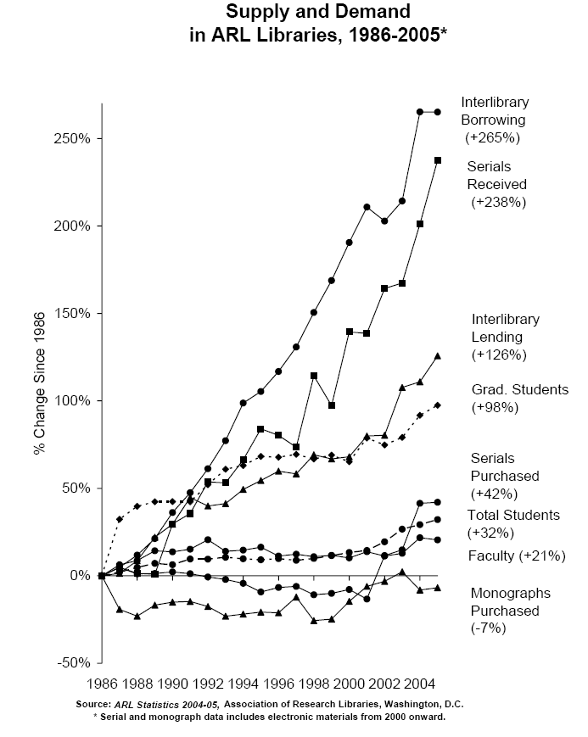
Resource Allocation
&
Interlibrary Loan
Interlibrary
Borrowing
(+265%)
Why such growth rates for Interlibrary Loan ?
Declining budgets
Cost inflation
ILL systems mature
Interlibrary
Lending
(+126%)
Serials
Purchased
(+42%)
Monographs
Purchased
(-7%)
Notes:
One way to view it is by looking at ARL’s supply and demand reality – what this graph highlights is the correlation between resource sharing and library collections and resources.
Another way to look at this situation from the user’s information context…
http://www.bisg.org/conferences/mip5.html

Slide 8
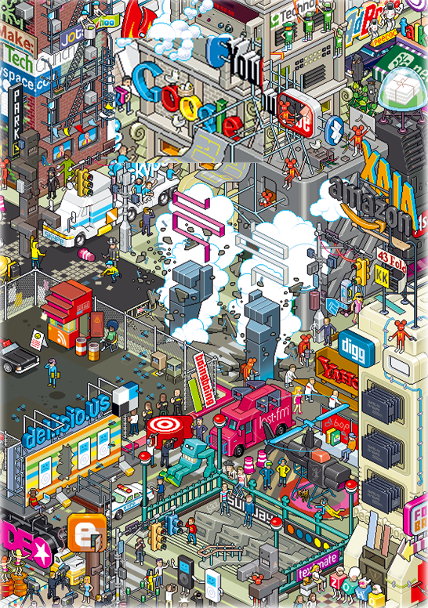
From the User’s Perspective
Undergraduate have a variety of successful strategies – see Univ. of Rochester’s Studying Students report
http://www.ala.org/ala/mgrps/divs/acrl/acrlpubs/downloadables/downloads.cfm
Users feel confident in locating information
OCLC Perceptions
www.oclc.org/reports/2005perceptions.htm
Dempsey, Lorcan, 11 June 2008 Web 2.0, Library Systems and the Library System SCONUL Conference, Edinburgh, Scotland (UK)
Notes:
First a trend to be aware of is that we have to look at the information environment from the user’s perspective; they are comfortable with discovery, perhaps more so than libraries.
11 June 2008
Web 2.0, Library Systems and the Library System
SCONUL Conference, Edinburgh, Scotland (UK)
OCLC Perceptions: http://www.oclc.org/reports/2005perceptions.htm

Slide 9
Transforming Service Delivery Matters
“main frustration is not with the research discovery services themselves, but with the problem of subsequently accessing identified sources and materials.” Research Information Network (2006) survey of researchers.
“We now have a situation in which users may discover items in online indexes or online library catalogues then hit a dead end as far as delivery is concerned. This is a dangerous situation for the role of libraries in general. If libraries collectively do not seek to find ways to get around these dead ends others will.” Gatenby & Goldner, 2005
Recommendations: “The core value of libraries is the service they provide to their users.” Liu, 2008
Notes:
What users aren’t comfortable with is accessing information.
While libraries increasingly focusing energy and money into their discovery systems, many actually developing a local next generation catalog, the real problem is an access and delivery problem. I think that is where Getting It fits in nicely with this discussion?

Slide 10
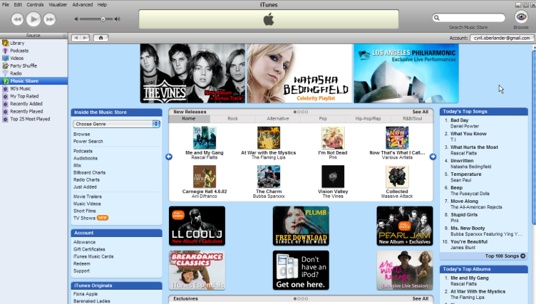
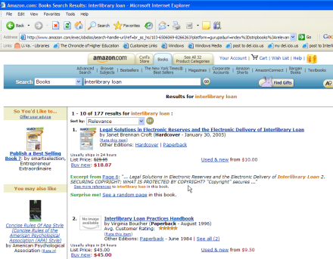
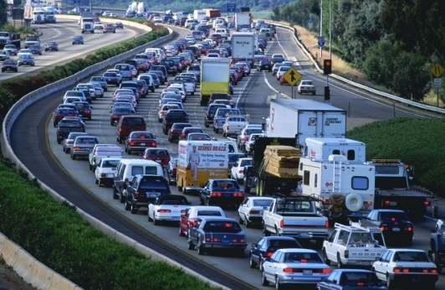
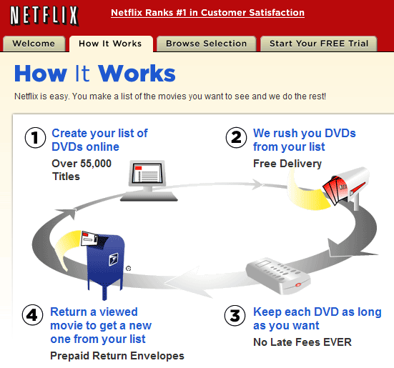
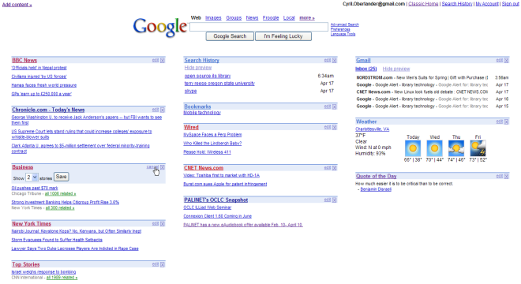
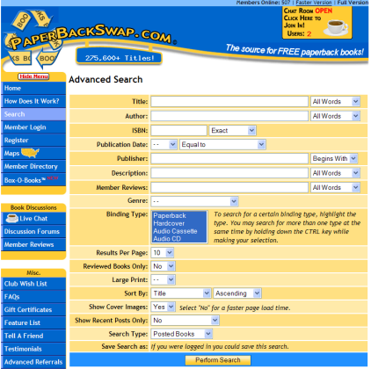
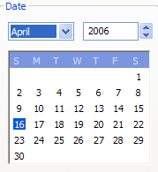
Sense-making with Options
User Search
& Discovery
Get Options
Find it @ your Library
or drive to another library,
or ILL from your Library,
or request Library buy it.
Notes:
How many people believe that in an age of video streaming and home deliveries, our users prefer to come into the library to place an ILL request, or pickup the item at Circulation, or be told by ILL to pickup materials on the shelf and not Circulation? Ironic given that Libraries are more willing to send books to another library for free or small fees than to satisfy their user’s paging request.
User expectations will continue being shaped by web services, and we have to rethink how we deliver our services, and what policies need reshaping in order to make sense of it.
What are core assumptions about discovery and delivery services with people using Amazon?
The dangerous reality of our service environment is that it is far more controlled by the reality of our organization than user expectations.

Slide 11
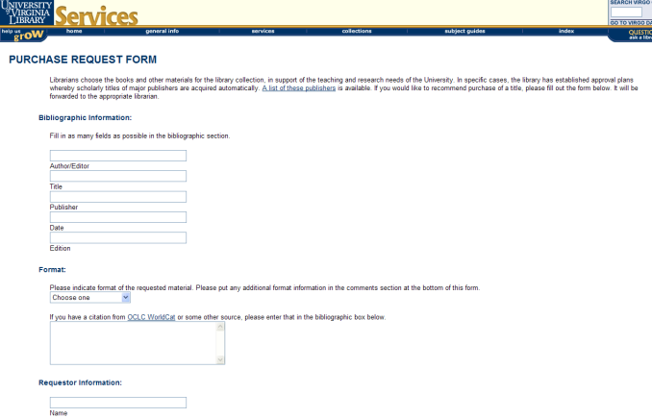
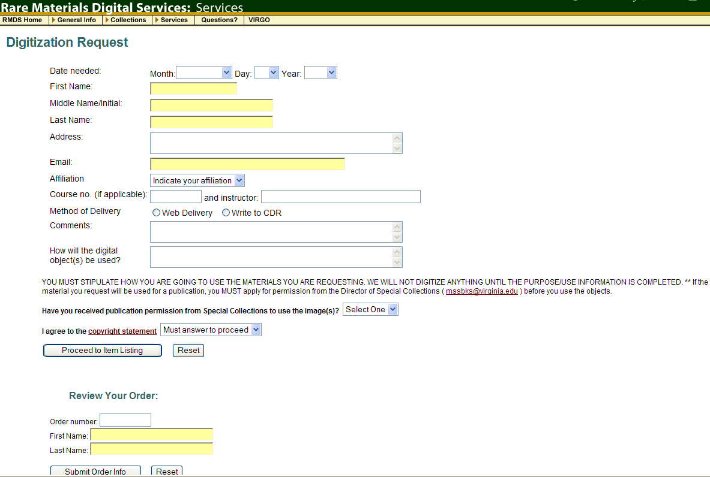
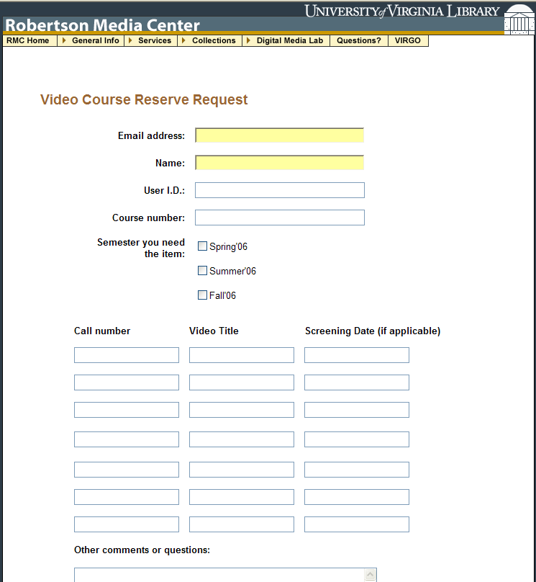
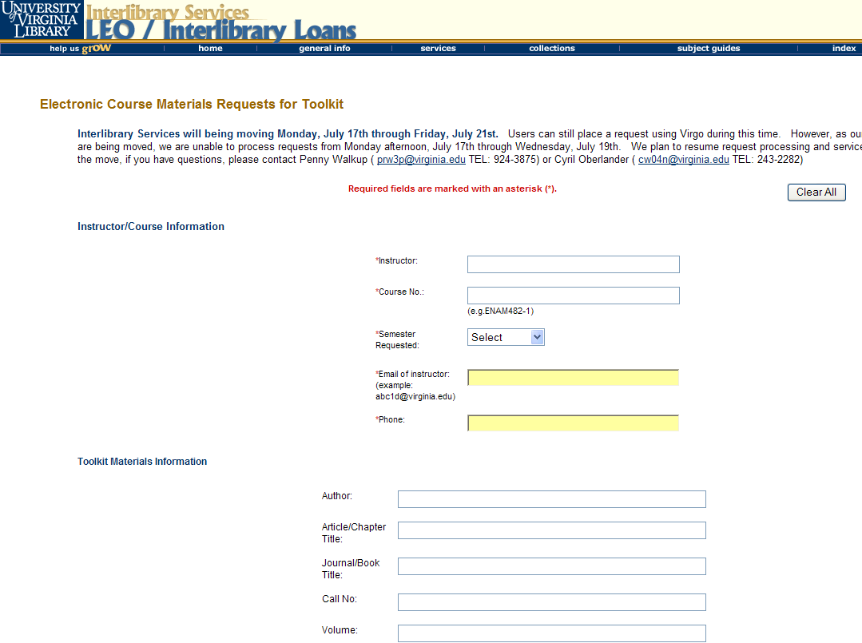
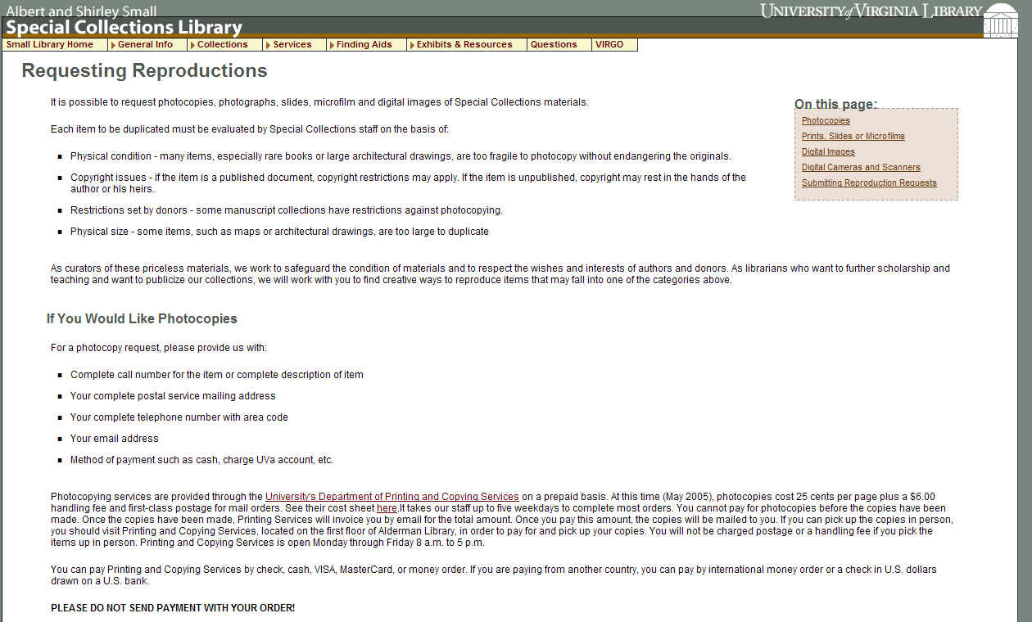
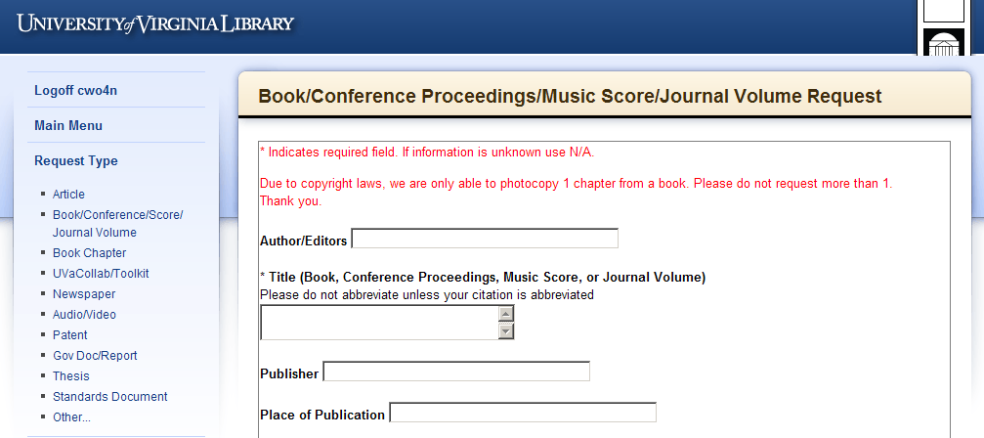
Request Service – but what context?
Rare Materials Scan Request
Purchase Request
Video Booking Request
Library Services are fragmented by
Request Systems that
Reinforce functional divisions
E-Reserve Request
Special Collection Duplication Request
Interlibrary Services Request
Notes:
Add to this that Libraries have created numerous disparate request systems, primarily based around departmental workflows. How does the very fractured service design or request environment we offer make sense to our users? Does it serve us well in user’s information environment?
Many libraries are still using old fashion web request forms that send an email for their purchase request forms? While that is where ILL was 10 years ago, ILL developed request management software that proved highly effective for users, libraries, and also relevant, for library groups. – It is time to have the conversations that help us leverage the strengths of various systems we use with an eye toward our users, because they aren’t waiting…

Slide 12
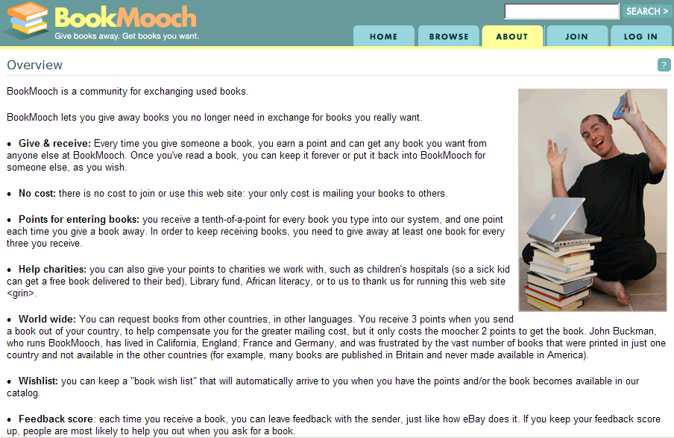
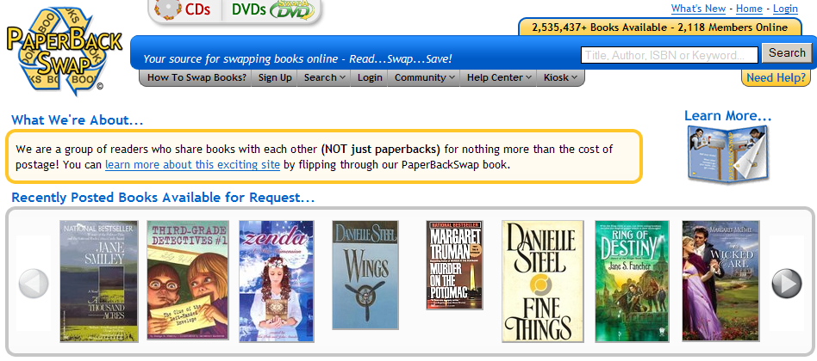
Readers are doing something about it…
Notes:
Reader’s are doing something about making systems meet their expectations… For example, PaperBackSwap, at age 4 has over 2.5 M books, and has swapped over 2M books, that’s almost 5,480 books per day, about 1/10 the total daily traffic of ILL on OCLC in 2003, probably 1/6 of loan traffic.
This system credits and debits swap units, while libraries often charge by invoice, IFM, EFTS or send printed IFLA vouchers. These could be interesting ways to handle gift books and ILL.
So what are libraries going to do about this situation?
How many here have used Book Mooch?: http://bookmooch.com/ Well, users are figuring out that they can have home delivery and share books, CDs, etc. at a fraction of what it costs to do an ILL.
http://www.paperbackswap.com/index.php

Slide 13
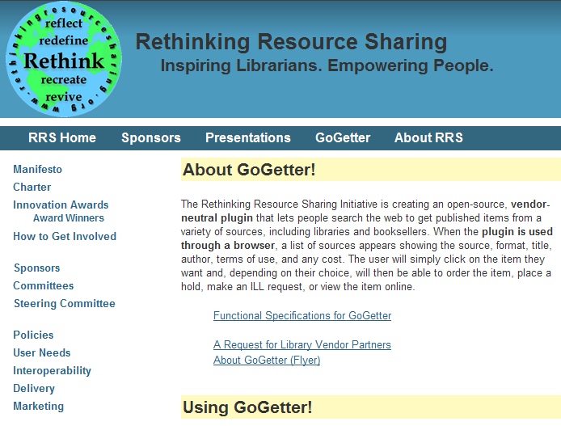
GoGetter helps users deal with Us?
GoGetter: http://www.rethinkingresourcesharing.org/getit.html
Notes:
Explain RRS toolbar is an attempt at empowering users by making it easier to submit requests into our ILL systems - great, but what do they really want is still the gorilla at our table…

Slide 14
Why focus on requests?
SYLLABICATION: | re·quest
TRANSITIVE VERB: | Inflected forms: re·quest·ed, re·quest·ing, re·quests 1. To express a desire for; ask for. Often used with an infinitive or clause: requested information about the experiment; requested to see the evidence firsthand; requested that the bus driver stop at the next corner. 2. To ask (a person) to do something: The police requested her to accompany them.
NOUN: | The act of asking. Something asked for.
IDIOMS: | by request In response to an expressed desire: We are offering these scarves for sale again by request. in request In great demand: a pianist in great request. on (or upon) request When asked for: References are available on request.
ETYMOLOGY: | From Middle English requeste, the act of requesting, from Old French, from Vulgar Latin *(rs) requaesita, (thing) requested, from alteration of Latin requsta, feminine past participle of requrere, to ask for. See require.
Notes:
Does anyone know what our users really want, imagine if you had a list of what users wanted the library to have?

Slide 15
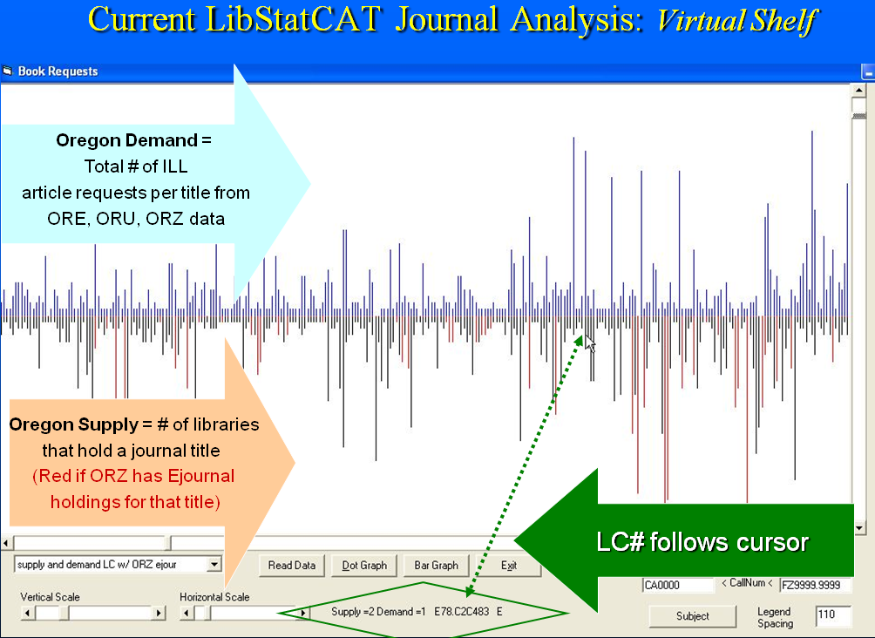
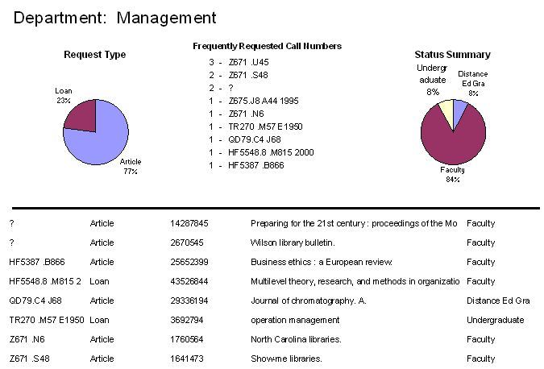
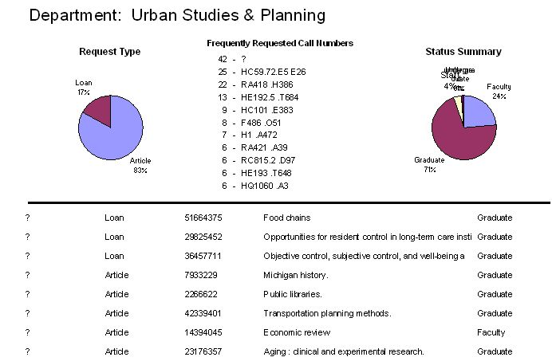
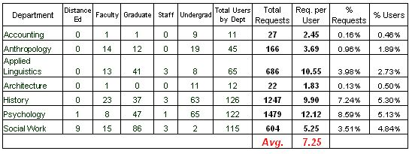
Keeping our eyes on where Requests are taking us?
Consortia view of journal titles in LC# order, with use and # of libraries
SYLLABICATION: | re·quest
TRANSITIVE VERB: | Inflected forms: re·quest·ed, re·quest·ing, re·quests 1. To express a desire for; ask for. Often used with an infinitive or clause: requested information about the experiment; requested to see the evidence firsthand; requested that the bus driver stop at the next corner. 2. To ask (a person) to do something: The police requested her to accompany them.
NOUN: | The act of asking. Something asked for.
IDIOMS: | by request In response to an expressed desire: We are offering these scarves for sale again by request. in request In great demand: a pianist in great request. on (or upon) request When asked for: References are available on request.
ETYMOLOGY: | From Middle English requeste, the act of requesting, from Old French, from Vulgar Latin *(rs) requaesita, (thing) requested, from alteration of Latin requsta, feminine past participle of requrere, to ask for. See require.
Notes:
Is it any surprise that we already have that information in Interlibrary Loan requests? We keep an active and ongoing list of what users want, in the form of a ILL and document delivery requests, and a separate system for purchase requests. Borrowing provides us much needed information that helps us…
Explain slides…
Do we leverage the combination of point of need with the rich bibliographic data such as publisher, LC#, date, holdings data (such as who owns it regionally) and user data, such as departments, status, format and language preferences, etc.
Cancel locally held items? Example
What Getting It or the future of borrowing means to me is facing a reality our users face in the information world…
Explain data – ask what data do we want?

Slide 16
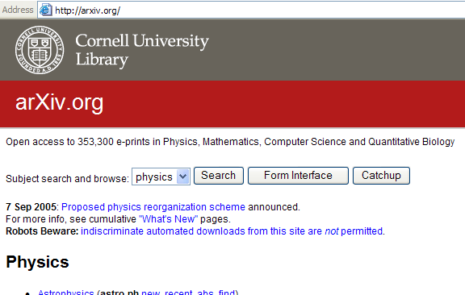
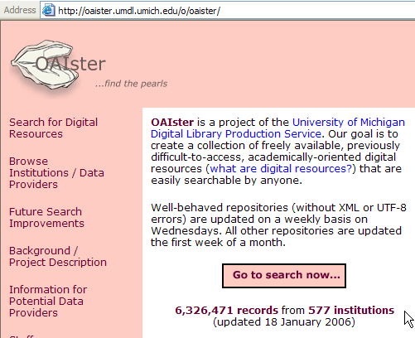
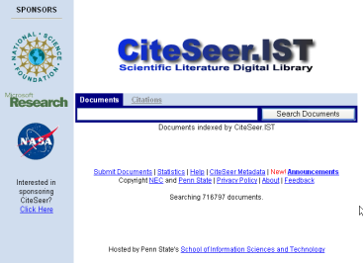
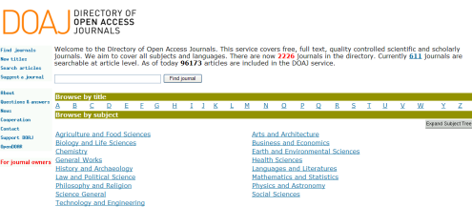
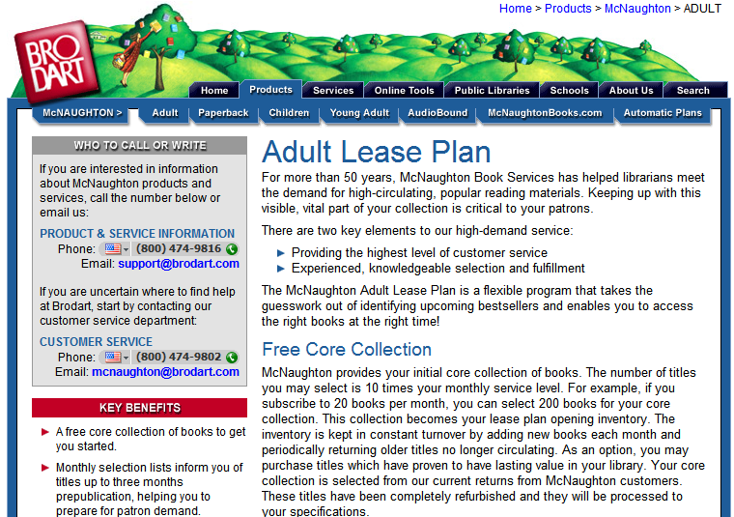
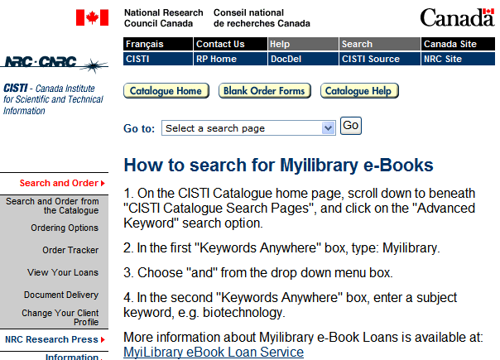
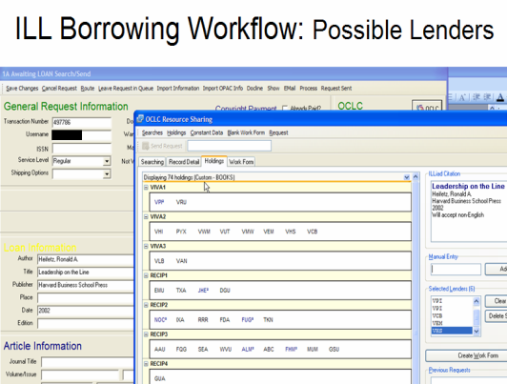
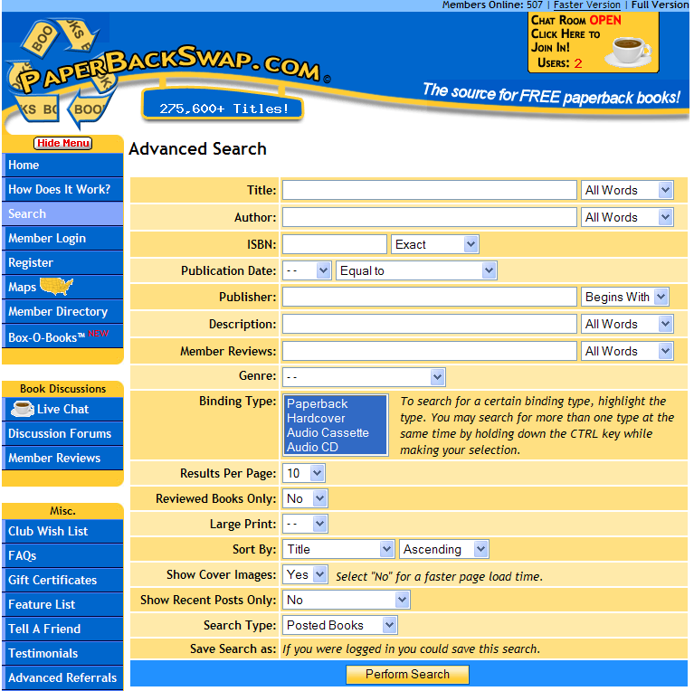
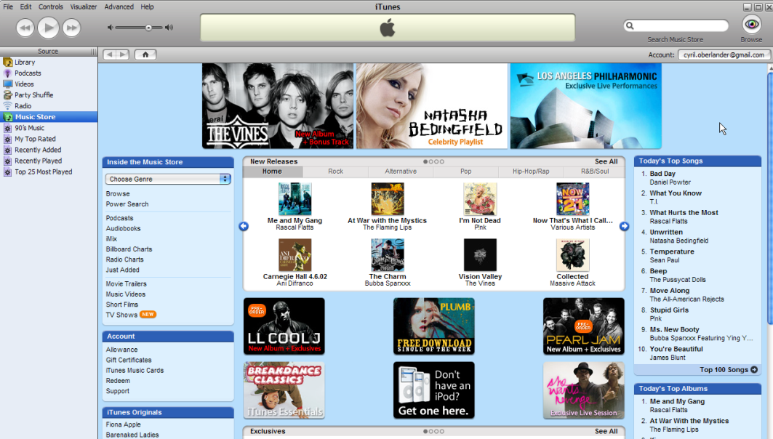
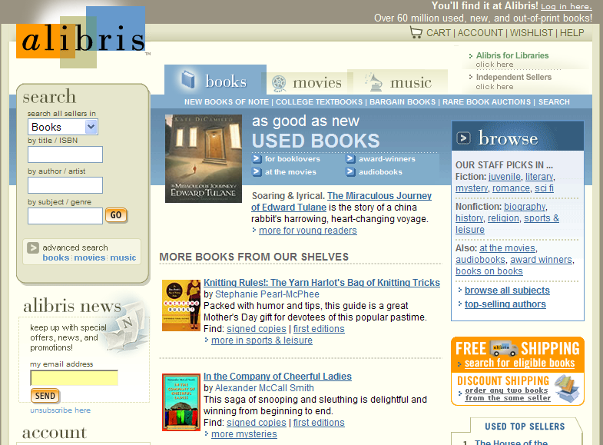

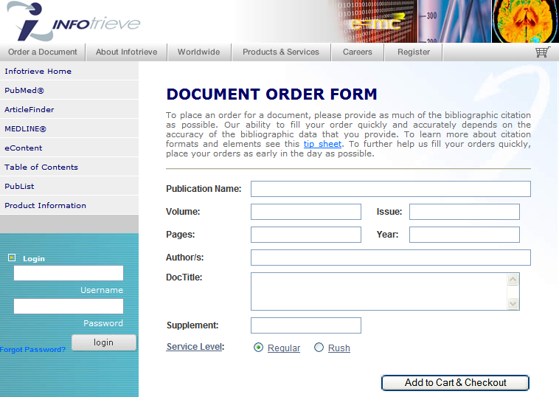
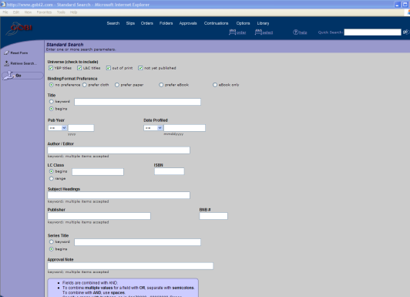
Sense-making for us & users
Free Domain
Context
Sensitive
Workflow
Borrowing / Library Domain
Renting
Domain
Buying Domain
Notes:
Briefly Explain domains –
In many ways, you can see this model of sense-making workflows that work for ILL, Acquisitions, even Reference.
While the name Interlibrary Loan conveys traditional library to library partnering, which successfully filled over 51K requests per day in OCLC in 2003, and today, every 4 seconds, the reality of our workflow is increasingly being pulled to other resources of interest because it makes sense to the needs of the user and to the library. Also, why not, lending libraries are raising their fees, many are now charging $15 to $20 per transaction; increasingly, the alternatives are faster, cheaper, and in case of articles, better quality. Explain domains
While we attempt to scale best practices and automate workflow for the traditional borrowing domain, the workflow for the emergent domains have significant Return on investment. While I encourage experimenting with these services, these explorations will scale well once we ask the right questions of our users by expanding the range of questions about format, etc., develop better processing profiles, like machine readable collection development policy profiles, that help us make collaborative decisions about what the user and what the library wants.
Besides diversifying our potential sources, we have to decide what weight, or criteria to apply for user requests and content containers and providers. Let’s apply some scenarios that may help illustrate what I mean…
Much like focusing on discovery, Libraries workflow focuses on the traditional borrowing domain, while the workflow for the emergent domains provide a strategic opportunity for return on investment, and transformation of workflow in the context of a very different information supply model and relevant to today’s discussion.

Slide 17
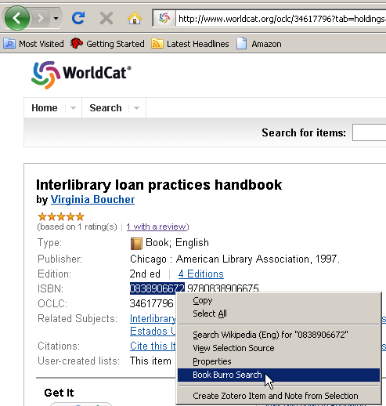
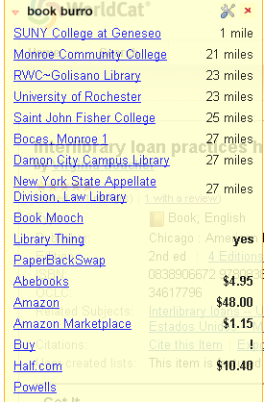
Tools that show the way… Book Burro
Click on library to run a search into your catalog.
Book Mooch & PaperBackSwap
Amazon, Abebooks, etc.
Notes:
To begin using those other domains, we have to start using and developing new tools that provide us more information. Book burro, a Firefox extension, was created by a user to look up information using ISBN’s on a website, it brings back information and linked services from Worldcat, Amazon, BookMooch, LibraryThing and much more. One of the obvious benefits to emergent web services and technologies is that we have more options than ever before.

Slide 18
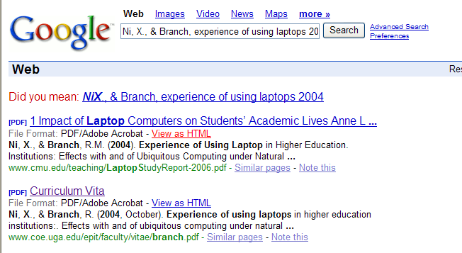
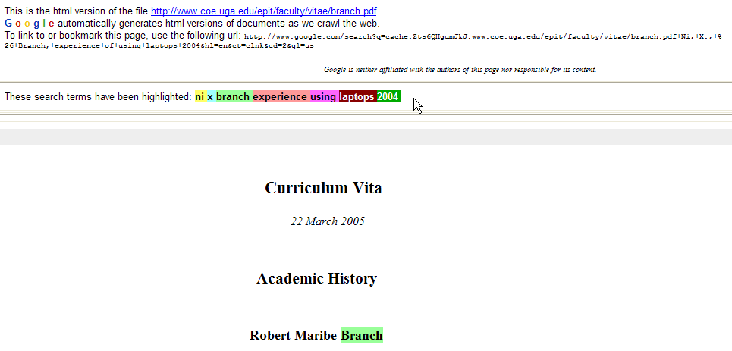
Verification Strategies = new workflow with Search Engines
Read about the tools: http://www.google.com/librariancenter/librarian_tools.html
Tips:
Auto-highlight
search terms.
Ctrl F – Find a word
in the html version.
Find @ your Library
Buy from BL Direct
Cached copies may
save the day
If the URL is 404, try the
Internet Archive:
http://www.archive.org/web/web.php
or UK Web Archiving Consortium:
http://www.webarchive.org.uk/
or Australia’s Pandora Archive:
http://pandora.nla.gov.au/about.html
View
As
HTML
Notes:
Ah the web – it simply started when looking to find some missing information from a citation, or the author’s name is misspelled, we locate an occasional full text. Everyone has a favorite search engine, how many have read their brochure that details all the search limiters and functions you can use for advanced searches?
Searching Google, for example, you might want to View as HTML, because Google color codes your search terms in the HTML derivative. The more citation you add, the more colorful your results.
Don’t waste time searching through the pages, use Ctrl F to find a specific author name or title phrase “ “.
The same search engine or similar, can also take the citation you find and run it through your library’s catalog, provided you have linked your catalog or metasearch tools.
Using Google Scholar also provides a link to buying the article from BL Direct. Remember that when dealing with document suppliers that charge copyright, you have to remove this request from your copyright royalty reports, never pay twice.
Two ways to access URL’s in search engines that lack content and give you the friendly 404… some search engines provide a cache view, and more importantly, you can find some of them in the Internet Archive. There are other archives such as the UK web archiving consortium, Australia’s Pandora – important to note, not all of them allow search engines to index their contents, or limit title only.
Besides one search engine, you can also multiply your searches

Slide 19

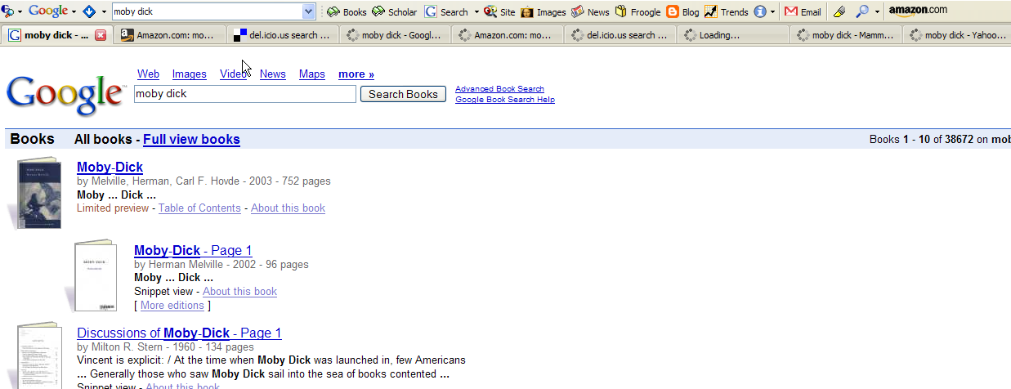
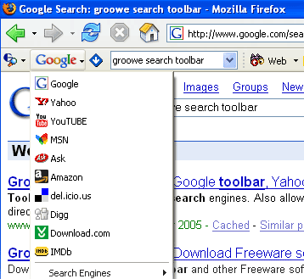
Verification Strategy
Groowe search toolbar: http://www.groowe.com/
Notes:
Verification using metasearches can easily multiply your search, upside, fewer pasting citations, downside, more records to paddle through.
There are various ways to run federated searches, Dogpile and Amazon’s A9 take two interesting and different approaches. Another one is a Firefox extension called Groowe, with this plugin, you can multiply searches across various web services.
Customized searches offer a great way to combine the work of searching across not only your usual targets, but also, sources that you can work – so what can you find using search engines in borrowing…

Slide 20

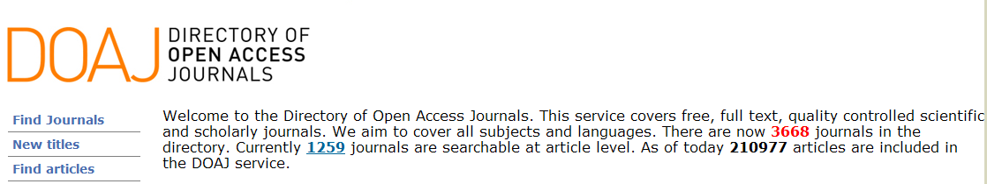
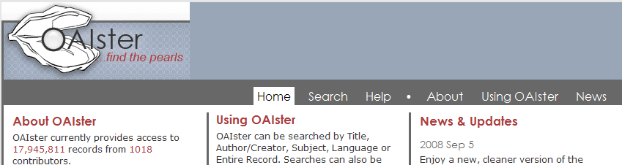
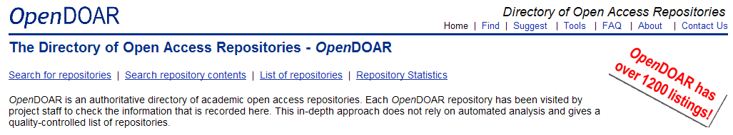
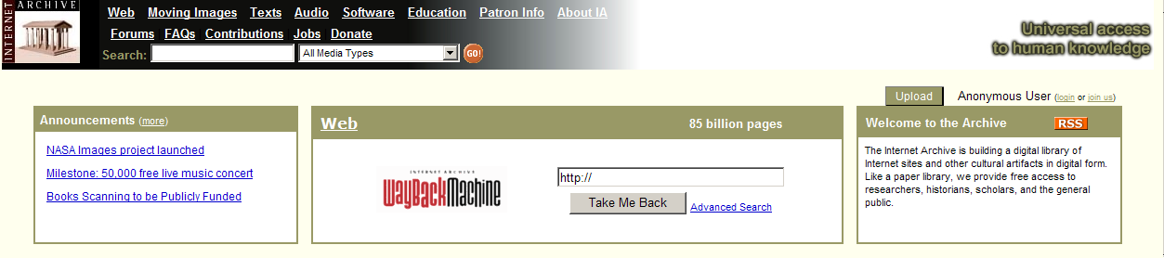
Free Domain – Free Stuff!
Search Engine
Can’t Search Here with Search Engines though…
Notes:
Free Domain is becoming a significant source for ILL. On a slow day, or as a regular practice, have you checked how many items articles you find online free? Ohio State University is now checking GoogleScholar to find online articles and filling over 100 articles per month using it. Anyone want to share their results? I am going to share some of the big free online sources.
http://arxiv.org/ - Anyone familiar with this resource – it was created by the science community, and later supported by a library.
http://www.doaj.org/
http://www.opendoar.org/
http://www.oaister.org/- explain the Google Scholar connection.
http://www.archive.org/index.php – Waybackmachine – a great utility for ILL, Open Content Alliance, and Open Library project.
Others? The free domain isn’t just articles, reports and websites, increasingly, they are full text books…

Slide 21








Looking for Moby – Free Online Books
UVA ILL 2005/2006 Data
2006/2007
Over 23% were found in Google Book
Notes:
When looking for a white whale, it’s clear that the ocean of the internet is full of them. CLICK to 23%
When is the tipping point for changing our workflow to look here first? When Google Books API was integrated into Library catalogs this year, did you find it interesting that we only link google’s full text for materials we own, and not search the over 2 Million books in their database? Should we?
Free is ideal, but sometimes we pay to borrow…
Note: AAP industry statistics 2007 shows 3.2% growth, this eventhough ILL is up, book swaps, and google books use are also up. http://www.publishers.org/main/IndustryStats/indStats_02.htm

Slide 22




Renting Domain
Also…
ILL Libraries that charge lending fees
Charge = Cost of Lending?
2002 $9.28 / unit
$9.48 / unit
http://www.arl.org/newsltr/230/illdd.html
Notes:
Netflix: http://www.netflix.com/
Paradies bookstore Read-Return program – everyone familiar with this concept, buy now and return for 50%, then the bookstore sells it used again –what a great idea for our new books that everyone requests, or better yet, buy it used for a significant discount: http://www.theparadiesshops.com/artman/publish/specialprograms/Buy_a_book_in_Hartford_get_half_your_money_back_in_San_Francisco.shtml
http://www.bookswim.com/
McNaughton Plan – is the more traditional form of renting for libraries; hopefully ILL is providing recommendations from request data to scope the selection of titles. http://www.books.brodart.com/Content3.aspx?P=93
Lastly, every summer you see the emails – some library is raising their lending fees. As more libraries charge $15-25 per request, it undermines the effectiveness of resource sharing, however, it also promotes alternatives like buying, more attractive than ever. Speaking of buying…

Slide 23








Buying Domain: Article Pay Per View
Amazon $5.95
Avg. ILL Cost $17.50
CCC Royalty Fee $32
Science Direct Download $30
($25 w/ Institutional logon)
& don’t forget tokens…
Notes:
Articles can easily be purchased by a variety of pay per view methods; credit cards and publisher tokens. How many currently purchase articles rather than borrow them?
Looking at copyright royalty fee transaction data and comparing the fees incurred to fill a borrowing request with the fees for purchasing articles online from the publisher illuminate why sometimes it makes more sense to buy the article for a user.
Over the last two years, SUNY Geneseo paid 290 copyright royalty fees on 70 titles, and in analyzing this data, we found that 279 or 88.6% of the articles could have been purchased full-text immediately from the publisher, and in a few cases, from a secondary online document supplier. While the overall cost, including copyright fees, for the 279 articles was $6,662, the fees for purchasing immediate access to the online articles from the publisher would have been $6,100.
Interestingly enough, the cost between royalty and purchase varied widely; for example, the royalty fee on The Journal of Clinical Psychiatry was $9 per article, the cost of the online article was $20, on the other hand, the royalty fee for the Journal of Health Psychology was $26, while the cost of the online article was only $15.
Lets take a look at how newspapers fits into this picture too…

Slide 24


Find it – Access it (maybe pay for it)
Notes:
Newspapers are perhaps the easiest to find, some free, some fee based for $3.95 – far better than asking a nearby library to scan in a microfilmed article.

Slide 25



Resource Sharing: Purchase on Demand Opportunities
Why Purchase on Demand / Just in Time Acquisition: one study of Purchase on Demand books found that within 5 months…
28.7% of ILL Purchase on Demand books were checked out again.
18% Regular Acquisition books were checked out once.
Ward, 2002
Average ILL cost $17.50 for borrowing library Almost $30 for borrowing + lending libraries (ARL 2002)
2004’s OCLC ILL frequently requested titles:
  3,187 requests for The DaVinci Code
  1,197 requests for The Secret Life of Bees
$13.79 New
$9.44 Used
$22.94 New
$12.94 Used
Save
Over 26%
Save
Over 46%
Notes:
At what point does it make sense to buy versus borrow? Who decides? User, collection development, or Interlibrary Loan – and what strategy makes sense. explain slide CLICK
Practices vary widely & its safe to say most Purchase on Demand services are pilots.
What makes sense or the strategy we develop for borrowing and buying options really does depend on how we consider the cost benefit with the return on investment. Note the relatively higher demand for titles users select. These are opportunities that we can incorporate into the strategy of building a more diverse collection and save money…
How…
Note:
According to Mary Jackson’s study of ARL libraries, the average cost to a borrowing library (not including the cost to a lending library) was $17.50. http://www.arl.org/newsltr/230/illdd.html
Image: http://www.d.umn.edu/cla/faculty/troufs/Buffalo/images/pf056932.jpg
2004 Data on DaVinci Code and Secret Life of Bees comes from a report prepared by Aric Rubin, Alibris.
Buy New Buy Used Borrow 22.94 12.94 17.5 davinci code 13.79 9.44 17.5 secret life of bees secret life of bees davinci code 53.9% 73.9% 1197 req. 46.1% 26.10% 3187 req. 4.5675 12.94 2004 Aric Rubin, Alibris

Slide 26
April 6, 2008 a day in the life of ILL…
On April 6, 2008, 110 borrowing requests for loans came into SUNY Geneseo, of these…
20.9% or 23 items could not be purchased from Amazon
79.1% or 87 items could be purchase from Amazon
  If monograph budgets didn’t matter…
  Of those 87 items that could be purchased from Amazon:
  Purchased used for a grand total of $2,224.71 coming to $25.57 per item.
  Purchase new (3 could only be purchased used) for a grand total of $2,851.27 coming to $32.77 per item.
However…
Over 1/3 could be purchased used for less than $10 (almost 1/5 for less than $5).
Over 1/5 could be purchased new for less than $10.
46% could be purchased for under the ARL unit cost for borrowing: $17.50
2 DVD requests could be filled for under $6 each (used), or under $10 each (new).
2 Music CD requests could be filled for under $9 each (used), or under $14 each (new).
When should we evaluate buying options? & when NOT?
Notes:
First, consider what I found searching 110 ILL book requests from one day last spring. Highlight screen findings
Explain that the reality of weeding for 10-20 years will have a significant impact on the used book market, and possible strategies.

Slide 27


SUNY Geneseo ILL Borrowing – Sorted by Amazon $
Notes:
This is a sample of Geneseo’s borrowing book requests where lending libraries charged lending fees, we see the following characteristics, seen sorted by cost to purchase in Amazon (in blue) juxtaposed with the ILL fees (in yellow) and # of libraries holding the title (in green)
In this small sample of 62 books – we found that we could only buy 51.6% of the titles in Amazon, of these, 4 could be purchased less than $5, 6 for less than $10. 38% we could buy for less than $20. Whenever we have to look beyond our free reciprocal libraries, and increasingly, library lending charges are $15 plus the cost of shipping to return the books, making it roughly a $20 rental, buying books makes much more sense.
To give you an idea of how much libraries pay, just in November 2008, SUNY Geneseo spent almost $3,000 (in IFM) on borrowing books and articles from libraries that charge what amounts to rental fees.
Looking at the same data sorted by how many libraries have these titles, the opportunity cost plus the collection diversification increases as you move towards few libraries that hold the title (moving to the right of the chart) and evaluate the differences between what a library charges us to borrow, and what amazon charges.
CLICK – here are some of the titles from the graphed sample.
Opportunity costs is a great strategy, however, it may lead to some very untraditional approaches.

Slide 28

Buy Access &/or Buy then De-select – Univ. of Virginia
Sample of 52 Remote User ILL requests:
50% available to purchase in Amazon
~ 6% for $1 (Rush shipping for $4)
Avg. cost to acquire & catalog: $83.10
Est. cost of ILL & D.E. Service: $26.78
Avg. cost for ILL: $17.50
Avg. cost for Consortia Circulation: $2.04-14.70
Notes:
What makes sense? Depends… @ UVA Library, I looked at the ILL service to remote users – demonstrate 4 shipments in the process
Looking at these costs of doing business, and the Internet book market, many thanks to library weeding projects, make it possible to buy good condition used books for one dollar; we have to face the question, do we really want to borrow, buy to own, buy and weed (with no cataloging), or just buy the user an inexpensive book?
Given the realities of the Internet book market how shall we shape our workflow to match the new options? What makes sense in the market makes us question what makes sense with the workflow we developed at libraries. While we are talking about ILL purchase on demand, we need to also discuss a parallel or duplicate service in acquisitions called just-in-time acquisitions.

Slide 29




Direct Delivery – Borrow to Buy Model coming…
Better World Books - OCLC Symbol QUICK
http://www.betterworldbooks.com/Programs/Library.aspx
$10 to borrow…
QUICK Features
Return postage/envelope enclosed
have option to buy the book
Direct Delivery
Real Example: $17.24 for user to buy
Direct Delivery to User in Europe…
Notes:
While many in ILL are now used to the idea of using Alibris to purchase books using OCLC and ILL funny money, I mean IFM. OCLC and Better World Books have recently come up with a new variation on fulfilling requests.
OCLC’s Worldcat Delivery Pilot in Montana, Denmark’s at your doorstep and others are direct lending to borrowing library user’s homes. The ideas of direct delivery may seem complicated, but they really are not, it’s basically less work on the borrowing library if the lending library uses insured tracking delivery services to send to the user’s home. The question how do we agree on changing our workflow to handle insurance and tracking shipping is probably our biggest delivery challenge, but Direct Delivery. Ironically, direct to home usually charges users fees while the more expensive hold for pickup is free.
EXPLAIN real example: we borrowed a book for $10, and in it, the book had a price tag for the user (or potentially the library) to buy it without returning it. EXPLAIN WHY this is fantastic… remember the skit… Direct Delivery (Double Delivery Dilemma) & Distance Education services.
CLICK: Most interesting aspect to this new supply chain is that the bulk of their materials comes from library discards, so what we weed today, may find its way to be borrowed or purchased by another library and user, all through the OCLC system.
CLICK: Do we need to find new workflows? YES

Slide 30
If we could start this all over…
Knowing what we know today…
Where would we start?
Notes:
I would like to start off from the perspective of knowing what we know today, what would we have done differently?
How would you have liked to seen ILL develop?… (besides changing it’s acronym) – see if audience has a comment or two…
Would more libraries be involved with Docline?
Would charging lender fees be less important than having load leveling capabilities in our systems?

Slide 31





Recommended enhancements to transform workflow: Get It System
$
Proposed Services…
Amazon$ like worldcat.org
Just in Time Acquisition:
  Buy for Library,
  Attach OCLC symbol, &/or download to ILS
Refer to selector for review.
Buy for user
Rent for user
APIs to Google Book, Amazon, CCC, OCA, Publishers, etc.
Edit OCLC holdings
Notes:
Purchase on demand, that could mean that the ILL department forwards request information to a subject or acquisitions librarian for evaluation, and others have a fund for ILL to purchase books. This is a model I proposed to OCLC and Atlas. Explain flow…
Key points are; what criteria or better yet, machine readable collection development profiles make sense (both to an individual library and a consortia) and can they be applied or compared against ILL CUSTOM HOLDINGS, better yet, machine readable profiles that work to automate the comparison and either direct a purchase or borrow? If buying, why not add the OCLC Symbol and download the record – you have OCLC open already.
How many ILL’s have a purchase on demand process? What is an ideal workflow for books?
Purchase on demand, that could mean that the ILL department forwards request information to a subject or acquisitions librarian for evaluation, and others have a fund for ILL to purchase books. This is a model I proposed to OCLC and Atlas. Explain flow…
Key points are; what criteria or better yet, machine readable collection development profiles make sense (both to an individual library and a consortia) and can they be applied or compared against ILL CUSTOM HOLDINGS, better yet, machine readable profiles that work to automate the comparison and either direct a purchase or borrow? If buying, why not add the OCLC Symbol and download the record – you have OCLC open already.
The number and variety of options are growing, and I would argue that is one of the realities that is making libraries such an exiting place to work. However, in order to make better use of options, we have work out details of how to select options that match local institutional practices.

Slide 32
Next Step:
More Group Purchase Strategies for Libraries – not just big deals…
IDS Project 2006/2007 Data: Filled by non-IDS Project Libraries…
Articles Subscription Cost
79 requests for Early Child development and Care $2,973
57 requests for Terrorism and Political Violence $610
51 requests for Archives of general psychiatry $490
Loans New Cost
15 requests for Synthesis and optimization of digital circuits $135.69
7 requests for Treatise on harmony $10.10
6 requests for The pursuit of happiness $3.24
What data and criteria matter for cooperation?
How do we get that data to where it is needed - workflows?
Notes:
If we look beyond the request by request and local view, how does the data help collectively? This data is an excerpt from IDS Project data, looking specifically at frequent requests filled outside the group of libraries. Often, these are requests filled with some lender fees.
Obviously with groups or networks of libraries, it makes sense to begin asking the question, especially during these times, can we do more to leverage the shared value of what we are doing?
As library monograph budgets are reducing across the country, the cost of ILL is going to increase because the times you go outside your reciprocal (non-charging) groups will only increase with time. (Illustrate charging circles & increase cost expectation) So…
How do we begin to use this data is the next question worth raising because it offers the value of diversifying our collections that are valued by user demands from our group.

Slide 33





Strategic Benefits within Groups:
Consortia,
Networks Work
Notes:
Trend or One of most important strategies for libraries to do is work cooperatively at many levels, whether they are fee membership organizations like RapidILL or locally free, like the IDS Project: http://idsproject.org libraries can accomplish a great deal working together.
Where we may see more movement or just more talk is in coordinated collection development.

Slide 34

Prospective Cooperative Strategy – Approval Plan
One Vendor approach, for example GobiTween YBP Library Services – Orbis-Cascade, OhioLink, TRLN, and others…
Successful Diversification:
Pre-coordination: 54% of available titles not acquired on approval plans.
Post-coordination: 24% of available titles not acquired on approval plans. Armstrong, p. 105
If interested, planning and evaluation information about YPB available from Orbis-Cascade website:
http://www.orbiscascade.org/index/cdmc-meetings
Notes:
Coordinating approval plans, standing orders, etc. various forms of purchasing can work. The data from the Research Triangle libraries is most useful.
Explain the pre-coordination table – unique in green and most duplicated in yellow.
Some success in diversifying the approval plan.

Slide 35

Retrospective Cooperative Collection Strategy
Collection Maintenance, De-selection, or Weeding is a critical ongoing task that lends itself well to group strategies, however, in practice, few have accomplished a committed Coordinated Last Copy policy.
In practical terms, this de-duplication post-purchasing is another collection diversity program, that increases the reliance and use of Interlibrary Loan.
Cooperative Collection Management Trust Pilot was closest to accomplishing systematic federated program, however, they seem to have only accomplished the cataloging practice to indicate permanent archival retention (583 field).
Related:
CRL/JSTOR Print Archive Project
How does all this impact ILL?
Notes:
Impact on ILL.
Other realities are also making our work more interesting…
http://www.crl.edu/content.asp?l1=13&l2=19&l3=35&l4=94

Slide 36
Symmetrical Convergence within a Library:
Digital Library & ILL
Digitize on Demand for ILL & Digital Library…
  “Small items that are too fragile to circulate on interlibrary loan are usually supplied through a photocopy. But photocopying often shortens the life of the original… LOC now scans this type of material and delivers the images via the Web… A scanned item will be accessible from this page for at least six months… then be permanently accessible from the Library of Congress catalog…, and an 856 tag will also be added for the DLC holdings record in OCLC.”
  Digital Interlibrary Loan, Library of Congress: http://www.loc.gov/rr/loan/illscanhome.html
  Others doing this…
    National Library of Australia, for public domain Australian works that are requested by ILL: http://www.nla.gov.au/policy/digitisation.html
    Europe eTen DoD: http://www.uibk.ac.at/ub/dea/eten/
Notes:
Instead of scanning for one time use, why not digital ILL where ever possible, scan for two uses; one for ILL lending, the other to contribute to your repository.
This type of request processing and partnership has many benefits, including multiple delivery options, including print on demand options, what I call an assymmetrical convergence.

Slide 37


Asymmetrical convergence:
Digitizing and Printing – Borrowing options for medium rare
Print on Demand - a solution to rare material ILL, or another acquisitions program?
There are over 12K books from the Michigan Historical Reprint Series in Amazon; prices range between $12-$43.
“Print-on-demand is an attractive alternative for scholars on a budget. Another top seller, the 1898 textbook "A Treatise on Universal Algebra with Applications" by Alfred North Whitehead, is available from Cornell for $35.99 versus $600 for the original from a used book dealer. “ http://www.news.cornell.edu/stories/April07/LibAmazon.dea.html
Notes:
Not everyone is crazy about reading a 300 page PDF file, but again, expanding our scope, diversifying the service and the source to include print on demand is very important. So partnering with vendors such as Amazon – or more specifically Book Surge may be an easy way to reach out beyond your own community and not having to deal with the infrastructure for a commercial enterprise.
Explain book surge - $99 per item to load, users buy at market value, library gets 25-35% of the price. CLICK
Latest news is Michigan is also printing books on demand and selling them for about $10, so the books are available from Amazon and the Espresso Book Machine. The marketplace is about options.
Remind them about the consequences of retrospective duplicate weeding… (this helps us provided we can purchase on demand)

Slide 38
Other Partnerships…
Reference, ILL, Collection Development Partnerships
Request for Grey/Gray Literature or unpublished materials are collaborative opportunities for collection development, ILL, and reference.
How do we handle requests for unpublished materials?
Opportunities to teach about scholarly publishing, connect user to subject librarian, or user to author?
Do you treat the request as copies; non-returnables?
Why not acquire and catalog, or request rights to digitally maintain an open access copy from the author?
Notes:
Partnerships make sense to us, while we often look for recips with other libraries, we must also act like a bridge between our divisions – take grey literature requests for instance.
Who struggles to obtain unpublished materials?
Many libraries end up giving them to the user, as though it were a copy, but because someone wanted it, and they will probably cite it, it makes it more critical that we acquire and catalog it.
Acting as bridges between user requests and the variety of library services is a unique opportunity for adding value to the service, and making significant long term contributions to the user, organization, interlibrary loan and beyond.

Slide 39
Users as Partners…
Where do we finish a transaction?
Delivery
Discovery
Beside Focusing on Discover
and Get It
ILLiad customization example
“Interested in writing a review on this material? Worldcat review: http://www.worldcat.org/oclc/<#ESPNumber>?tab=reviews#tabs “
Notes:
Almost done… which brings me back to users and their requests
Getting to see things from a complete user cycle is important and honestly, we focus too much on discovery, and then delivery. We also have to remember that we can make our environments more engaging if we want to. So - Why in the world does engaging environments and community matter?

Slide 40



Big Challenges Ahead…
Delivering eBooks for ILL and to phones
Can we lend our eBooks?
Do they work for phones?
Notes:
One of the biggest challenges in reaching the mobile community maybe market entry. Libraries buy electronic books that aren’t necessarily as useful to mobile uses; for instance, mobipocket books allow annotation, etc., while this Fictionwise ebook is audio enables. Are Library eBooks essentially becoming the electronic equivalent to microcards?
http://www.fictionwise.com/ebooks/

Slide 41

Staff Development & Training
http://shareill.org/index.php/Main_Page
Notes:
Lastly, a reminder that our resource sharing and library culture have to continually put resources into our staff development. TECHNICAL COMPETENCIES & BEST PRACTICES help us as individuals and networks to scale our service to the growing user expectations.

Slide 42


Staff Development & Training
http://shareill.org/index.php/Main_Page
http://www.ifla.org/VII/s15/index.htm
http://ala.org/ala/mgrps/divs/rusa/archive/rusaourassoc/rusasections/stars/rusastars.cfm
Notes:
Lastly, a reminder that our resource sharing and library culture have to continually put resources into our staff development. TECHNICAL COMPETENCIES & BEST PRACTICES help us as individuals and networks to scale our service to the growing user expectations.

Slide 43



Alternative Strategies…
Notes:
Explain use of lending library web request forms as an inexpensive alternative strategy for borrowing libraries without an ILL system.

Slide 44


Alternative Strategies…
http://www.emeraldinsight.com/
Notes:
Databases have useful options that we can tap into if desired.

Slide 45



Open Library as OCLC competitor?
Notes:
2 clicks- your local library currently goes to worldcat, what if it went to an ILL system, or sent an email to the ILL librarian like the database example before?
BookMooch is already one of the ILL systems of choice by readers, in fact, I recommended that a school library contact BookMooch and see if they will create a separate instance to essentially build a next generation floating collection catalog. The important question to ask ourselves is what options exist, and what models and strategies make sense.

Slide 46
The Nature of Resource Sharing has changed…
Predictions for the next 2-3 years?
Strategic purchasing new/used print books will get easier in the context of new workflow:
  Automated purchase price and lending fees comparisons
  New supply chain options and services
  Machine readable collection development profiles
Full-text access via Google Books and Live Books can fill almost all requests for materials published before 1923.
Print on Demand for Google Book, Live Books, and Amazon is an attractive alternative to ILL under certain conditions.
Purchasing full-text articles from pay-per-view will get easier and less costly than copyright royalty fees.
Service convergence expected between acquisitions & copy cataloging, and ILL.

Slide 47
Flexible Frameworks
Allow for parallel (many to many) and distributed capabilities
Request
Request Management
& Workflow
Customer Relations Management
Get It
Deliver It
Integrate It
ILL - Borrow
Pickup
Reserves
Purchase
Link to
Reference
Reference
Email to
Learning
Management
System
Doc. Del.
Fax to
Digital
Library
Other
Mail to
Other:
user preferences
Group projects
Grant projects
Exhibits
Annotation
& Tagging
Personal
Digital Assistant
Notes:
We built and asked vendors to build an ILS around our focus, a digital card catalog, a representation of the collection. In doing so, we must re-evaluate our focus, should it not be in the relationship between user and collection of resources and services – request brings us close to that – to the user tasks, but even that is missing a critical piece.
Explain chart and integrate it... Need for odyssey delivery to learning management systems to cooperate because it makes sense that in document delivery, a faculty member might place an e-reserve request, and want the resulting PDF loaded onto their course.
Can we pick delivery targets that are more thoughtful to the scope of user needs and within a context, by simply asking them the right questions; you want this article, in what format, where, when, what condition, etc. based on their status – because we can customize ILLiad main menu and various requests based on user status. One of the things I am exploring is how customer relations management software (vTiger CRM if anyone is curious) may be the most strategic system for libraries, because it places the user and their tasks at the center, and it builds on our knowledge base as an organization around our services and engagement with users.

Slide 48
Borrowing
Thank you - Questions
Hilyer, Lee Andrew, “Interlibrary Loan Operations,” Journal of Interlibrary Loan, Document Delivery & Electronic Reserve, vol. 16 (1/2), 2006.
Reighart, Renee, Cyril Oberlander, “Exploring the future of interlibrary loan:,” Interlending & Document Supply, vol. 36 (4), 2008, p. 184-190.
Stein, Joan E., IFLA Guidelines for Best Practices for Interlibrary Loan and Document Delivery (2006): http://www.ifla.org/IV/ifla72/papers/073-Stein-en.pdf
Worldcat Resource Sharing guides:
  Quick Reference: http://www.oclc.org/support/documentation/resourcesharing/using/refcard/WCRS.pdf
  Tutorials: http://www.oclc.org/support/training/firstsearch/tutorial/
Cyril Oberlander
cyril@geneseo.edu
Skype: cyriloberlander
AIM: electronicCyril
GoogleTalk: cyril.oberlander
Notes:
Apologize for trying to bring everything and the kitchen sink into this presentation, but I am more than happy to work with you through out this day, conference, and by email or phone later on questions you might have about details you are wondering about like best practices or tools. Thank you.

