Slide 1

EBD 13.3/BARC #13.3
2017-2018 ALA CD #16.1
2017-2018 Annual Conference
Endowment Trustee’s Report at the Information Session
to the ALA Executive Board and ALA Council
Rod Hersberger – Senior Endowment Trustee
Annual Conference – New Orleans LA
Saturday – June 23, 2018
Monday – June 24, 2018
Notes:
Endowment Trustee’s Report at the Information Session
to the ALA Executive Board and ALA Council
Rod Hersberger – Senior Endowment Trustee
Saturday June 23, 2018
Sunday June 24, 2018

Slide 2

ALA Returns vs the Largest Endowment
Exhibit #1
10 year average annual return of 5.4%
on $41.9 million endowment
10 year average annual return of 4.4%
on $37.0 billion endowment
ALA American Library Association
Source: NACUBO June 30, 2017 study
This Photo by Unknown Author is licensed under CC BY-SA
Notes:
ALA returns vs the largest endowment
ALa’s 10 year return is 5.4% compared to 4.4% for harvard

Slide 3
Time Weighted Rate of Return
Exhibit #2
 | Opening | Contributions | Interest | Appreciation | Closing | ROR* | ROR*
 | Balance | (Withdrawals) | Dividends | (Depreciation) | Balance | Period | Cumulative
May – 2018 | $ 45,028,467 | $ 0 | $ 52,272 | $ 592,657 | $ 45,673,395 | 1.43 | 1.37
April – 2018 | $ 44,821221 | $ 0 | $ 58,136 | $ 149,110 | $ 45,028,467 | 0.46 | (0.06%)
March – 2018 | $ 45,204,025 | $ 3 | $ 150,110 | $ ( 532,917) | $ 44,821,221 | (0.85%) | (0.52%)
February – 2018 | $ 47,438,334 | $ (857,245) | $ 41,803 | $ (1,418,867) | $ 45,204,025 | (2.92%) | 0.33%
January – 2018 | $ 45,900,664 | $ 0 | $ 33,734 | $ 1,503,935 | $ 47,438,334 | 3.35% | 3.35%
Total | $ 47,438,334 | $ (857,245) | $ 75,537 | $ 85,068 | $ 45,204,025 | NA | 0.33%
*Rate of Return
Notes:
Time Weighted Rate of Return @ 5-31-18
May 2018 Opening Balance - $45,028,467, Contributions/(Withdrawals) - $0, Interest/Dividends - $52,272, Appreciation/(Depreciation) – ($592,657), Closing Balance - $45,673,395, Rate of Return for the period – (1.43%) and Rate of Return Cumulative (1.37%).

Slide 4
World Market Performance
- Calendar Year Market Returns @ 5-31-18
Exhibit #3
Notes:
FTSE 100 -8.2% Dow Jones -0.2% Hang Seng 3.0% Euro Stoxx 1.0% NASDAQ 8.3% ML US Broad Market Bonds -1.5% DAX -2.4% Nikkei 225 -1.7% Shanghai Comp -6.1% S&P 500 2.0% ALA Endowment 1.4%

Slide 5
Long Term Historical Returns
- 1802 thru 2012 -
Exhibit #4
 | Annual Returns
Private Equity** | 13.4%
Hedge Funds* | 6.6%
Stocks (Equities) | 6.5%
Bonds | 3.6%
Treasury Bills | 2.7%
Gold | 0.7%
US Dollar | (-1.4%)
*Twenty seven years of coverage via the HFRI Fund of Funds (FOF) Composite Index through 12-31-17
**Twenty five years of information from the Cambridge Associates LLC US Private Equity Index through 12-31-17
Source: Professor Jeremy Siegel’s book “Stocks for the Long-Run”
Notes:
Long-term historical returns (1802 – 2012)
Private Equity**13.4%
Hedge Funds*6.6%
Stocks (Equities)6.5%
Bonds3.6%
Treasury Bills2.7%
Gold0.7%
US Dollar (-1.4%)

Slide 6
Manager Allocation and Style
Exhibit #5
*MLPA is a platform under which ALA can access different managers of various investing styles in the form of mutual funds and ETF’s - 9 managers.
Notes:
Manager Allocation and Style
Manager Value %
Clearbridge ESG - Large Cap Core $9,498,873 20.8%
Merrill Lynch Personal Advisor* - (MLPA) $21,971,967 48.1%
The Endowment Fund/KKR/Blackstone/ JLL - Alternatives
$ 3,920,637 8.6%
Capital Group – International $ 2,110,627 4.6%
Equity Income & Growth – ETF $ 8,171,292 17.9%
Total $44,824,221 100.00%

Slide 7

The Work of the Endowment Trustees
Recent Trustee Actions
Exhibit #6
Reviewed Blackstone payout – “J” Curve
- Investments begins payoff shortly
Made no recommended changes to the portfolio’s asset
allocation between equites (64%), bonds (24%) and
alternatives (12%)
Reviewing two new ESG investments
- Preliminary review at the spring meeting
- Final review at the fall meeting
Review portfolio holdings
- Made access to portfolio holdings available to Council &
membership
Implemented a Senior Trustee succession plan
“Strategic Review” of the Endowment
- Interviewing consulting candidates
This Photo by Unknown Author is licensed under CC BY
Notes:
The work of the Trustees – recent actions
Reviewed Blackstone payout – “J” Curve
- Investments begins payoff shortly
Made no recommended changes to the portfolio’s asset
allocation between equites (64%), bonds (24%) and
alternatives (12%)
Reviewing two new ESG investments
- Preliminary review at the spring meeting
- Final review at the fall meeting
Review portfolio holdings
- Made access to portfolio holdings available to Council &
membership
Implemented a Senior Trustee succession plan
“Strategic Review” of the Endowment
- Interviewing consulting candidates

Slide 8
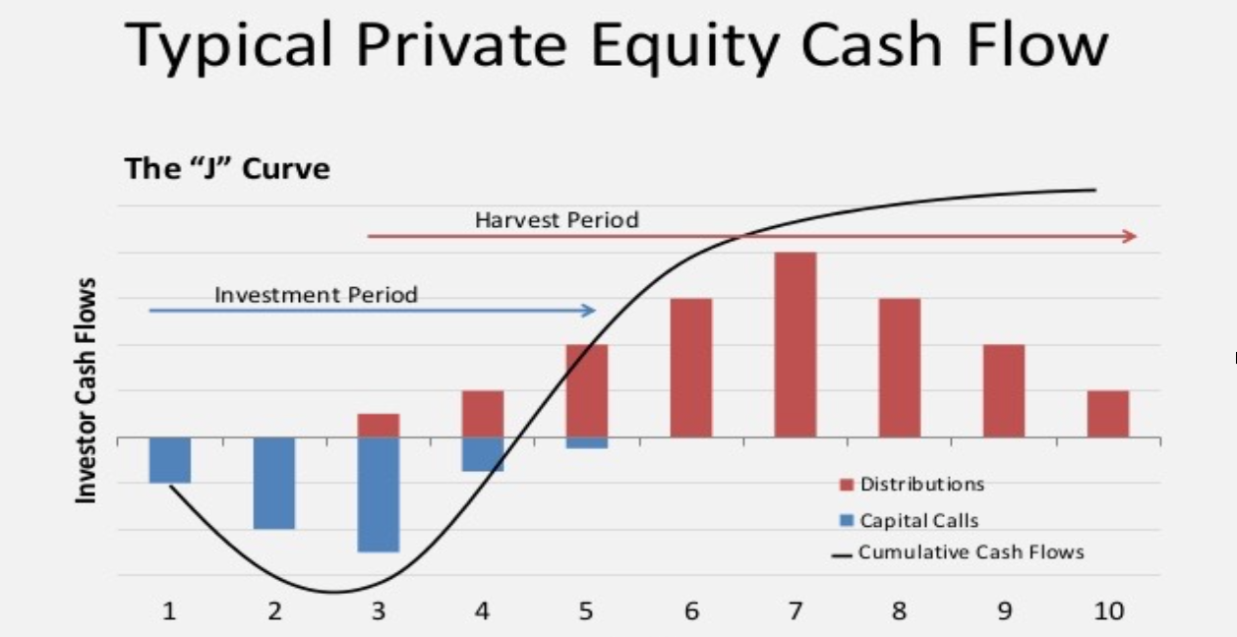
Investing in Private Equity
Exhibit #7
The “J” Curve
BTAS 2015 Estimated Cash Flow
Notes:
Investing in private equity
Illustration of the J curve where funds are used with no return for the first 3-5 years then in years 5-10 funds come back in at elevated returns

Slide 9
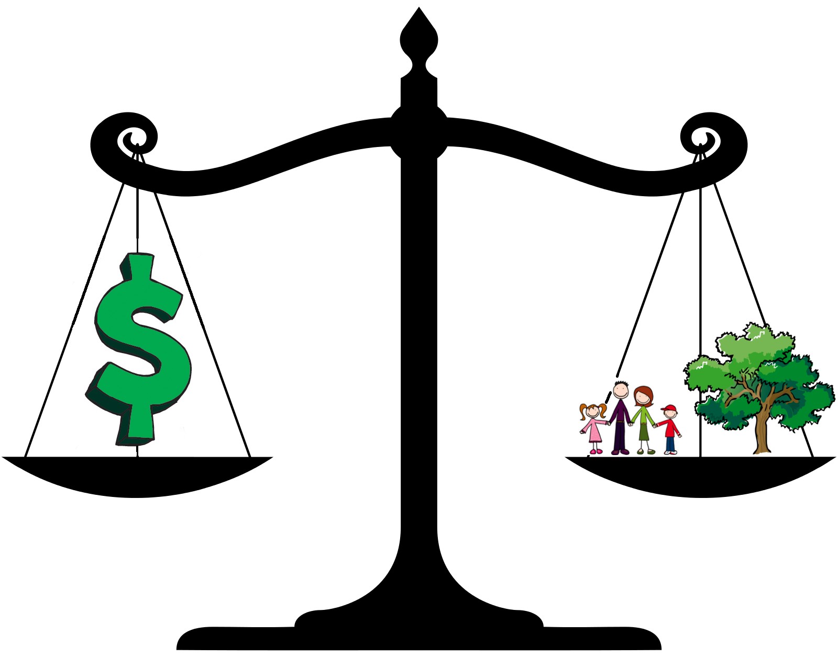
Trustees Continue to Address ESG
Exhibit #8
All investment decisions are made to meet a strategic investment goal
The values of the Association are considered in all investment decisions
Two ESG managers were given a preliminary review in the spring
A more intensified review of the managers will be made in the fall
This Photo by Unknown Author is licensed under CC BY-SA
Notes:
Trustee continue to address ESG
All investment decisions are made to meet a strategic investment goal
The values of the Association are considered in all investment decisions
Two ESG managers were given a preliminary review in the spring
A more intensified review of the managers will be made in the fall

Slide 10
Endowment Fund Portfolio Holdings
Exhibit #9
During the Information Session at the 2018 Midwinter Meeting in Denver, a member requested an opportunity to see the holdings in the portfolio
Trustees worked with the finance staff, our investment advisor – Merrill Lynch and our portfolio managers to make this happen
While working through the process we discovered
    Some managers have proprietary strategies and would prefer not to share
    Publicly owned mutual funds and EFT’s have open access but challenging processes to access the information
An excel and PDF file with access/links to the holdings in the ALA portfolio have been placed on the Treasurer’s page and the Endowment Trustees page
If you encounter any difficulty please contact the ALA finance department and other efforts to get information to you will be made
Notes:
Endowment Fund Portfolio Holdings
During the Information Session at the 2018 Midwinter Meeting in Denver, a member requested an opportunity to see the holdings in the portfolio
Trustees worked with the finance staff, our investment advisor – Merrill Lynch and our portfolio managers to make this happen
While working through the process we discovered
Some managers have proprietary strategies and would prefer not to share
Publicly owned mutual funds and EFT’s have open access but challenging processes to access the information
An excel and PDF file with access/links to the holdings in the ALA portfolio have been placed on the Treasurer’s page and the Endowment Trustees page
If you encounter any difficulty please contact the ALA finance department and other efforts to get information to you will be made

Slide 11
Endowment Fund Portfolio Holdings (con’t)
- Mutual Funds and EFT’s -
Exhibit #10
Notes:
Listing of links to portfolio holdings – mutual funds and EFT’s

Slide 12
Endowment Fund Portfolio Holdings (con’t)
- Mutual Funds and EFT’s Alternative Links -
Exhibit #11
AQR Long Short Equity | https://funds.aqr.com/our-funds/alternative-investment-funds/long-short-equity-fund
Calvert Short Duration | https://www.calvert.com/Calvert-Short-Duration-Income-Fund-CDSIX.php
Doubleline Total Return | https://doublelinefunds.com/wp-content/uploads/total-return-bond-fund-fact-sheet.pdf?c=1522692758
Guggenheim Total Return | https://www.guggenheiminvestments.com/fixed-income/total-return-bond-fund
Lazard International Strategic | http://www.lazardnet.com/lam/us/pdfs/Funds/LazardInternationalStrategicEquityPortfolio_Holdings.pdf
Vanguard REIT | https://personal.vanguard.com/us/FundsAllHoldings?FundId=0123&FundIntExt=INT&tableName=Equity&tableIndex=0&sort=marketValue&sortOrder=desc&funds_disable_redirect=true
Lord Abbett Short | https://www.lordabbett.com/en/strategies/mutual-funds/short-duration-income-fund.html
Nuveen Real Estate Income | https://www.nuveen.com/closed-end-funds/JRS
Principal Midcap Fund | https://www.principal.com/InvestmentProfiles/holdings.faces?inv=7009&rtclss=20&retail=true
Schwab US Small Cap ETF** | https://www.schwab.com/public/schwab/investing/investment_help/investment_research/etf_research/etfs.html?&&path=%2FProspect%2FResearch%2Fetfs%2Fsummary.asp%3Fsymbol%3DSCHA
The Oakmark International Fund | https://www.oakmark.com/Our-Funds/Overview/International.htm
Pimco Income Fund | https://www.pimco.com/en-us/investments/mutual-funds/income-fund/inst
Notes:
Listing of links to portfolio holdings Mutual funds and EFT’s

Slide 13
Endowment Fund Portfolio Holdings (con’t)
- Clearbridge -
Exhibit #12
ADBE | ADOBE SYSTEMS INC RSTD - SHS
AKAM | AKAMAI TECHNOLOGIES INC
ALXN | ALEXION PHARMS INC
GOOGL | ALPHABET INC SHS CL A
GOOG | ALPHABET INC SHS CL C
AMZN | AMAZON COM INC COM
AXP | AMER EXPRESS COMPANY
AAPL | APPLE INC
BIIB | BIOGEN INC
BLK | BLACKROCK INC
BUFF | BLUE BUFFALO PET - Products Inc SHS
CAT | CATERPILLAR INC DEL
CELG | CELGENE CORP COM
KO | COCA COLA COM
CMCSA | COMCAST CORP NEW CL A
COST | COSTCO WHOLESALE CRP DEL
CVS | CVS HEALTH CORP
XRAY | DENTSPLY SIRONA INC
DIS | DISNEY (WALT) CO COM STK
EBAY | EBAY INC COM
ECL | ECOLAB INC
EQIX | EQUINIX INC
FB | FACEBOOK INC - Class A common
HD | HOME DEPOT INC
HON | HONEYWELL INTL INC DEL
JNJ | JOHNSON AND JOHNSON COM
MKC | MC CORMICK NON VTG
MSFT | MICROSOFT CORP
ORCL | ORACLE CORP $0.01 DEL
PANW | PALO ALTO NETWORKS INC - Common
PYPL | PAYPAL HOLDINGS INC SHS
PXD | PIONEER NATURAL RES CO
PX | PRAXAIR INC
RHT | RED HAT INC
REGN | REGENERON PHARMACTCLS
SLB | SCHLUMBERGER LTD
SCHW | SCHWAB CHARLES CORP NEW
SPLK | SPLUNK INC - common
TXN | TEXAS INSTRUMENTS
TMO | THERMO FISHER SCIENTIFIC
UPS | UNITED PARCEL SVC CL B
UNH | UNITEDHEALTH GROUP INC
V | VISA INC CL A SHRS
VMW | VMWARE INC
GWW | W W GRAINGER INCORP
Notes:
Listing of portfolio holdings - Clearbridge

Slide 14
Endowment Fund Portfolio Holdings (con’t)
- Equity Income and Growth -
Exhibit #13
XLY | CONSUMER DISCRETIONARY - SPDR
FDN | FIRST TR EXCHANGE TRADED - FD Dow Jones Industrial
XLV | HEALTH CARE SELECT - SPDR
IBB | ISHARES NASDAQ BIOTECH - ETF
XLB | MATERIALS SELECT SECTOR - SPDR Fund
XLRE | REAL ESTATE SELECT - SECTOR SPDR Consumer Staples
XLP | SECTOR SPDR CONSMRS STPL
XLE | SECTOR SPDR ENERGY
XLI | SECTOR SPDR INDUSTRIAL
XLU | SECTOR SPDR UTILITIES
KIE | SPDR S&P INSURANCE ETF
VFH | VANGUARD FINANCIALS ETF
VGT | VANGUARD INFORMATION - TECH ETF
Notes:
Listing of portfolio holdings – Equity income and Growth fund

Slide 15
Succession Planning
Exhibit #14
Patricia Wand will serve as Senior Trustee from 2019 – 2021
Mario Gonzalez will serve as Senior Trustee from 2021 - 2023
Notes:
Succession Planning
Patricia Wand will serve as Senior Trustee from 2019 – 2021
Mario Gonzalez will serve as Senior Trustee from 2021 - 2023

Slide 16
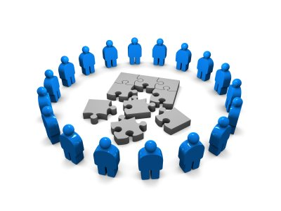
Strategic Review
Exhibit #15
Trustees hope to undertake a Strategic Review later this year on our governance, management and business practices.
Interviews for a facilitator earlier this year were unsuccessful
Pat Wand, Mark Leon and Rod Hersberger have conducted promising telephone interviews this month and hope to have in-person interviews next month in Chicago.
Senior Trustee has developed a list of questions/issues to be reviewed.
This Photo by Unknown Author is licensed under CC BY-NC-SA
Notes:
Strategic Review
Trustees hope to undertake a Strategic Review later this year on our governance, management and business practices.
Interviews for a facilitator earlier this year were unsuccessful
Pat Wand, Mark Leon and Rod Hersberger have conducted promising telephone interviews this month and hope to have in-person interviews next month in Chicago.
Senior Trustee has developed a list of questions/issues to be reviewed.

